Slide 1

How to access Arbor Student App

Slide 2
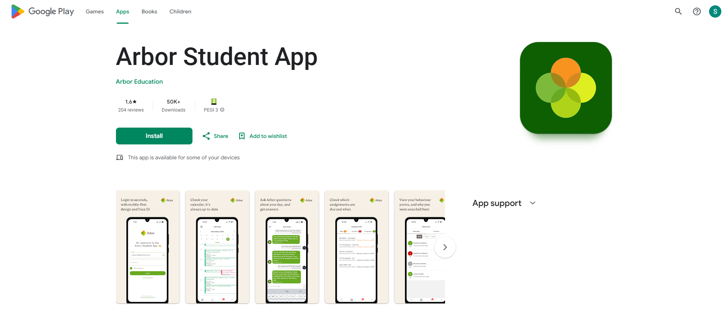
Download Arbor Student App
Android – Play store
IOS – App Store

Slide 3
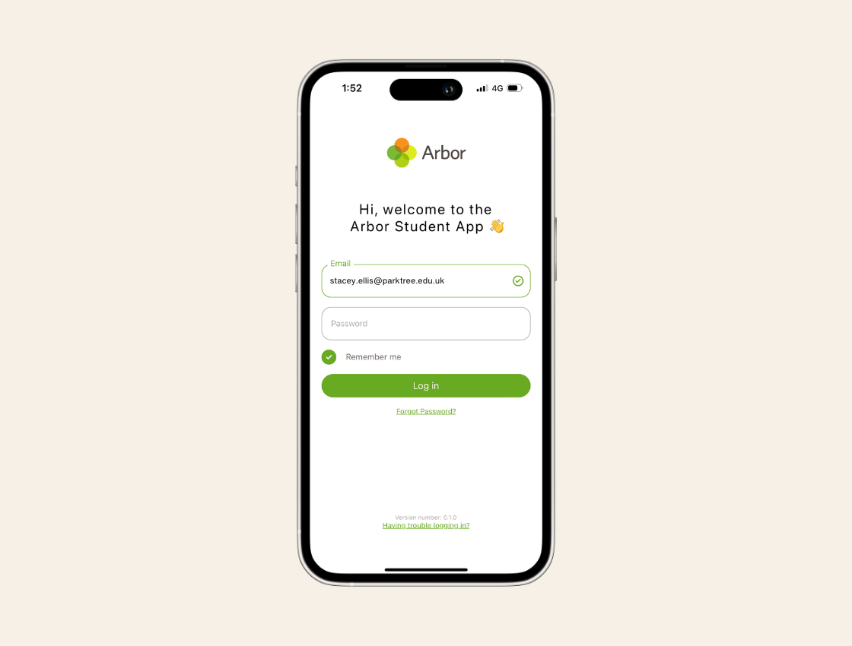
Create Password
Open App Store on device you wish to use.
Enter your school google email address – for example – j.bloggs@dorsetstudioschool.co.uk
Click on “Forgot Password”
This will Send an email to your school email address to reset password.

Slide 4
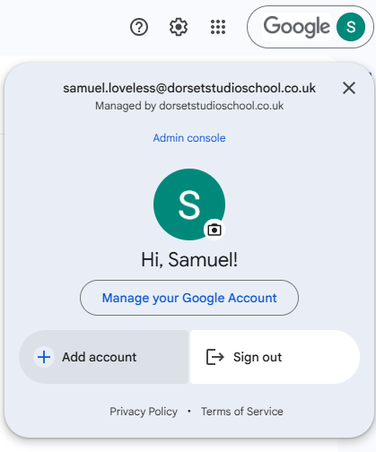
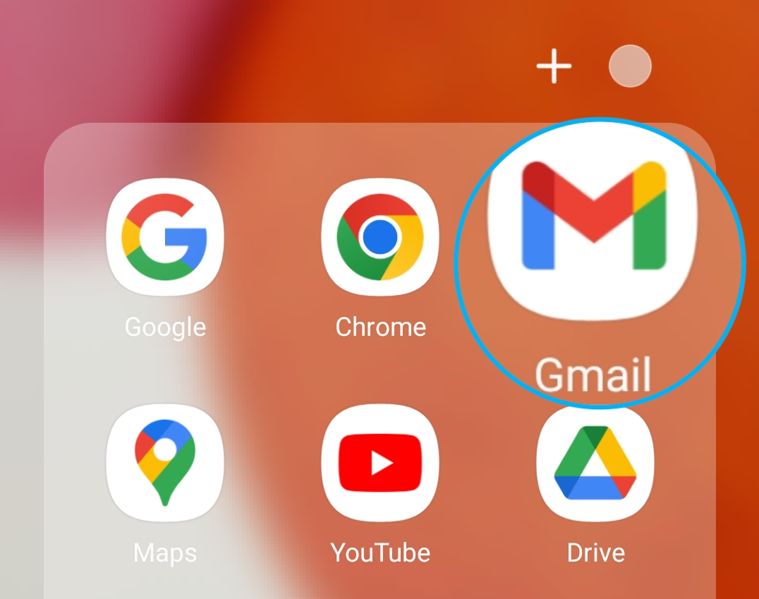
Open Gmail
Open Gmail App or open Gmail on web browser
Log in using your school email address and password you normally use for the Chromebooks in school.
If you already have a personal account, please click top right corner and sign in with different account.
Locate email from Arbor and follow instructions to reset Arbor password.
Once reset return to Arbor App and proceed to login.

