Slide 1

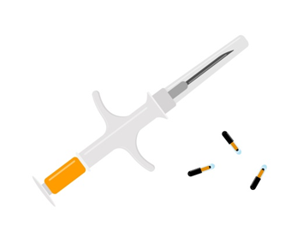
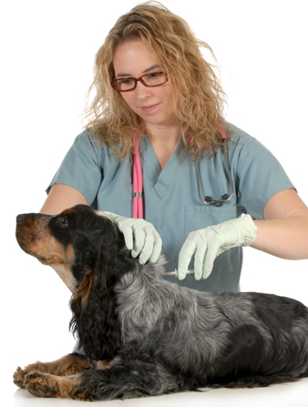
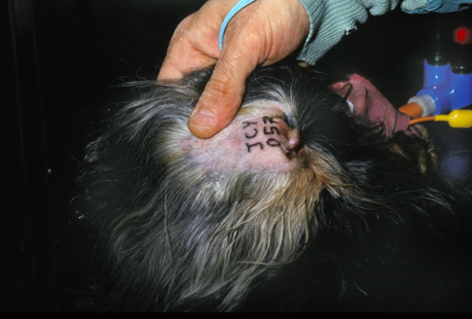
The five animal welfare needs
To live in a suitable environment To eat a suitable diet To be housed with or apart from other animals To be protected from pain, injury, disease and suffering To exhibit normal behaviour patterns Animal Welfare Act 2006
What are the methods of identifying animals?
Trace animals back to their owner if lost Track disease and movement Medical purposes Transport Food and human safety Reduce theft Which methods can be used to identify animals? Markings Ear tags Microchip Tattoo Pet passport Horse passport Hot and cold branding Dog collar and tag Spray paint sheep during lambing Ear notching in swine Ring clips for chickens
Animal Care
What are the positives of microchipping?
Permanent, easily scanned, most reliable methods of identifying an animal, cheap, accessible for a wide of animals, quick to implant. No known side effects once inserted. Law in the UK, which means most animals are re-joining with their owners if lost. Holds animals’ details and owners’ details. Quick to inject.
What are the negatives of microchipping?
Only reliable if owners’ details are kept up to date, microchip can migrate across the body. Lack of visible deterrent to potential thieves. Abscess formation/bruising after implanting. Minor pain at the time of injection however quickly it is done.
Animal Health and Welfare
Students must demonstrate knowledge of different animals’ needs, purposes and protection in
society in order to support their health and welfare. They need to Know about common diseases, their
symptoms and treatments and good animal care routines.
What does live in a suitable environment mean?
This ‘need’ or ‘freedom’ requires owners and caregivers to supply the correct environment for the individual and species A horse may be happy to live outdoors with shelter available all year round. A bearded dragon, however, requires a vivarium with specialised equipment Each species requires an environment that encourages normal behaviours
Tattooing
A permanent method to identify animals Not often used in the UK Series of letters and numbers Before microchipping, tattooing was more common Completed at birth or at a very young age Used for a range of animals from alligators to mice Compulsory for excepted section 1 dogs in the UK Normally on the ear or inner thigh National register for the UK
Microchipping
A microchip is a small chip that is inserted in the animal’s neck The chip is the size of a rice grain A 9–13-digit number identifies the animal Only effective if details are kept up to date Petlog database Legal requirement, i.e. Microchip Regulations 2016 Fines of £500 Can be inserted by vets, nurses or other qualified individuals
What are the positives of a tattoo?
Permanent, deterrent to thieves, quicker and simpler compared to branding, can be used on a variety of animals.
What are the negatives of a tattoo?
Painful, can blur over time, animal has to be restrained, which means the animal will become stressed, difficult to see on dark pigmented animal skin, animal has to be restrained when reading the identification number.

Slide 2
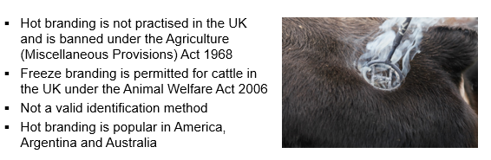
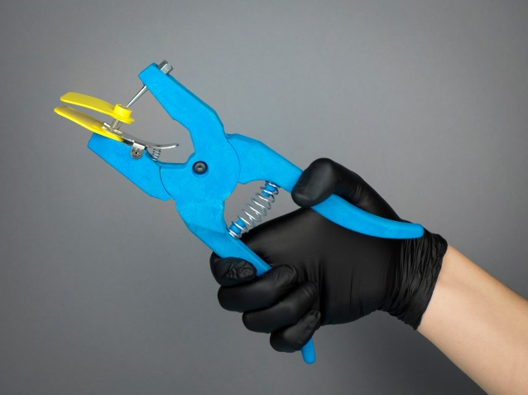
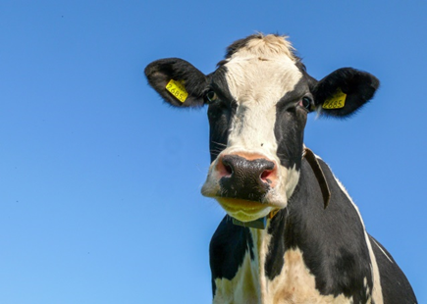
Branding
Hot branding: Application of a symbol or equivalent with an extremely hot iron that is held to the skin for several seconds until the skin turns to a brown/tan colour. Freeze branding: Application of a symbol or equivalent with a cold branding iron that is held to the skin for up to 10 seconds until there is a white or bald mark.
Ear tags
Ear tagging is a legal requirement for all cattle, sheep, goats and pigs in the UK DEFRA Livestock animals must be tagged for the purpose of traceability, to track disease and maintain quality of meat Cattle Identification Regulations 2007 Livestock animals must have two tags They are placed in the ear by a clamp within 20 days of birth The tag contains; the crown logo, country code, herd mark, individual animal number
Feeding animals Questions
Why do we need to feed animals correctly? What are the six nutrients that animals need? How do you think this differs between life stages? How do the feeding habits of cats, guinea pigs and pigs differ? How much water should an animal have access to?
Dog diet and water
What percentage of a dog’s daily nutritional needs do each of the following comprise? Protein: 18–30 per cent Carbohydrates: 25–50 per cent Fats: 5.5–25 per cent Vitamins and minerals: less than 10 per cent Water should always be available Growing puppies need 18 per cent more protein for developing muscles Obese dogs require less fat and protein It is recommended that dogs be fed twice a day Dogs are omnivorous (check that learners know the meaning. Ask for other examples of omnivorous animals) Dogs need fibre. They get this from the omnivorous diet they follow. Explain, or have learners research, foods that are dangerous/poisonous for dogs, e.g. onion family, chocolate, corn on the cob, cooked bones.
What are the positives of branding?
Simple to apply, visible deterrent to thieves, unable to be sold on if stolen, helpful for free-roaming cattle. Some experts argue this process is relatively painless, no blotching in freeze branding. Freeze branding is less painful compared to hot branding
What are the negatives of branding?
Takes a relatively long time to brand, freeze branding is expensive and has mixed results depending on coat colour, hot branding is argued to be more painful than freeze branding.
Cat diet and water
Protein: 30–50 per cent Carbohydrates: less than 10 per cent Fats: 25–30 per cent Vitamins and minerals: less than 10 per cent Make the following points: Cats get most of the water they need from their food Taurine (amino acid) is particularly important in feline diets as they cannot naturally produce it; a taurine deficiency causes severe heart problems. Meat and fish are good sources of taurine. Kittens require more protein than adult cats Cats often graze their food (access to food, usually dry food, all day) Cats are carnivores (ask for other examples of carnivorous animals) As carnivores, cats do not need fibre in their diet. Explain, or have learners research, foods that are dangerous/poisonous for cats, e.g. onion family, table scraps, dairy products, raw eggs.
What are the positives of ear tagging?
Quick, easy, cheap to apply. Tracks health, herd and disease of the individual. Has two tags to prevent becoming unidentifiable.
What are the negatives of ear tagging?
Not permanent, can be removed or cut off, tags need to be replaced or changed annually, which increases cost, can cause damage to the ear if not applied correctly.

