Slide 1

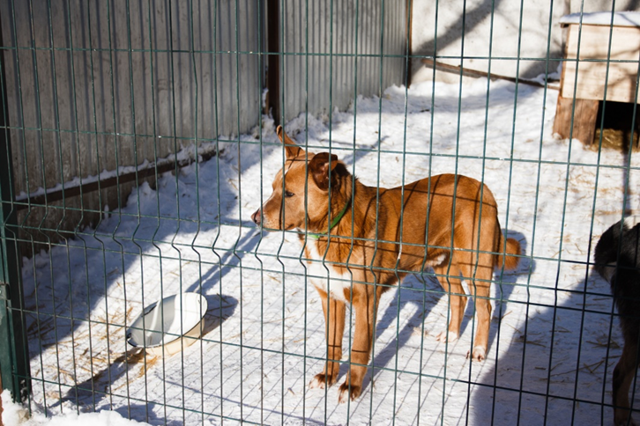
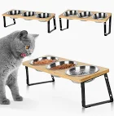

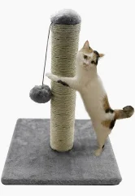
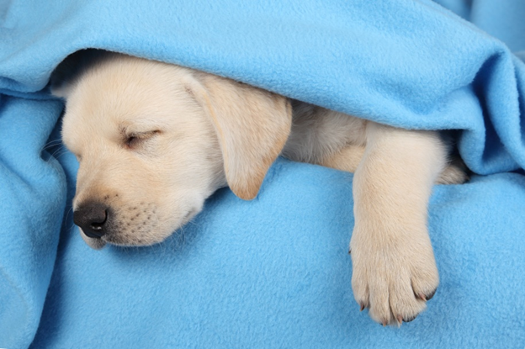
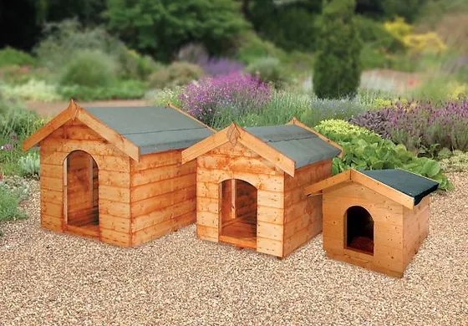
A2 Animal housing and care
What are the important features of animal accommodation?
Well-ventilated Warm Appropriate size Light and airy Opportunity to shelter Secure Ease of access Offers protection against heat, cold, rain Water permanently available Space
QUESTION- What is good about this kennel? What improvements would you make?
POSSIBLE ANSWER
The kennel is quite big. It appears to be dry and clean. There is no obvious evidence of enrichment, bedding or a place to retreat to. It appears to be outside and may be draughty. A dog could get its feet/muzzle stuck in the gaps between the wires. These issues should be corrected
What is required for a cat to maintain good welfare within its environment?
A cats housing needs Scratching posts or areas Range of toys Cat tower Indoor or outdoor access Food Water Bedding Comfort Space Litter tray Litter substrates Enough resources for a multi-cat household Dry and draught-free environment Protection from hazards
Students will understand what constitutes good housing and care appropriate to
different types of animal. They will gain knowledge about what aspects of care need to
be put in place as a responsible animal owner and the importance of its provision to
ensure the health and welfare of animals.
What is required for a dog to maintain good welfare within its environment?
Exercise requirements – breed/life stage differences Enrichment – toys e.g. chewy toys, food toys, sensory toys, snuffle mats Bedding – hard beds, Vetbed, mattress Social – dependent on the individual dog’s behaviour Dry and draught-free Clean and hygienic Protected from hazards A place to retreat to – e.g. crate Choice – indoor and outdoor Toilet area
QUESTION You are bringing an eight-week-old Labrador puppy home. What would you do to make the home welfare-friendly for the new puppy?
POSSIBLE ANSWER Crate with soft bedding = safe space Hazards removed = cleaning products, wires, poisonous foods and general food kept out of the way, flower food and poisonous flowers removed, furniture and other household items removed to prevent chewing, i.e. shoes Dry and clean bedding Chewable toys to aid in teething, i.e. rope toys, correct toy bones, as well as a range of other toys Puppy proofing the home, e.g. ensure there are no gaps in the fences Baby gates to create boundaries Keeping the home at a steady temperature Ventilation

Slide 2
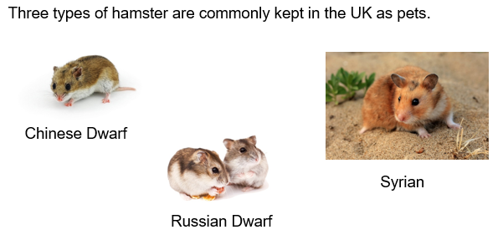
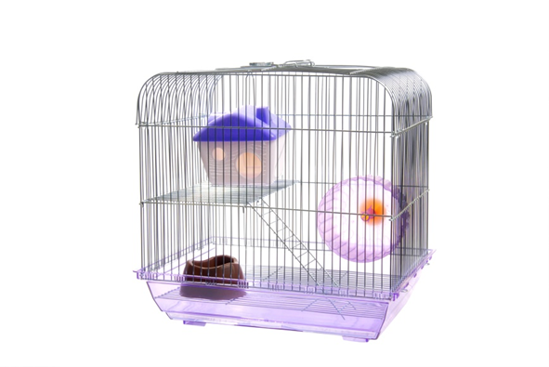
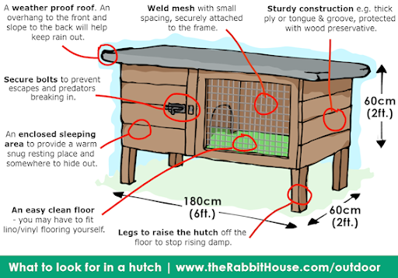
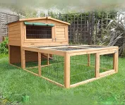
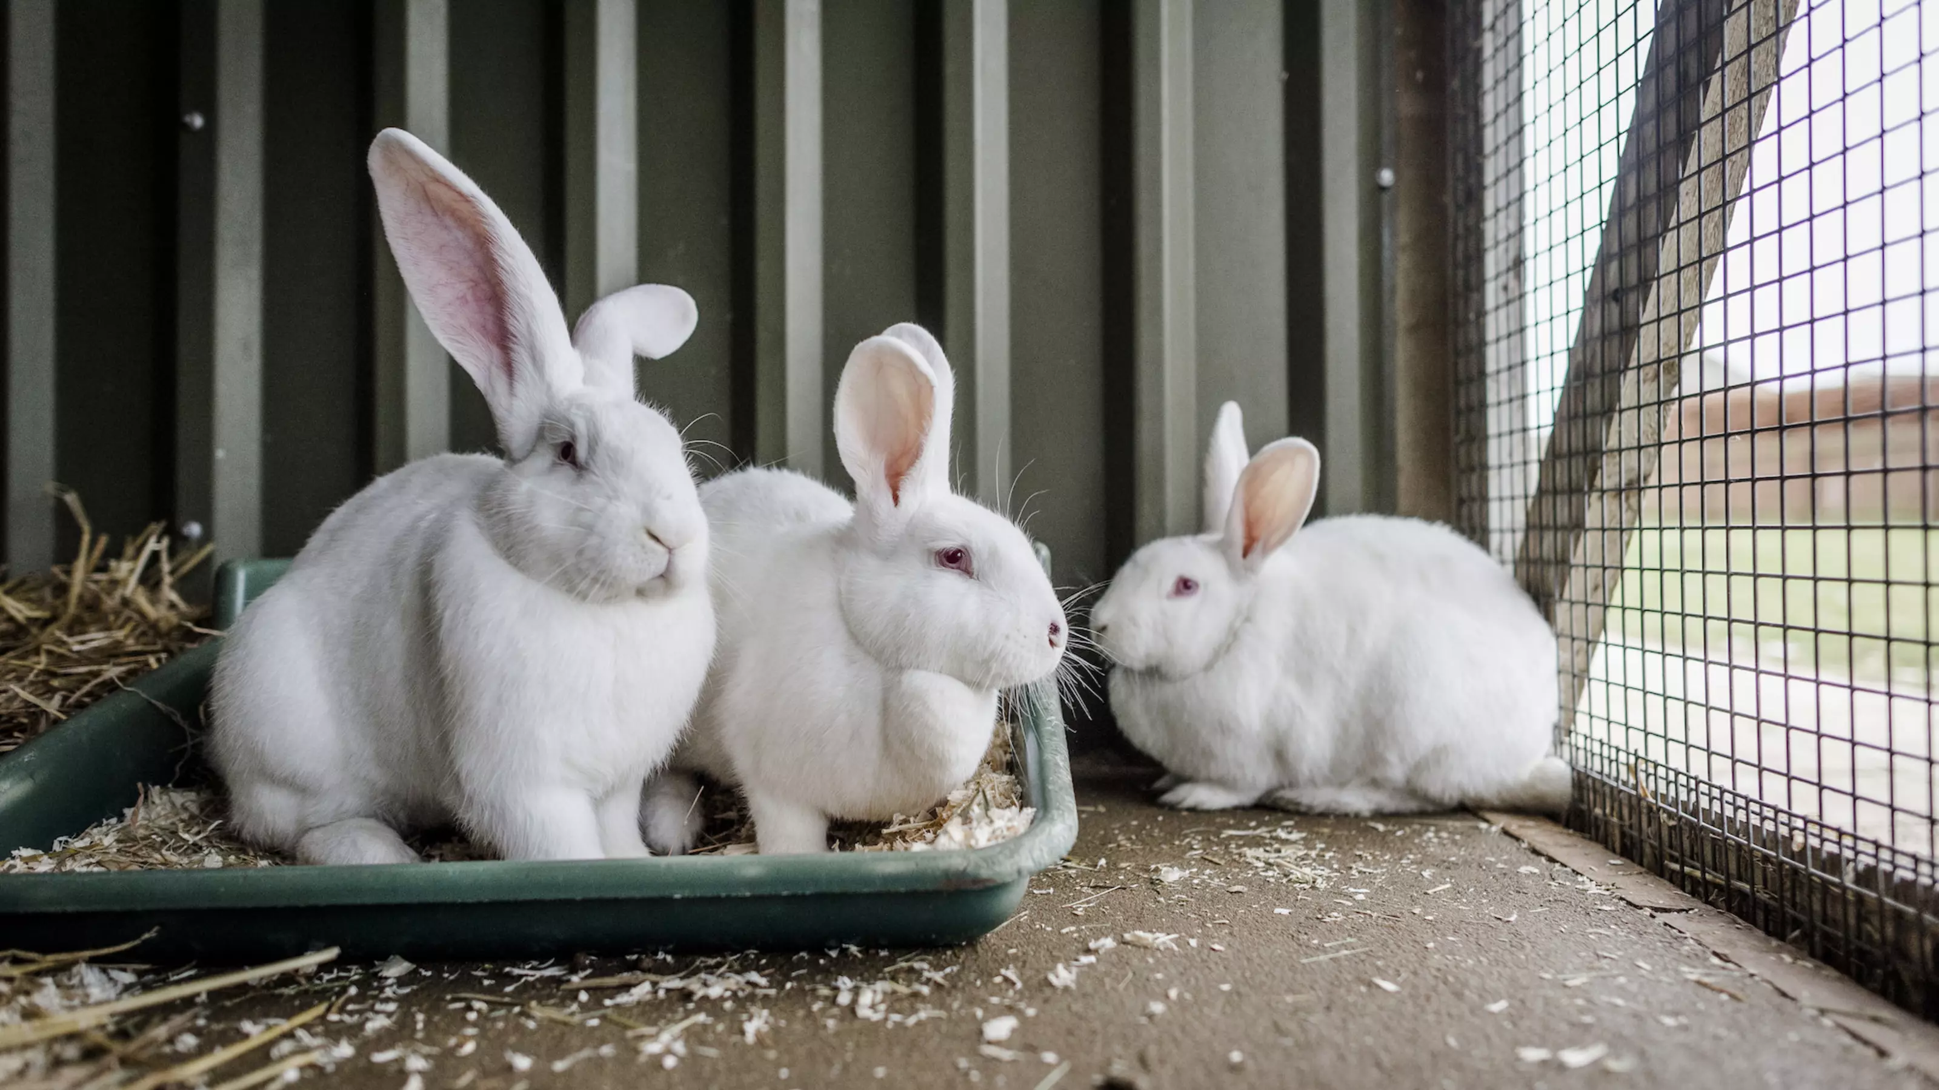
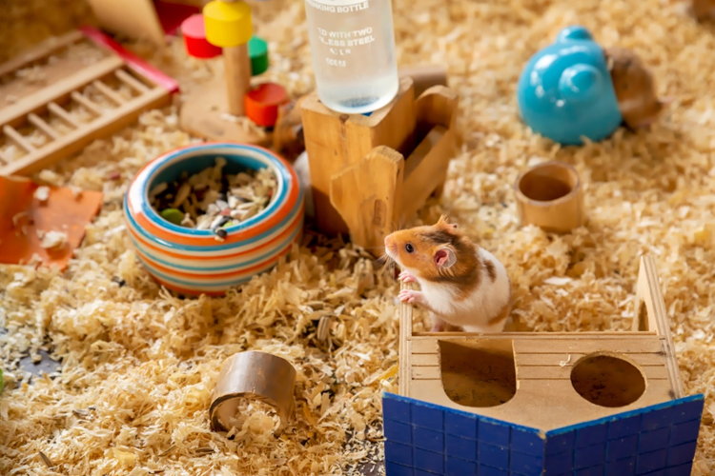
Test your knowledge with the rabbit quiz below:
QUESTIONS A. When were rabbits first domesticated? B. When were rabbits first brought to the UK? C. How many rabbits are kept as pets in the UK? D. How many breeds of rabbit are there? E. What percentage of rabbits are kept in the correct husbandry conditions in the UK? F. How much do you think it costs to keep a rabbit for their entire life? G. Are rabbits social animals?
ANSWERS A. By French monks in AD 600 B. 1066, by the Normans C. 900,000 D. 305 breeds across the world E. 25 per cent (75 per cent are kept in poor conditions, RSPCA) F. £12,000 is the average lifetime cost G. Yes, rabbits are social animals.
Rabbit housing needs
A hutch should meet the minimum size requirements. It should also: Be made of safe, sturdy and durable materials. Wood, mesh and fencing should be secure against predators Be easy to clean. Regular spot checks and full cleans are important to prevent diseases, such as flystrike Have separate feeding, water and toilet areas Have a litter tray Be waterproof Have toys and enrichment Have bedding, either sawdust, wood shavings, straw, newspaper or hay Be warm and insulated.
Hamster accommodation
Classic hamster housing Leading hamster societies and welfare charities promote a minimum size of 75 cm (H) x 40 cm (L) x 40 cm (W) for one hamster. The RSPCA now advocates quality of accommodation over size.
Modern hamster housing
Classic housing: Typical housing/cages that are sold in pet shops, small plastic-based enclosures that use wire to enclose the cage. Modern housing: Naturalistic housing that has a variety of enrichment and choices, such as platforms, houses and burrowing opportunities. Substrates that resemble hamster’s wild counterparts. Most importantly, cages that are large and go beyond the minimal size requirements.
Rabbits
According to UK animal welfare organisations: Poor husbandry in rabbits reduces their lifespan by 75 per cent 75 per cent of owners look after their rabbits incorrectly 50 per cent of owners misunderstand their rabbits. Why do you think this is the case? Minimum requirement for rabbit housing should be: 3 m x 2 m x 1 m (10 ft x 6 ft x 3 ft)
Hamster housing needs
Enough appropriate bedding for digging/burrowing Warmth Appropriate food Access to water A clean environment A quiet location Toys and other enrichment such as platforms and tubes

