Slide 1

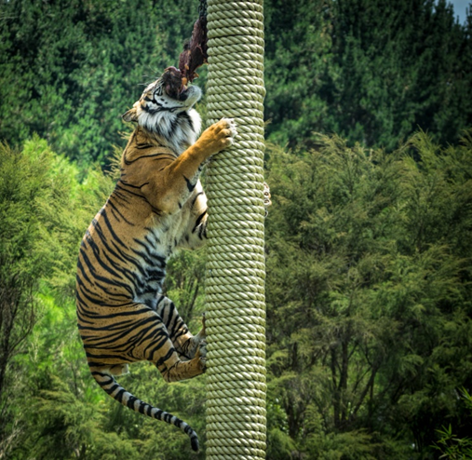
What are the benefits of exercise in animals?
Maintains the correct weight for the animal Is a form of enrichment Encourages normal behaviours Lowers blood pressure Builds up muscle Encourages an animal to excrete Decreases stress Improves cardiovascular fitness Encourages overall wellbeing Improves appetite, sleep and digestion. Types of exercise appropriate for these animals
Enrichment
Enrichment is adding material or infrastructure to the environment to encourage natural behaviours in the species Enrichment should be species- specific and safe Five types of enrichment Physical enrichment Sensory enrichment Nutritional enrichment Social enrichment Cognitive enrichment
Animal Care
Dog Vaccinations
Rabies: a virus that attacks the central nervous system and causes aggressive damage to the brain and spinal cord Parvovirus: a viral infection that affects puppies and causes serious sickness and diarrhoea Leptospirosis: a bacterial disease that causes the liver and kidneys to shut down Canine hepatitis: a virus that affects the spleen, liver, lungs and lining of the blood vessels Kennel cough: a bacterial and viral disease that attacks the lungs and causes a dry hacking cough in dogs. Generally contracted in kennels Canine parainfluenza: a viral infection that attacks the lungs How often puppies and dogs should be vaccinated. Puppies should be vaccinated between six and eight weeks of age. Vaccination consists of two–three injections that are spaced one or two weeks apart. Annual boosters are then recommended. If travelling abroad to a rabies area, the rabies vaccination will need to be updated.
Learners will understand what constitutes good care appropriate to different types of animal. They will gain knowledge about what aspects of care need to
be put in place as a responsible animal owner and the importance of its provision to
ensure the health and welfare of animals.
Cat | Access to the outdoors, general toys or toys that encourage hunting behaviours, training, materials to explore, e.g. cardboard boxes, puzzle feeders
Hamster | hamster wheels, platforms, climbing apparatus, boxes to explore
Guinea pig | hamster wheels, platforms, climbing apparatus, boxes to explore
Horse | grazing with other horses, hand walking, lunging
Rabbit | outdoor access, mini-agility courses, tunnels, chew toys, human interaction and playing, digging opportunities, jumping, grazing/foraging
Preventative care
Preventative treatment requires owners and caregivers to organise and plan treatments to prevent diseases Part of preventative treatment is healthcare provision, which involves regular grooming of the animal

Slide 2
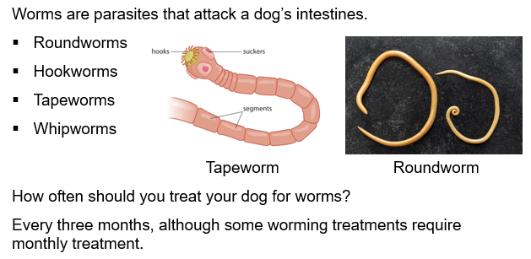
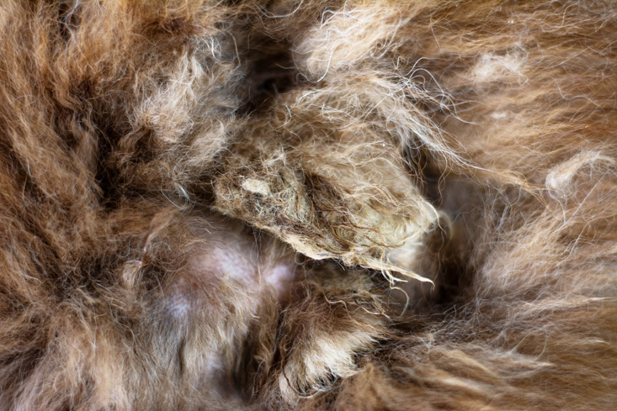
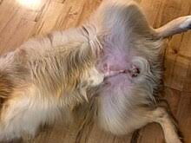
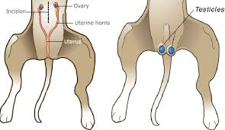
Worms and dogs
What is neutering
Neutering is a surgical process where the reproductive organs are removed In females, this is referred to as spaying, where the reproductive tract, both ovaries and the uterus are removed In males, this is referred to as castration, where both testicles are removed 54 per cent of the UK dog population is neutered It is believed 90 per cent of the UK cat population is neutered Neutering is not performed on hamsters due to anesthetic risks
The positives and negatives of neutering
Positives Prevents diseases, such as mammary/testicular cancer Prevents roaming in males Stops seasons and associated behaviour changes in females Reduces the chances of urine infections Prevents unwanted young Negatives Can lead to loss of body conditioning and weight gain Is a form of mutilation Early neutering can cause bone growth problems Surgical procedure. Risk of infection and reaction to anaesthetic Cost Not a guarantee that it will change a dog's behaviour Texture of coat can change Can cause urinary incontinence May stop natural behaviour
Grooming
Grooming is an important part of preventative care Grooming can involve washing, combing, hair and nail trimming Grooming is important for these reasons: Helps remove dead hair and skin cells Allows owners and/or caregivers to check for lumps, bumps, fleas and ticks By removing dead hair, this allows for the skin to breathe and therefore reduces grease buildup Clipping allows for dogs to be cooler in the summer and equally remove dead hair Washing should be done in quarterly intervals as this can dry skin out Nail trimming should be done intermittently when the nails start touching the ground, nails should be cut to the quick length.
Why are animals neutered?
Prevents seasons Prevents pregnancy and contributing to the animal population problem Prevents womb infections, such as pyometra Prevents false pregnancies Reduces mammary/testicular cancers Reduces the risk of prostate conditions such as benign prostatic hyperplasia Can reduce behavioural problems, such as males trying to find a female.
Chemical castration
Chemical castration is a non-permanent procedure, where a hormone chip is inserted under the skin of a male dog The chip is made up of a hormone to reduce the testosterone reproduction The chips can last between six and 12 months Chemical castration is reversable
Methods of neutering?
Closed neutering: removal of the testes via a pre-scrotal incision Open neutering: removal of the testes by opening the vaginal tunics Traditional spaying: removal of the female reproductive organs Laparoscopic neutering: removal of the ovaries through two small incisions. Commonly referred to as keyhole surgery

