Slide 1

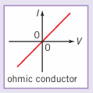
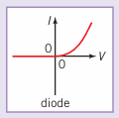
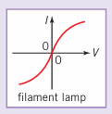
Science (Physics) – Year 10 – Autumn 2
Charge is a fundamental property of matter. Charge can be positive or negative. Charge is measured in coulomb (C).
The symbol for charge is Q.
Electric current is the rate of flow of charge. Current is measured in ampere (amp, A).
The symbol for current is I.
1 ampere = 1 coulomb of charge per second
Potential difference (p.d.) is the amount of energy transferred between two points in a circuit by a coulomb of charge. Potential difference is measured in volt (V).
The symbol for potential difference is V.
1 ampere = 1 coulomb of charge per second
When electrons move through a circuit, they collide with the ions and atoms of the wires and components in the circuit. This causes resistance to the flow of charge. The unit of resistance is the ohm (Ω).
The symbol for resistance is R.
Charge = Current x Time
Current = Charge ÷ Time
Potential difference = Energy transfer ÷ Charge
Energy transfer = Potential difference x Charge
Potential difference = Current x Resistance
Resistance = Potential difference ÷ Current
Current = Potential difference ÷ Resistance
Q = I x t
I = Q ÷ t
V = E ÷ Q
E = V x Q
V = I x R
R = V ÷ I
I = V ÷ R
A graph of current through a component against the potential difference across it (I–V graph), is known as the component characteristic.
Current is directly proportional to the potential difference in an ohmic conductor at a constant temperature. The resistance is constant. A resistor or a piece of metal wire will behave as an ohmic conductor.
The resistance of a thermistor decreases as the temperature increases.
The resistance of a light dependent resistor decreases as the light shining on it gets brighter.

Slide 2
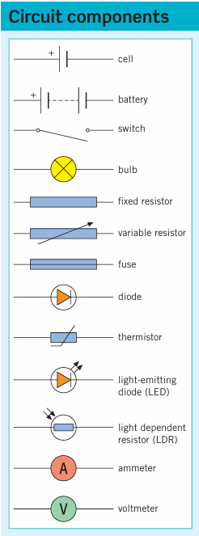
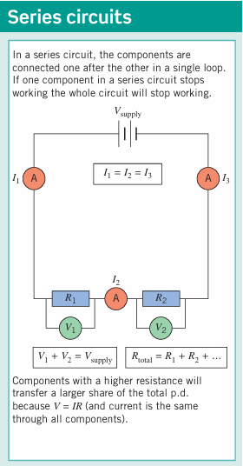
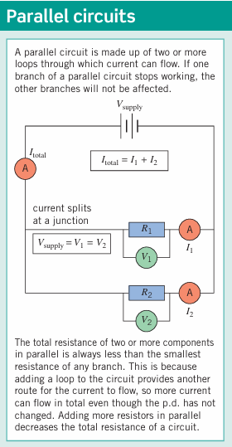
Science (Physics) – Year 10 – Autumn 2
A cell or a battery provides a direct current (dc). The current only flows in one direction (positive to negative) and is produced by a direct potential difference.

Slide 3
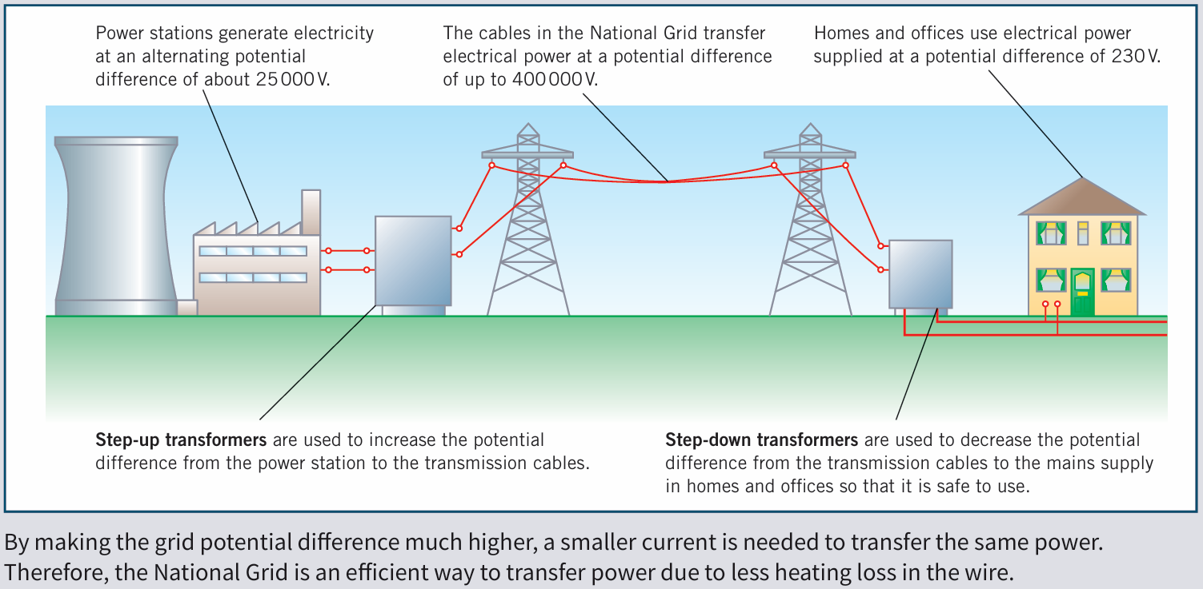
Science (Physics) – Year 10 – Autumn 2
Mains electricity provides an alternating current (ac). The current repeatedly reverses direction and is produced by an alternating potential difference. The frequency of the mains electricity supply is 50 Hz and its potential difference is 230 V.
Power is the rate of transfer of energy. It is measured in watt (W). The symbol for power is P. 1 watt = 1 joule per second
Power = Current x Potential difference P = I x V

