Slide 1
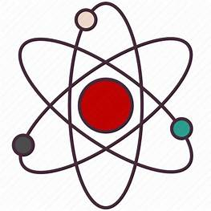
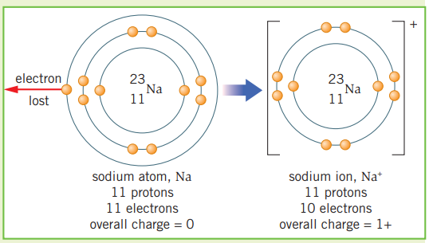
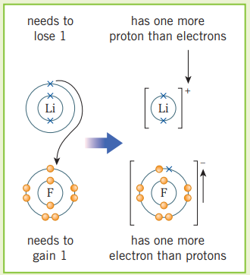
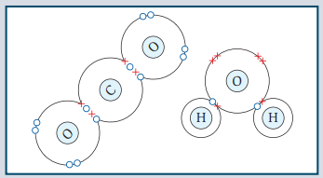
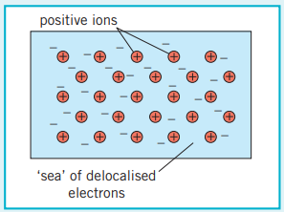
Science (Chemistry) – Year 10 – Autumn 2
Ionic bonds
Atoms can gain or lose electrons to give them a full outer shell. The number of protons is then different from the number of electrons. The resulting particle has a charge and is called an ion.
When metal atoms react with non-metal atoms they transfer electrons to the non-metal atom.
Metal atoms lose electrons to become positive ions.
Non-metal atoms gain electrons to become negative ions.
These are attracted to each other by the strong electrostatic force of attraction. This is called ionic bonding.
The electrostatic force of attraction works in all directions, so many billions of ions can be bonded together in a 3D structure.
Covalent bonds
Atoms can share or transfer electrons to form strong chemical bonds.
A covalent bond is when electrons are shared between non‑metal atoms.
The number of electrons shared depends on how many extra electrons an atom needs to make a full outer shell.
If you include electrons that are shared between atoms, each atom has a full outer shell.
Single bond = each atom shares one pair of electrons.
Double bond = each atom shares two pairs of electrons.
The atoms that make up metals form layers. The electrons in the outer shells of the atoms are delocalised – this means they are free to move through the whole structure.
The positive metal ions are then attracted to these delocalised electrons by the electrostatic force of attraction.

Slide 2
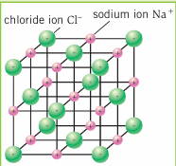
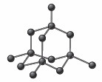

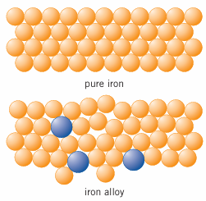
Science (Chemistry) – Year 10 – Autumn 2
Giant Covalent Structures
Many billions of atoms, each one with strong covalent bonds to other atoms.
High melting and boiling points because the strong covalent bonds between the atoms must be broken to melt or boil the substances.
This requires a lot of energy.
Solid at room temperature.
Small Covalent Molecules
Only a few atoms with strong covalent bonds between these atoms. Different molecules are held together by weak intermolecular forces.
Low melting and boiling points because only the intermolecular forces need to be overcome to melt or boil the substances, not the bonds between the atoms.
This does not require a lot of energy as the intermolecular forces are weak.
Normally gaseous or liquid at room temperature.
Giant Ionic Lattice
When metal atoms transfer electrons to non-metal atoms you end up with positive and negative ions.
These are attracted to each other by the strong electrostatic force of attraction which works in all directions, so many billions of ions can be bonded together in a 3D structure.
Solid ionic substances do not conduct electricity because the ions are fixed in position and not free to carry charge.
When melted or dissolved in water, ionic substances do conduct electricity because the ions are free to move and carry charge.
They have high melting points because the electrostatic force of attraction between oppositely charged ions is strong and so requires lots of energy to break.
Alloys
Large Covalent Molecules (polymers)
Many repeating units joined by strong covalent bonds to form a long chain. Separate chains are held together by intermolecular forces that are stronger than in small molecules.
Melting and boiling points are low compared to giant covalent substances but higher than for small molecules. Large molecules have stronger intermolecular forces than small molecules, which require more energy to overcome.
Normally solid at room temperature.

