Slide 1
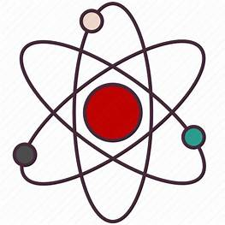
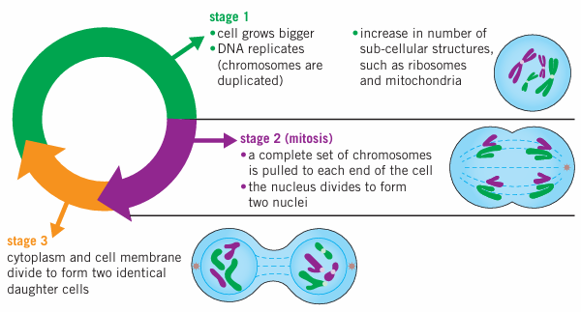
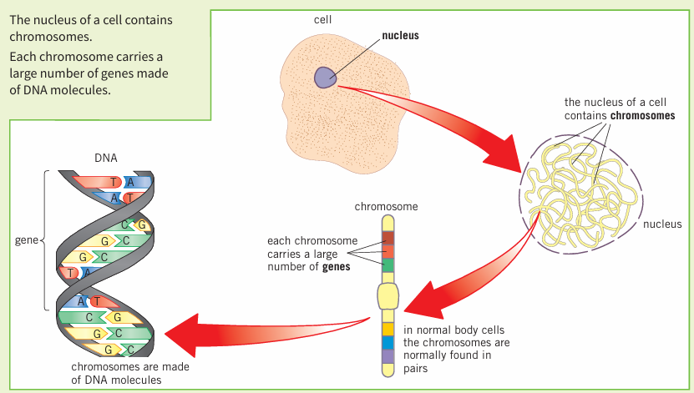
Science (Biology) – Year 10 – Autumn 2
Body cells divide by mitosis to form two identical daughter cells by going through the cell cycle.
This is important for the growth and repair of cells, for example, the replacement of skin cells. Mitosis is also used for asexual reproduction.
There are three main stages in the cell cycle:
A stem cell is an undifferentiated cell that can develop into one or more types of specialised cell.
There are two types of stem cell in mammals: adult stem cells (for example in bone marrow to produce new blood cells) and embryonic stem cells.
Embryonic stem cells can differentiate into any type of specialised cell in the body.
There are stem cells in a plant meristem (tips of the roots and shoots). They can be used to create clones of whole plants.
Rare species of plants can be cloned to prevent extinction
Plants with desirable traits can be cloned to produce large numbers of identical plants
Cloned plants are genetically identical so a whole crop is at risk of being destroyed by a single disease.

