Slide 1

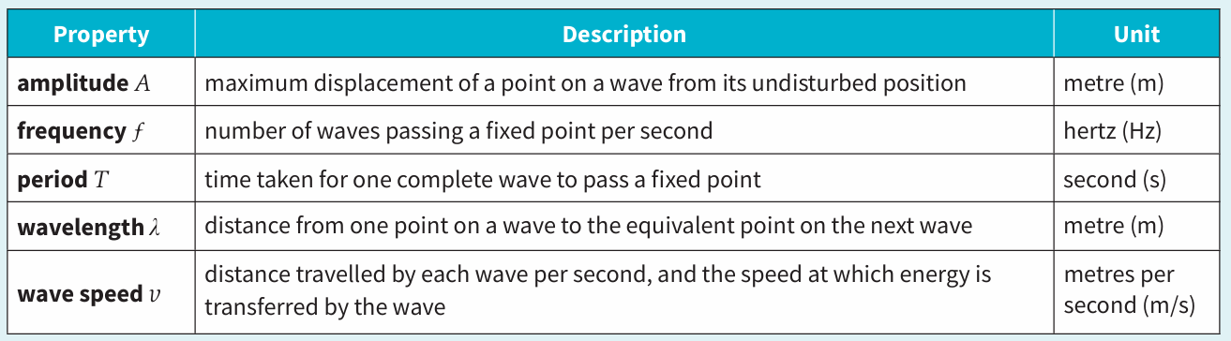
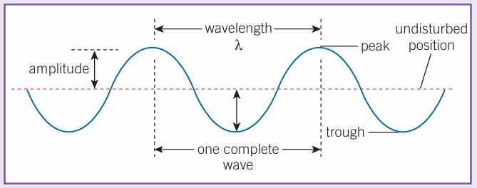
Science (Physics) – Year 11 – Autumn 2
Transverse Waves
The oscillations are perpendicular (at right angles) to the direction in which the waves transfer energy.
Ripples on the surface of water are an example of transverse waves.
Longitudinal Waves
The oscillations are parallel to the direction in which the waves transfer energy.
Sound waves are an example of transverse waves.
Electromagnetic (EM) waves are transverse waves that transfer energy from their source to an absorber.
They all travel at the same velocity through air or a vacuum. 3 x 10⁸ m/s.
Period (seconds) = 1 ÷ Frequency (hertz)
Frequency (hertz)= 1 ÷ Period (seconds)
Speed (m/s) = Frequency (Hz) x Wavelength (m)
Frequency (Hz) = Speed (m/s) ÷ Wavelength |(m)
Wavelength (m) = Speed (m/s) ÷ Frequency (Hz)

Slide 2
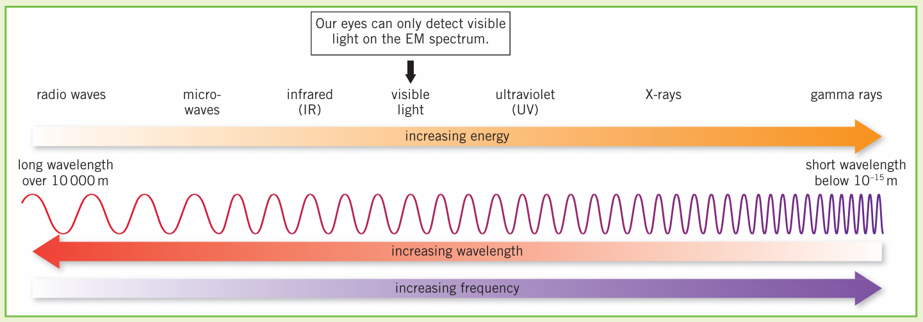
Science (Physics) – Year 11 – Autumn 2
When waves arrive at the boundary between two different substances, one or more of the following things can happen:
Absorption – the energy of the waves is transferred to the energy stores of the substance they travel into (for example, when food is heated in a microwave)
Reflection – the waves bounce back
Refraction – the waves change speed and direction as they cross the boundary
Transmission – the waves carry on moving once they’ve crossed the boundary, but may be refracted
Radio-waves and micro-waves can penetrate the body and cause internal heating.
Infrared can damage or kill skin cells due to heating.
Ultraviolet can damage skin cells (skin cancer) and cause blindness.
X-rays and gamma rays can penetrate the body and can damage or kill cells, cause mutations of genes and lead to cancers.
Ultraviolet, X-ray and gamma rays are forms of ionising radiation.
Radiation dose (in sieverts) is the risk of harm from exposure of the body to a particular radiation.

