Slide 1
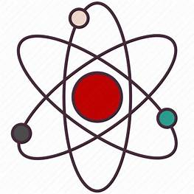
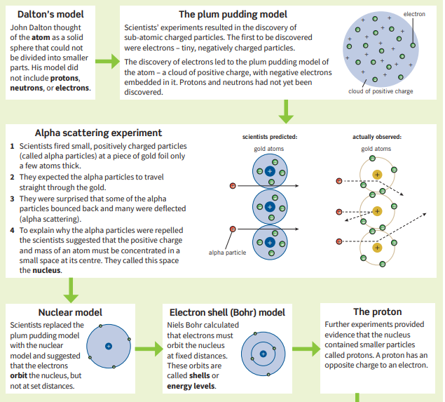
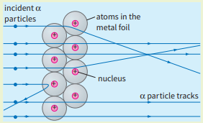
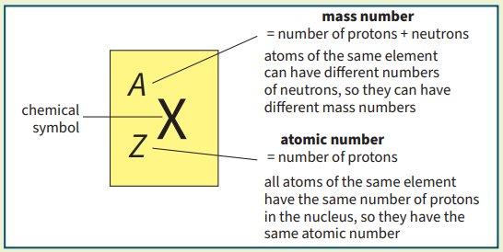
Science (Physics) – Year 11 – Autumn 2
Isotopes are atoms of the same element, with the same number of protons but a different numbers of neutrons.
 | Relative Charge | Relative Mass
Proton | +1 | 1
Neutron | 0 | 1
Electron | -1 | Very small
The nucleus, which is 10 000 times smaller than the radius of the atom, consists of two particles:
• positively charged protons
• neutrons which are neutral
An atom is uncharged overall and has equal numbers of protons and electrons.

Slide 2
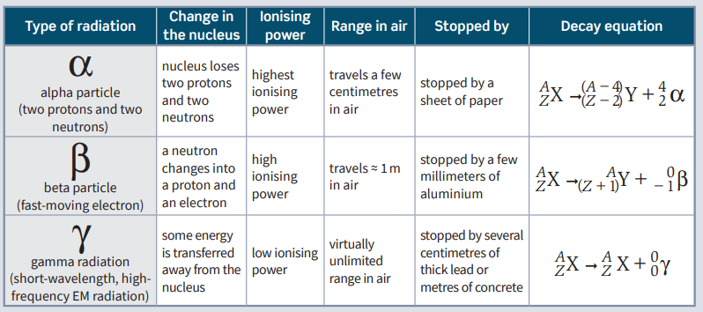
Science (Physics) – Year 11 – Autumn 2
Radioactive decay is when nuclear radiation is emitted by unstable atomic nuclei so that they become more stable.
It is a random process. This radiation can knock electrons out of atoms in a process called ionisation.

Slide 3
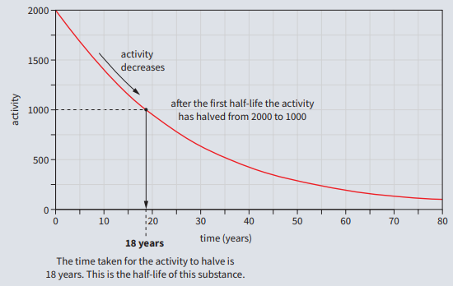
Science (Physics) – Year 11 – Autumn 2
The half‑life of a radioactive source is the time
• for half the number of unstable nuclei in a sample to decay
• for the count rate or activity of a source to halve.
The half‑life of a source can be found from a graph of its count rate or activity against time.

