Slide 1

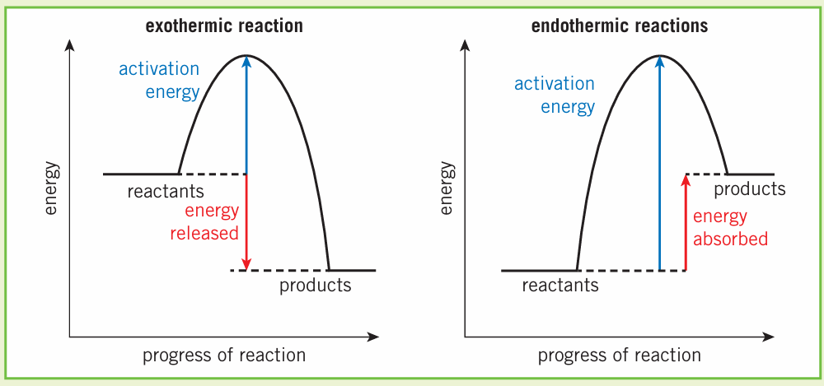
Science (Chemistry) – Year 11 – Autumn 2
Exothermic
Energy transfer to the surroundings
Thermometer shows an increase in the temperature.
Oxidation, combustion, neutralisation reactions.
Used in self-heating cans, handwarmers.
Endothermic
Energy transfer from the surroundings
Thermometer shows a decrease in the temperature.
Thermal decomposition reactions.
Used in sports injury packs.
A reaction profile shows whether a reaction is exothermic or endothermic.
The activation energy is the minimum amount of energy that particles must have to react when they collide.

