Slide 1
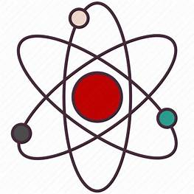
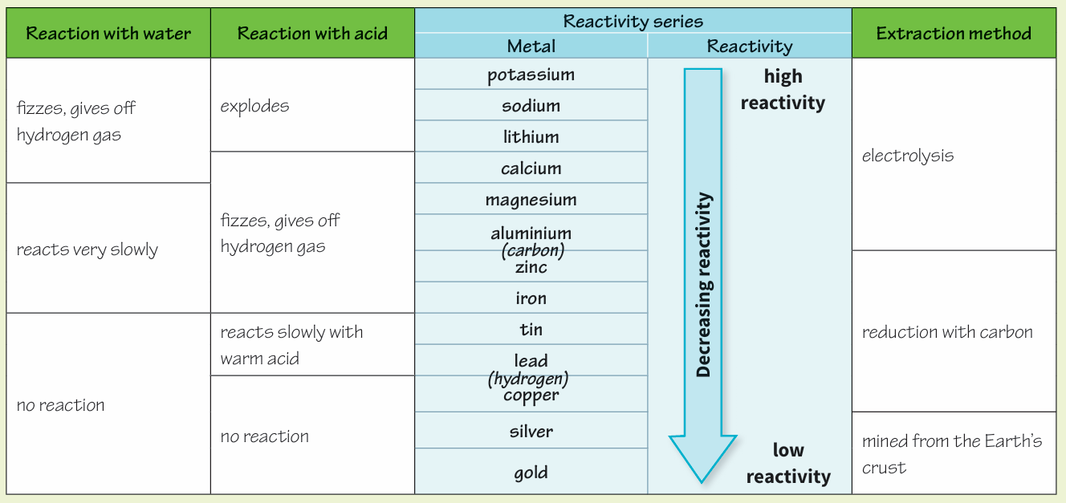
Science (Chemistry) – Year 11 – Autumn 2
The reactivity series for metals. Carbon and hydrogen which are non-metals are included for comparison.
Some metals, like gold, are so unreactive that they are found as pure metals in the Earth’s crust and can be mined.
Most metals exist as compounds in rock and have to be extracted from the rock. If there is enough metal compound in the rock to be worth extracting it is called an ore.
Metals that are less reactive than carbon can be extracted by reduction with carbon.
Metals that are more reactive than carbon can be extracted using a process called electrolysis.
If a substance gains oxygen in a reaction, it has been oxidised.
For example iron is oxidised when:
iron + oxygen ➞ iron oxide
If a substance loses oxygen in a reaction, it has been reduced.
For example iron is reduced when:
iron oxide + carbon ➞ iron + carbon dioxide

Slide 2
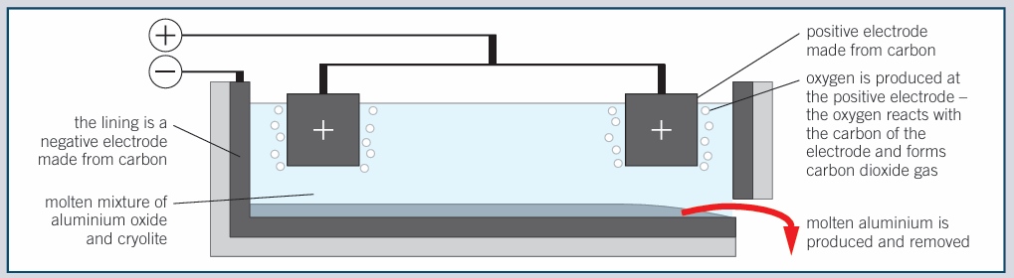
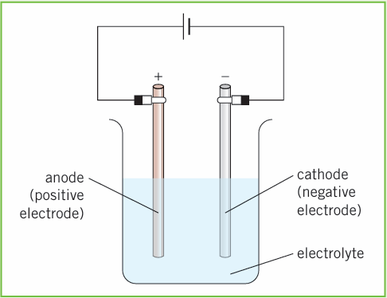
Science (Chemistry) – Year 11 – Autumn 2
Electrolysis of molten compounds
● The positive metal ions are attracted to the cathode (negative electrode), where they will gain electrons to form the pure metal
● The negative non-metal ions are attracted to the anode (positive electrode), where they will lose electrons and become the pure non-metal.
Aluminium is extracted from its ore by electrolysis.
The cryolite lowers the melting point, saving energy.
The graphite slowly wears away and has to be replaced.
Electrolysis of aqueous solutions (salts dissolved in water)
Products at the anode.
If the non-metal contains oxygen then oxygen gas is formed at the anode: carbonates, sulfates, nitrates all produce oxygen at the anode.
If the non-metal ion is a halogen, then the halogen (gas) is formed at the anode: fluorine, chlorine, bromine or iodine produced at the anode.
Products at the cathode.
If the metal is more reactive than hydrogen then hydrogen gas is formed at the cathode.
If the metal is less reactive than hydrogen then the pure metal is formed at the cathode: copper, silver or gold.

