Slide 1
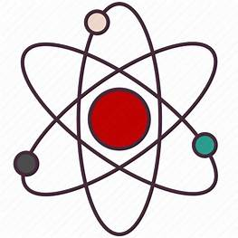
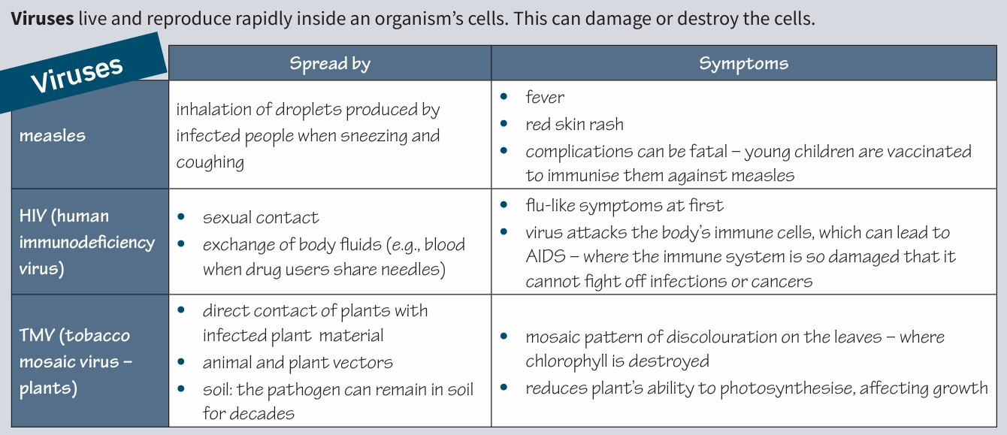
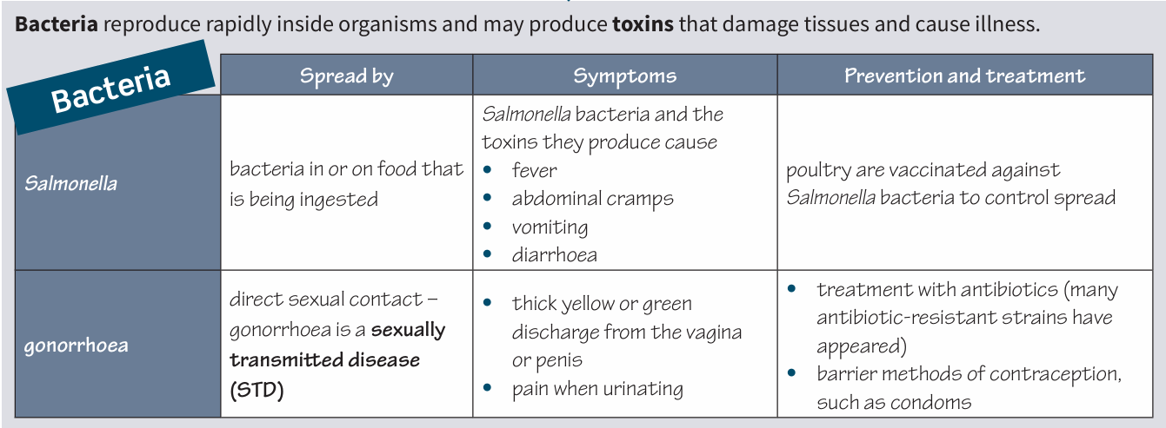
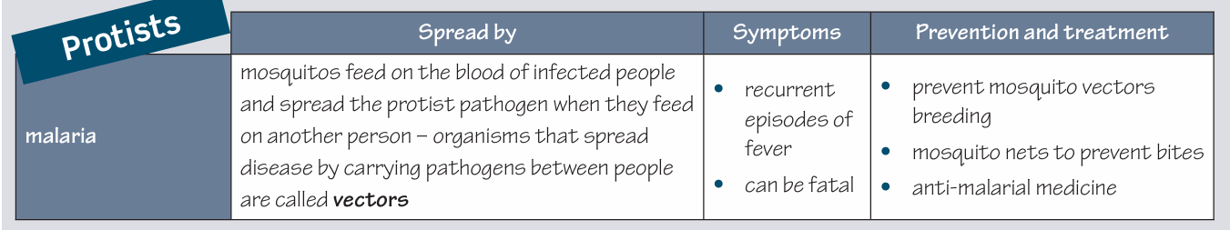
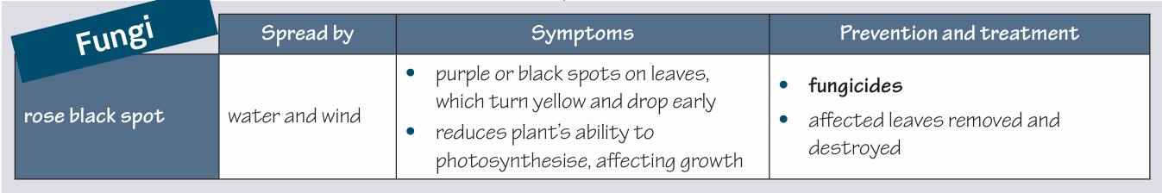
Science (Biology) – Year 11 – Autumn 2
Communicable diseases can be spread from one organism to another.
Pathogens are disease causing micro-organisms.
Primary defences of the human body against all pathogens include:
Skin : Physical barrier to infection, produces antimicrobial secretions and microorganisms that normally live on the skin prevent pathogens growing.
Nose : Cilia and mucus trap particles in the air, preventing them from entering the lungs. Trachea and bronchi produce mucus, which is moved away from the lungs to the back of the throat by cilia, where it is expelled.
Stomach : Produces strong acid (pH 2) that destroys
pathogens in mucus, food, and drinks.
Antibiotics are medicines that can kill bacteria in the body. Specific bacteria need to be treated by specific antibiotics.
Antibiotic-resistant strains of bacteria are emerging.
Antibiotics do not affect viruses.
Drugs that kill viruses often damage the body’s tissues.
Painkillers treat the symptoms of viral diseases but do not kill pathogens.

Slide 2
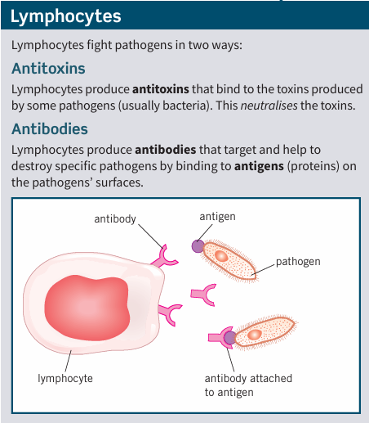
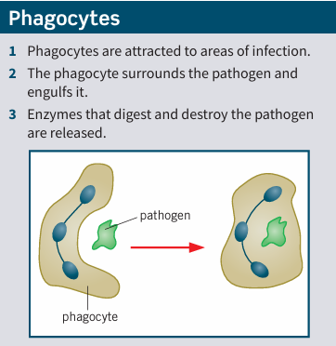
Science (Biology) – Year 11 – Autumn 2
If a pathogen enters the body, the immune system tries to destroy the pathogen. The function of white blood cells is to destroy pathogens. There are two main types of white blood cell – lymphocytes and phagocytes.
Drugs were traditionally extracted from plants and microorganisms.
• the heart drug digitalis comes from foxglove plants
• the painkiller aspirin originates from willow trees
• penicillin was discovered by Alexander Fleming from Penicillium mould.
Vaccinations involve injecting small quantities of dead or inactive forms of a pathogen into the body.
This stimulates lymphocytes to produce the correct antibodies for that pathogen.
If the same pathogen re-enters the body, the correct antibodies can be produced quickly to prevent infection.
If a large proportion of the population is vaccinated against a disease, it is less likely to spread. This is called herd immunity.
New drugs are extensively tested and trialled for
• toxicity – is it harmful?
• efficacy – does it work?
• dose – what amount is safe and effective to give?

Slide 3
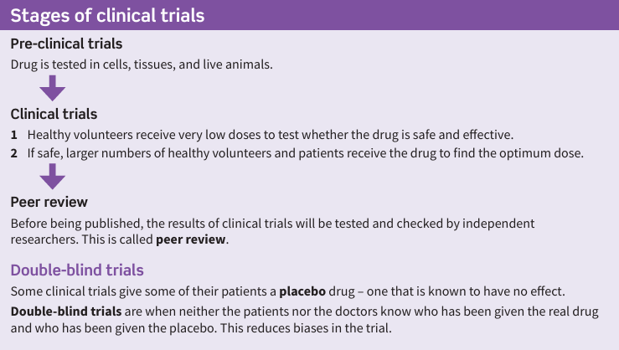
Science (Biology) – Year 11 – Autumn 2
Cancer is the result of changes in cells that lead to uncontrolled growth and division by mitosis.
Rapid division of abnormal cells can form a tumour.
Malignant tumours are cancerous tumours that invade neighbouring tissues and spread to other parts of the body in the blood, forming secondary tumours.
Benign tumours are non-cancerous tumours that do not spread in the body.

