Slide 1

Science (Physics) – Year 11 – Autumn 1
Speed is a scalar quantity. Has a magnitude. average speed (m/s) = total distance travelled (m) ÷ total time taken (s)
Some typical average speeds are: walking ≈ 1.5m/s, running ≈ 3m/s, cycling ≈ 6m/s
The speed of sound and the speed of the wind also change depending on the conditions. A typical value for the speed of sound is 300m/s
Velocity is a vector quantity. Has a magnitude and direction.
An object moving in a circle can have a constant speed but its velocity is always changing because its direction is always changing.
Acceleration is the change in velocity of an object per second. It is a vector quantity – it has magnitude and direction.
The unit of acceleration is metres per second squared, m/s².
An object is accelerating if its speed or its direction (or both) are changing.
A negative acceleration means an object is slowing down, and is called deceleration.
Acceleration can be calculated using: acceleration (m/s²) = change in velocity (m/s) ÷ time taken (s)
Uniform acceleration is when the acceleration of an object is constant.
The following equation applies to objects with uniform acceleration: (final velocity)² – (initial velocity)² = 2 × acceleration × distance
v² – u² = 2as .
If a falling object is only acted on by gravity the acceleration will be 9.8 m/s²

Slide 2
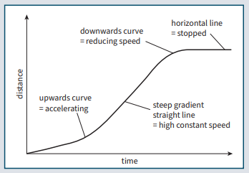
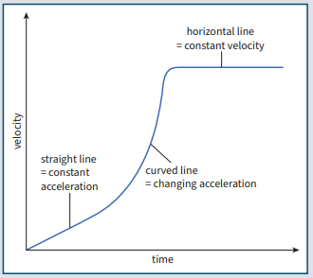
Science (Physics) – Year 11 – Autumn 1
A distance–time graph shows how the distance travelled by an object travelling in a straight line changes with time.
The gradient of the line in a distance–time graph is equal to the object’s speed.
If the object is accelerating, the speed at any time can be found by calculating the gradient of a tangent to the curved line at that time.
A velocity–time graph shows how the velocity of an object changes with time.
The gradient of the line in a velocity–time graph is qual to the object’s acceleration.
Newton’s Second Law says that the acceleration a of an object:
• is proportional to the resultant force on the object
• is inversely proportional to the mass of the object
The equation is : resultant force (N) = mass (kg) × acceleration (m/s²)
F = ma
The inertial mass of an object is a measure of how difficult it is to change the velocity of an object. It can be found using:
inertial mass (kg) = force (N) ÷ acceleration (m/s²)

Slide 3
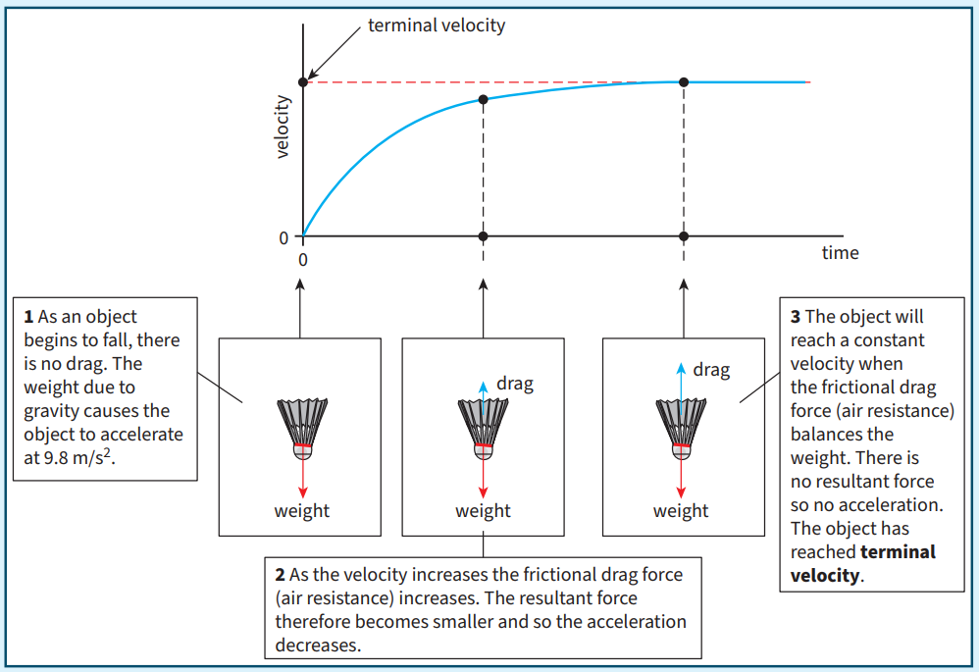
Science (Physics) – Year 11 – Autumn 1
For an object falling through a fluid:
• there are two forces acting – its weight due to gravity and the drag force
• the weight remains constant
• the drag force is small at the beginning, but gets bigger as it speeds up
• the resultant force will get smaller as the drag force increases
• the acceleration will decrease as it falls
• if it falls for a long enough time, the object will reach a final steady speed.
Terminal velocity is the constant velocity a falling object reaches when the frictional force acting on it is equal to its weight.

