Slide 1

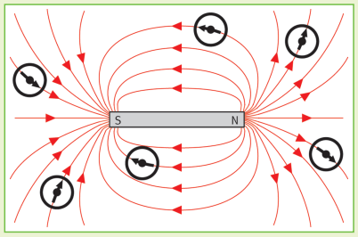
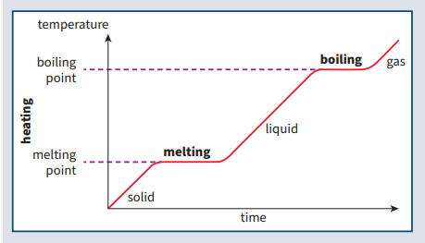
Science (Physics) – Year 9 – Autumn 1
Magnets
Magnets have a north (N) and a south (S) pole.
When two magnets are brought close together, they exert a non-contact force on each other.
Repulsion – If the poles are the same (N and N or S and S), they will repel each other.
Attraction – If the poles are different (N and S or S and N), they will attract each other.
The force between a magnet and a magnetic material (iron, steel, cobalt, or nickel) is always attractive.
A permanent magnet produces its own magnetic field which is always there.
An induced magnet is an object that becomes magnetic when it is placed in a magnetic field.
The force between an induced magnet and a permanent magnet is always attractive
A magnetic field is the region around a magnet where another magnet or magnetic material will experience a force due to the magnet.
A magnetic field can be represented by magnetic field lines.
Field lines show the direction of the force that would act on a north pole at that point.
Field lines always point from the north pole of a magnet to its south pole.
Density
density (kg/m³) = mass (kg) ÷ volume (m³)
mass (kg) = density (kg/m³) x volume (m³)
Density may also be measured in g/cm³.
Heating a substance increases its internal energy. Internal energy is the sum of the total kinetic energy the particles have due to their motion and the total potential energy the particles have due to their positions relative to each other.

