Slide 1
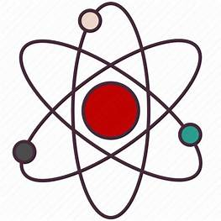
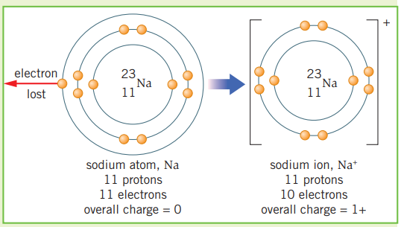
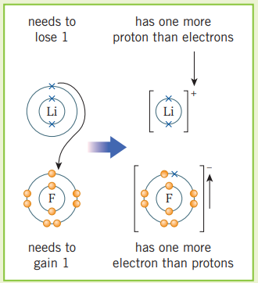
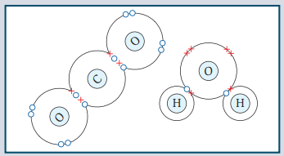
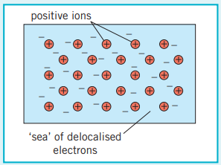
Science (Chemistry) – Year 11 – Autumn 1
Ionic bonds
Atoms can gain or lose electrons to give them a full outer shell. The number of protons is then different from the number of electrons. The resulting particle has a charge and is called an ion.
When metal atoms react with non-metal atoms they transfer electrons to the non-metal atom.
Metal atoms lose electrons to become positive ions.
Non-metal atoms gain electrons to become negative ions.
These are attracted to each other by the strong electrostatic force of attraction. This is called ionic bonding.
The electrostatic force of attraction works in all directions, so many billions of ions can be bonded together in a 3D structure.
Covalent bonds
Atoms can share or transfer electrons to form strong chemical bonds.
A covalent bond is when electrons are shared between non‑metal atoms.
The number of electrons shared depends on how many extra electrons an atom needs to make a full outer shell.
If you include electrons that are shared between atoms, each atom has a full outer shell.
Single bond = each atom shares one pair of electrons.
Double bond = each atom shares two pairs of electrons.
The atoms that make up metals form layers. The electrons in the outer shells of the atoms are delocalised – this means they are free to move through the whole structure.
The positive metal ions are then attracted to these delocalised electrons by the electrostatic force of attraction.

Slide 2
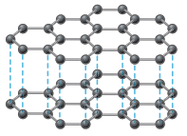
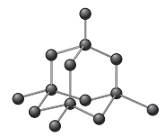
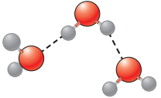
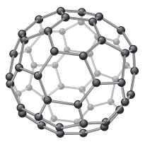
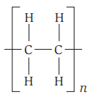
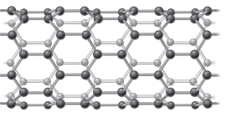
Science (Chemistry) – Year 11 – Autumn 1
Small molecules
Each molecule contains only a few atoms with strong covalent bonds between these atoms.
Different molecules are held together by weak intermolecular forces.
For example, water is made of small molecules.
Low melting and boiling points because only the intermolecular forces need to be overcome to melt or boil the substances, not the bonds between the atoms.
This does not require a lot of energy.
Normally gaseous or liquid at room temperature.
Large molecules
Many repeating units joined by covalent bonds to form a chain.
The small section is bonded to many identical sections to the left and right. The ‘n’ represents a large number.
Separate chains are held together by intermolecular forces that are stronger than in small molecules.
Polymers are examples of long molecules.
Melting and boiling points are low compared to giant covalent substances but higher than for small molecules.
Large molecules have stronger intermolecular forces than small molecules, which require more energy to overcome.
Normally solid at room temperature.
Graphite
Made only of carbon – each carbon atom bonds to three others, and forms hexagonal rings in layers. Each carbon atom has one spare electron, which is delocalised and therefore free to move around the structure.
Fullerenes – Spheres and Nanotubes
The carbon atoms in nanotubes are arranged in cylindrical tubes. Their high tensile strength (they are difficult to break when pulled) makes them useful in electronics.
Spherical fullerenes can be used as lubricants and in drug delivery.
Graphene
Graphene consists of only a single layer of graphite. Its strong covalent bonds make it a strong material that can also conduct electricity.
Giant covalent - Many billions of atoms, each one with a strong covalent bond to a number of others.
An example of a giant covalent structure is diamond.
High melting and boiling points because the strong covalent bonds between the atoms must be broken to melt or boil the substances.
This requires a lot of energy.
Solid at room temperature.

