Slide 1
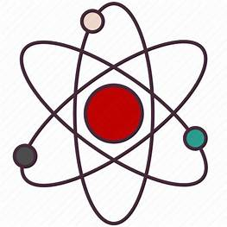
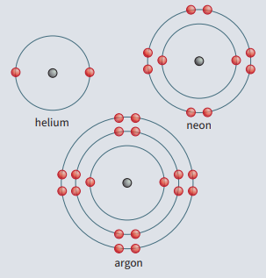
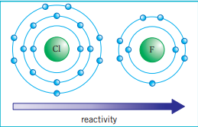
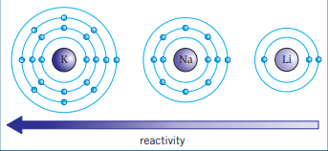
Science (Chemistry) – Year 10 – Autumn 1
Group 0 (Noble gases)
• full outer shells, so do not need to lose or gain electrons
• are very unreactive (inert) so exist as single atoms as they do not bond to form molecules
• boiling points that increase down the group.
Group 1 (Alkali metals)
All have one electron in their outer shell. Reactivity increases down Group 1 because as you move down the group:
• the atoms increase in size
• the outer electron is further away from the nucleus, and there are more shells shielding the outer electron from the nucleus
• the electrostatic attraction between the nucleus and the outer electron is weaker so it is easier to lose the one outer electron • the melting point and boiling point decreases down Group 1.
Group 7 (Halogens)
Reactivity decreases down Group 7 because as you move down the group:
• the atoms increase in size
• the outer shell is further away from the nucleus, and there are more shells between the nucleus and the outer shell
• the electrostatic attraction from the nucleus to the outer shell is weaker so it is harder to gain one electron to fill the outer shell.
They are non‑metals that exist as molecules made up of pairs of atoms.
First list of elements
Elements ordered by atomic mass.
No gaps.
Elements not grouped.
No clear distinction between metals and non-metals.
Mendeleev’s Periodic Table
Elements ordered by atomic mass.
Gaps left for undiscovered elements.
Elements grouped by chemical properties.
No clear distinction between metals and non-metals.
Modern Periodic Table
Elements ordered by atomic number.
No gaps.
Elements grouped by the number of electrons in the outer shell.
Metals to the left, non-metals to the right.

Slide 2
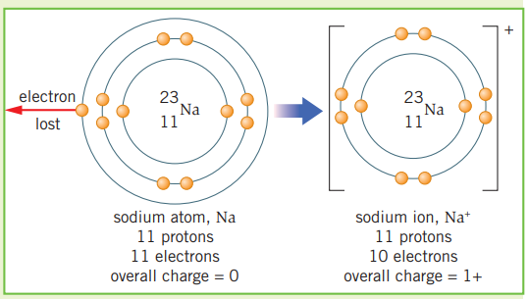
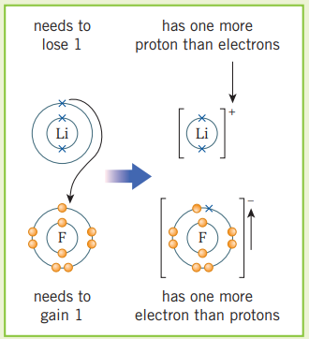
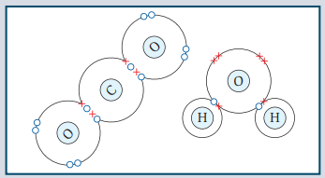
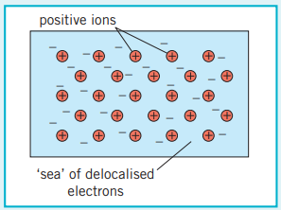
Science (Chemistry) – Year 10 – Autumn 1
Ionic bonds
Atoms can gain or lose electrons to give them a full outer shell. The number of protons is then different from the number of electrons. The resulting particle has a charge and is called an ion.
When metal atoms react with non-metal atoms they transfer electrons to the non-metal atom.
Metal atoms lose electrons to become positive ions.
Non-metal atoms gain electrons to become negative ions.
These are attracted to each other by the strong electrostatic force of attraction. This is called ionic bonding.
The electrostatic force of attraction works in all directions, so many billions of ions can be bonded together in a 3D structure.
Covalent bonds
Atoms can share or transfer electrons to form strong chemical bonds.
A covalent bond is when electrons are shared between non‑metal atoms.
The number of electrons shared depends on how many extra electrons an atom needs to make a full outer shell.
If you include electrons that are shared between atoms, each atom has a full outer shell.
Single bond = each atom shares one pair of electrons.
Double bond = each atom shares two pairs of electrons.
The atoms that make up metals form layers. The electrons in the outer shells of the atoms are delocalised – this means they are free to move through the whole structure.
The positive metal ions are then attracted to these delocalised electrons by the electrostatic force of attraction.

