Slide 1
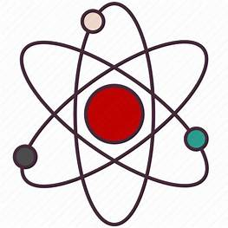
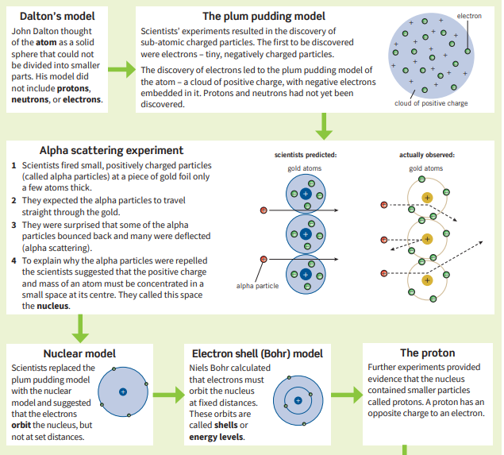
Science (Chemistry) – Year 9 – Autumn 1
Elements are substances made of one type of atom. Each atom of an element will have the same number of protons.
Compounds are made of different types of atoms chemically bonded together. The atoms in a compound have different numbers of protons.
The Atomic number is the number of protons in an atom.
The Mass number is the total number of protons and neutrons in an atom.
Electrons in an atom are placed in fixed shells.
You can put
• up to two electrons in the first shell
• eight electrons each in the second and third shells.
You must fill up a shell before moving on to the next one.
 | Relative Charge | Relative Mass
Proton | +1 | 1
Neutron | 0 | 1
Electron | -1 | Very small

