Slide 1

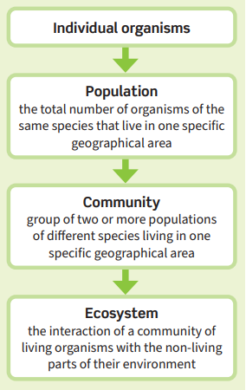
Science (Biology) – Year 10 – Autumn 1
Abiotic factors are non‑living factors in the ecosystem that can affect a community.
Too much or too little of the following abiotic factors can negatively affect the community in an ecosystem:
• carbon dioxide levels for plants
• light intensity
• moisture levels
• oxygen levels for animals that live in water
• soil pH and mineral content
• temperature
• wind intensity and direction.
Organisms have features – adaptations – that enable them to survive in the conditions in which they live.
Structural adaptations
The physical features that allow an organism to successfully compete:
• sharp teeth to hunt prey
• colouring that may provide camouflage to hide from predators or hunt prey
• a large or small body-surface area-to-volume ratio.
Behavioural adaptations
The behaviour of an organism that gives it an advantage:
• making nests to attract a mate
• courtship dances to attract a mate
• use of tools to obtain food
• working together in packs.
Functional adaptations
Adaptations related to processes
that allow an organism to survive:
• photosynthesis in plants
• production of poisons or venom to deter predators and kill prey
• changes in reproduction timings.
Biotic factors are living factors in the ecosystem that can affect a community.
The following biotic factors would all negatively affect populations in a community:
• decreased availability of food
• new predators arriving
• new pathogens
• competition between species.
Within a community each species interacts with many others and may depend on other species. If one species is removed it can affect the whole community – this is called interdependence.
Interspecific competition is between organisms of different species and intraspecific competition is between organisms of the same species.

Slide 2
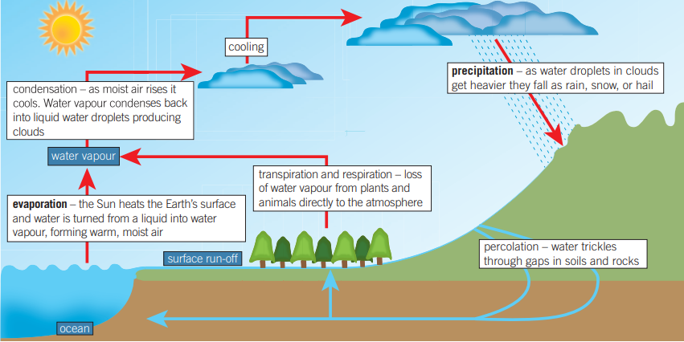
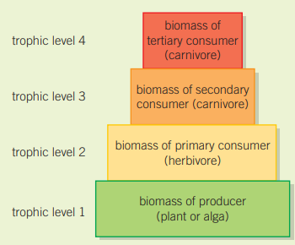
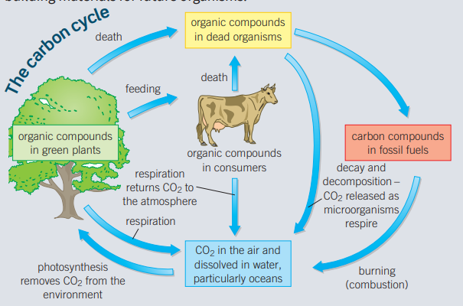
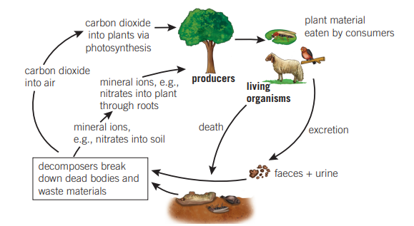
Science (Biology) – Year 10 – Autumn 1
The water cycle

