Slide 1
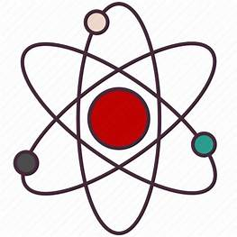
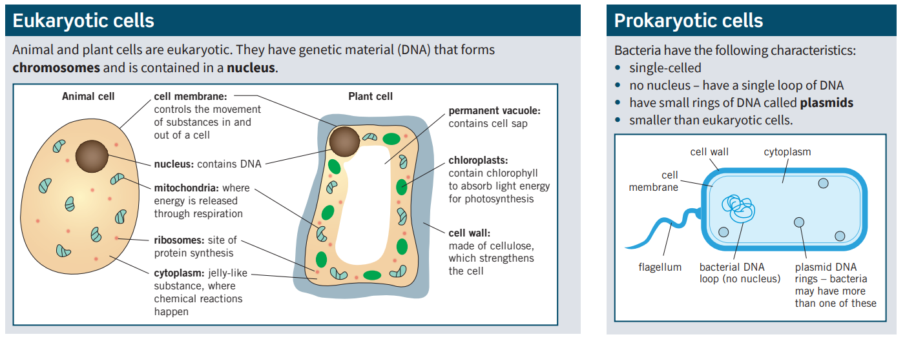
Science (Biology) – Year 9 – Autumn 1
Diffusion - The spreading out of particles, resulting in a net movement from an area of higher concentration to an area of lower concentration.
Osmosis - The diffusion of water from a dilute solution to a concentrated solution through a partially permeable membrane.
Active transport - The movement of particles from a more dilute solution to a more concentrated solution using energy from respiration.
To calculate the magnification of an image: magnification = image size ÷ actual size
Electron microscopes allow you to see sub-cellular structures, such as ribosomes, that are too small to be seen with a light microscope.

