Slide 1







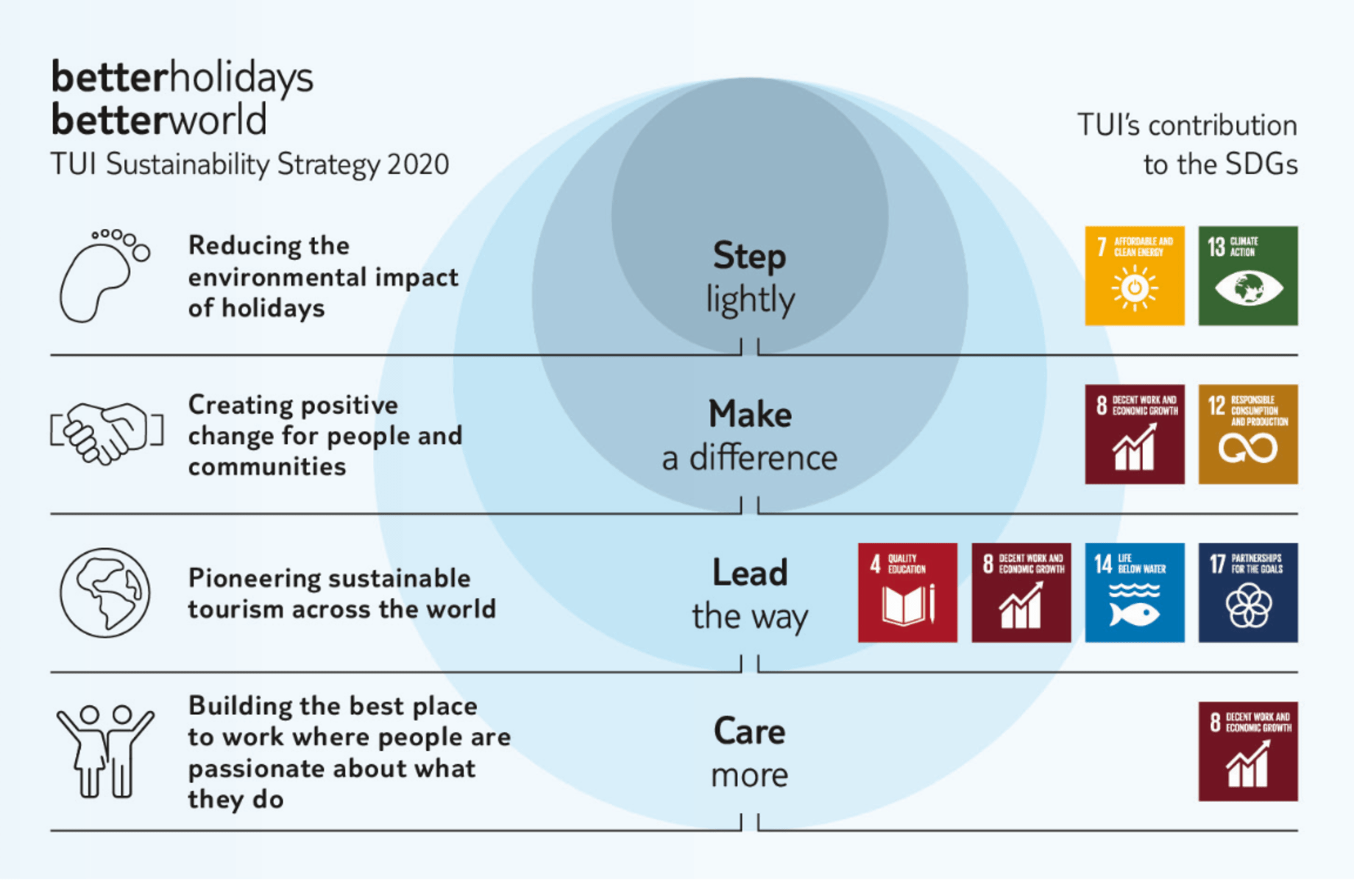




Component 2B: How The Needs & Preferences of T&T Customers Are Met BTEC Travel & Tourism: Autumn 2 – 2.0
2.1 VARYING CUSTOMER TRAVEL & HOLIDAY NEEDS
2.1.1. High or Peak Season | This is when there is high demand for specific holiday types e.g. Ski Resorts are more popular and more expensive in winter, whereas beach resorts are more popular and more expensive in summer, especially during school holidays.
2.1.2. Low Season | When holiday destinations are less popular due to factors like the weather or during the school term. However, they can be much cheaper at these times.
1.1.3. Special Events | Some holiday destinations are more popular during special events like festivals or sporting events e.g. visiting France during the Tour de France or visiting Bavaria (Germany) during Oktoberfest.
2.1.4. Accessibility Requirements | Some tourists may have special requirements due to mobility issues or because of travelling with small children. They may need help with luggage or adapted accommodation. They may also choose a specific holiday type to meet their needs e.g. a cruise.
2.1.5. Accommodation Requirements | These needs can vary due to a range of factors including; budget, length of stay, reasons for visit, dietary needs, type of visitor and size of travelling party. Depending on need, visitors may choose serviced accommodation which includes housekeeping, cleaning and meals etc or non-serviced accommodation.
2.1.6. Supplementary Charges | Families or solo travellers can often pay additional charges for family rooms or solo occupancy rooms. Also, planning and booking your own trip can reduce the cost as the knowledge and skills of a travel agent can come at a premium.
2.1.7. Stated & Unstated Needs | Stated needs are needs that a customer informs the T&T organisation of directly e.g. A wheel chair user. Unstated needs are when a customer assumes that all facilities will meet there expectations e.g. a cot in a family room.
2.1.8. Specific Needs | Not all specific needs are linked to mobility and not all disabilities are visible e.g. hearing, sight, cognitive/learning needs, allergies, language, cultural needs which require specific food or prayer facilities.
2.2 RESPONSIBLE TOURISM Vs CONVENIENCE
2.2.1. Carbon Footprint | This is the measure of the amount of carbon dioxide released by an individual or organisation. It is most often linked to air travel.
2.2.2. Responsible Tourism | People are becoming increasingly aware of the impact of global tourism and the need to minimise the negative environmental and cultural impact of tourism.
2.2.3. Convenience Travel | Many customers increasingly want ease and convenience when travelling. Regional airports like Bournemouth have increased significantly in UK and other countries. Coach & rail travel has also increased and it has become easier than ever to take your own car to other European countries.

Slide 2




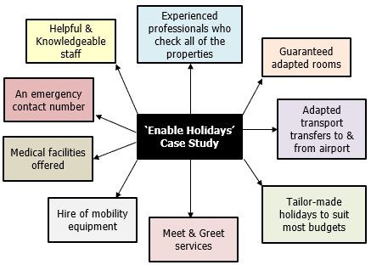
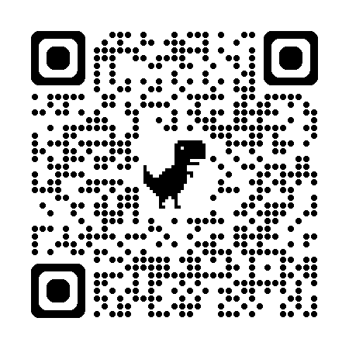
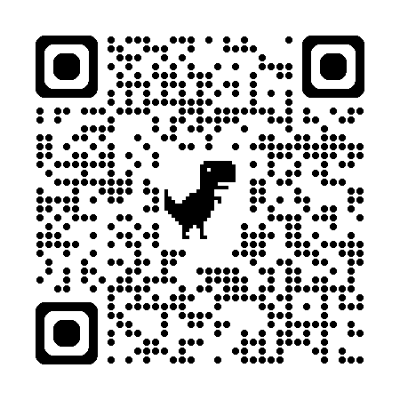

Component 2B: How The Needs & Preferences of T&T Customers Are Met BTEC Travel & Tourism: Autumn 2 – 2.0
2.3 PLANNING FOR ACCESSIBILITY
2.3.1. Practical Assistance | Many T&T organisations off offer practical assistance for customers with specific needs, from; planning & booking through to meeting transport, accommodation and meal time needs.
2.3.2. Dignity | T&T organisations make it a priority to meet the needs of all customers (especially those with specific needs) with professionalism in an understanding manner.
2.3.3. Disability Awareness | Most T&T organisations provide training to ensure that there staff understand the needs of customers with disabilities.
2.3.4. Special Assistance Teams | Some T&T organisations like Virgin Holidays have specialist teams to support passengers with disabilities whereas Royal Caribbean International offer cruises designed specifically for customers with mobility issues included adapted cabins.
2.4 PRICING & BOOKING
4.4.1. Travel Agents | Booking a holiday using a travel agent has become increasingly popular after Covid-19. Customers are looking for trips that are ATOL protected, providing greater financial security with bookings.
4.4.2. Digital Booking | Booking online has also increase as customers have become more comfortable with purchasing products and booking holidays and visitor attraction tickets online than ever before.
4.4.3. Technology | Many T&T organisations use apps as a marketing tool to sell products and services and to increase sales. The public enjoy the ease of use and the ability to read customer reviews prior to purchase.
4.4.4. Pricing | Prices fluctuate due to a range of factors including; demand, weather, political events, natural events (disasters) etc. Travel comparison sites help customers get the best value for the trips they plan.
4.4.5. Discounts | T&T organisations often offer discounts for early bookings, returning customers or even first time buyers. Tour Operators like TUI & Jet2 offer free child places and off-peak pricing to encourage more custom.
2.5 HOLIDAY ADAPTATIONS
2.5.1. Petcations | Holidays that are pet friendly and have pet friendly facilities.
2.5.2. Agile Working | Employment that enables people to combine travel and business , with an expectation that pets can go with them.
2.5.3. Staycations | Where people decide to holiday within the UK.
2.5.4. Short Breaks or City Breaks | Short holidays of between 2-5 days. City breaks are popular in UK like London, Edinburgh or Bath as well as European locations like Paris, Barcelona and Rome.

