Slide 1


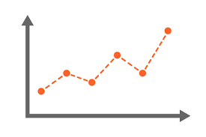




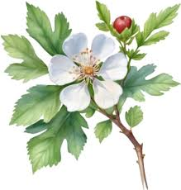

Component 2A: Identifying Customer Needs and T&T Trends BTEC Travel & Tourism: Autumn 1 – 1.0
1.1 KEY TERMS
1.1.1. Market Research | The action or activity of gathering information about consumers' needs and preferences. This is usually conducted so that companies know what products and services people want to buy.
1.1.2. Primary Research | Research that directly collects NEW data or facts to address a certain problem, validate a decision taken or to answer specific questions.
1.1.3. Secondary Research | Secondary research uses information that already exists and is gathered by someone else.
1.1.4. Quantitative Research | Collects objective, measurable data that can be used for statistical analysis. It targets how many people do a certain thing.
1.1.5. Qualitative Research | Seeks to understand the reasons, opinions and motivations of respondents and their behaviour. It targets why people do a certain thing.
1.1.6. Closed Questions | Questions that expect a specific response e.g. Yes/No or True/False. The questioner controls the response choices.
1.1.7. Open Questions | Questions that demand a more detailed response e.g. Tell me… or Explain why?
1.1.8. The Hawthorne Effect | People alter their behaviour when they are aware of being observed.
1.1.9. Rapport | Where the researcher gains a good sense of understanding or trust with the person being interviewed or questioned. This can often lead to more honest and accurate information being provided.
1.2 TYPES OF PRIMARY T&T RESEARCH
1.2.1. Questionnaires | A pre-defined set of questions designed to collect data about specific things, most often in the form of a customer satisfaction questionnaire. This relatively quick and easy primary research method that can be conducted in person, over the phone or online.
1.2.2. Surveys | These include the whole process of collecting data, through the use of questionnaires as well as other methods, and then analysing the information to determine its significance, draw conclusions and plan future action.
1.2.3. Focus Groups | Where a selected small number of people are invited to come and discuss a topic. The conversation is directed by the researcher in to ensure that the group stay on topic.
1.2.4. Observations | The researcher observes customer behaviour and records their findings by taking notes, photographs or videos. The Best results can be obtained when people do not know that they are being observed.
1.2.5. Visits | Visiting a location to gather information e.g. visiting a competitors shop or website to assess the range of products and services being sold.
1.2.6. Formal Interviews | A method of collecting information in a structured manner.
1.2.7. Informal Interviews | A method of collecting information in a relaxed and unstructured manner.
1.2.8. Advantages of Primary Research | Information collected is up to date, confidential (only the organisation has access to the research) and is specific to the organisations aims and objectives.
1.2.9 Disadvantages of Primary Research | It can be expensive, time consuming and the information obtained can be limited.

Slide 2
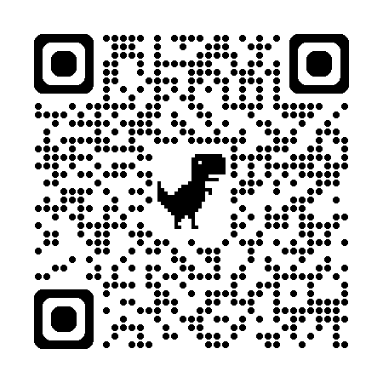
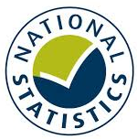
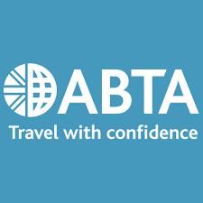
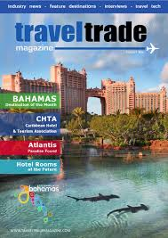

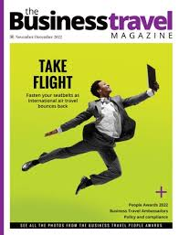
Component 2A: Identifying Customer Needs and T&T Trends BTEC Travel & Tourism: Autumn 1 – 1.0
1.3 TYPES OF SECONDARY T&T RESEARCH
1.3.1. Market and Government Reports & Statistics | The results of research carried out by T&T organisations. This often includes numerical data provided in charts, tables or graphs.
1.3.2. Visit Britain | Visit Britain promotes tourism in UK and is funded by the government. They produce a lot of statistical data related to UK tourism which is free to access online.
1.3.3. Association of Leading Visitor Attractions (ALVA) | This T&T organisation provides the latest visitor figures for UK visitor attractions.
1.3.4. Office for National Statistics | This government organisation has responsibility to collect and analyse data about the UK economy and society. They regularly report on current travel trends.
1.3.5. United Nations World Tourism Organisation (UNWTO) | This T&T organisation promotes sustainable tourism policies across the world. It produces publications, statistics and market trends reports.
1.3.6. Association of British Travel Agents (ABTA) | ABTA offers information and advice to the travelling public and to travel organisations to help deliver high standards of customer service. They report on annual holiday habits and produce travel trends reports.
1.3.7. Company Materials | T&T organisations publish reports and materials to show how they are performing. Information includes; competitor activity, new & developing trends, finance & turnover, customer activity, sustainability and employment.
1.3.8. Trade Organisations | They carry out research and release reports and publications about the industry to give advice and guidance to their members and the public.
1.3.9. Advantages of Secondary Research | Secondary research is often readily available online and can be quicker and easier to access than conducting your own primary research as someone else (often with greater resources) has done the work for you. It can also save a T&T organisation time and money.
1.3.10. Disadvantages of Secondary Research | The source of information could be unreliable or out of date. It may also be biased if produced by an organisation wanting to show itself in the best light. Also, it may not meet the specific needs of a T&T organisation. Subscriptions to journals and trade magazines is an added expense.
1.4 OTHER USEFUL INFORMATION
1.4.1. Market Segmentation | Dividing potential customers in to groups or segments of customers with similar needs and preferences e.g. Students or old age pensioners.
1.4.2. Target Market | The group that a T&T organisation aims its products and services towards e.g. cruises aimed at older people.
1.4.3. Customer Satisfaction | Good T&T organisations seek feedback about customer experiences in order to improve the products and services that they provide.
1.4.4. Customer Loyalty | T&T organisations often seek to exceed customer service expectations in order to ensure customers return.

