Slide 1

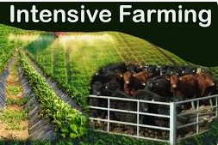
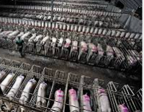
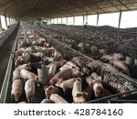
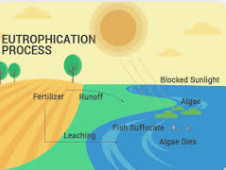
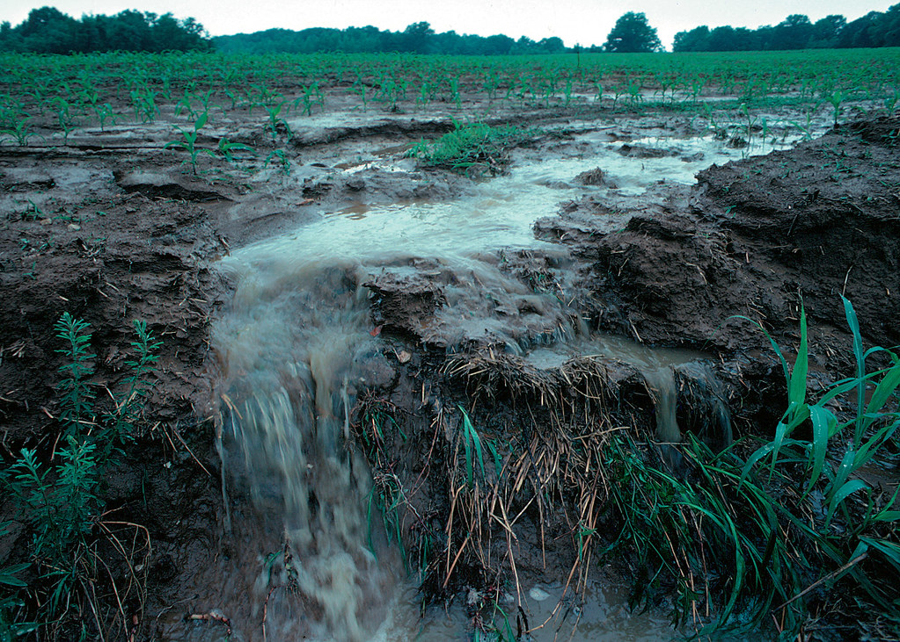
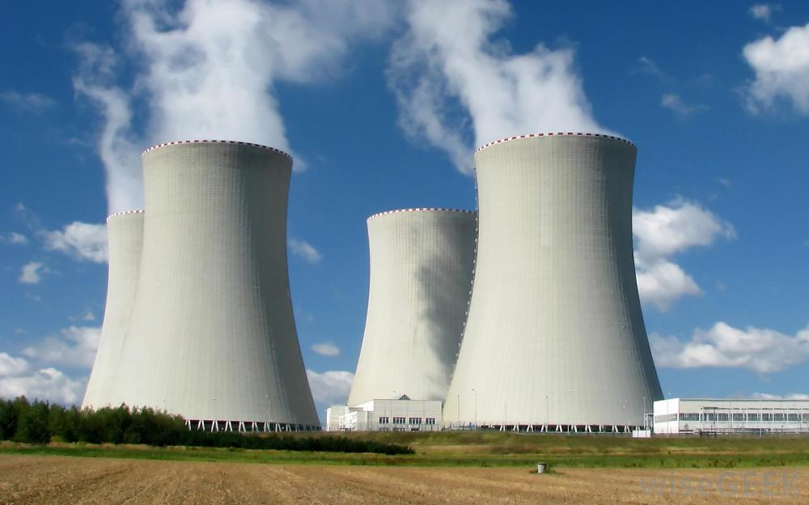
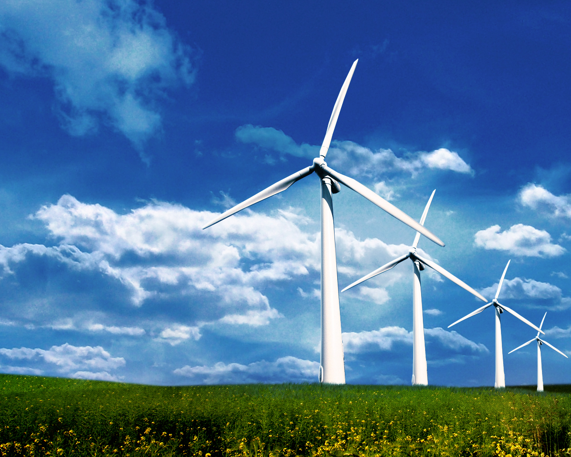
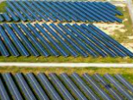
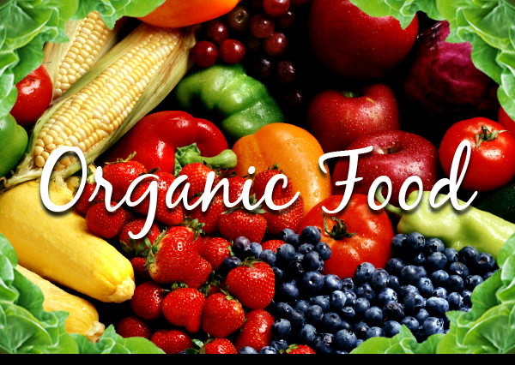
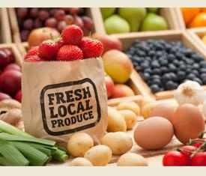
Intensive Farming
The conflict: Intensive farming has high yields but low production costs. These low costs get passed on consumers – keeping prices low in shops. There is heavy dependency on chemical fertilizer, anti-biotics (in livestock) and machinery. Demand for food is increasing with population
Eutrophication
Is when nitrogen from agriculture gets into the freshwater system and encourages algal blooms.
Causes | Solutions
Slurry being spread in rain Slurry being spread in the wrong months (Nov-Feb) Nitrogen being used heavily in NVZ (Nitrogen Vulnerable Zones – farms which have rivers going through them which end up in lakes/ estuaries such as Poole Harbour. | Fence Cattle out of rivers. Plant cover crops over winter to hold and condition soil naturally. Do not have maize (late harvest crop and heavy need of nitrogen] near rivers. Barley straw helps keep fresh water clean.
Land Based – 1.2.2
Challenge & Conflicts of land use
Climate change
Climate change is fact. Human practices since the industrial revolution in 1850s when we discovered steam power, have increased the amount of green house gases in the atmosphere which has caused us to have
UK Climate Change
Much wetter winters This prevents machinery from getting on the field so drill arable seeds Mean livestock are housed for longer periods of time | More frequent flooding of farms in flat topography areas is devasting for farms. Different crops growing in hotter summers such as vineyards/grapes
Loss of Biodiversity
Causes | Solutions
Use of monocrops Deforestation of land to turn into farmland. This then causes flooding further downstream as trees are climate regulators and water reservoirs. More disease is prevalent in monocrops of both plants and livestock. This then requires chemical intervention either with the use of pesticides in plants or antibiotics in livestock. Widespread use of antibiotics has now got into the food chain and made humans less responsive to antibiotics. | Regenerative farming Planting companion crops Leaving field margins Encouraging natural habitats such as wetland. Planting dual crops – e.g .clover and maize. Natural England (Gov org) are responsible for protecting against biodiversity loss. Their subsidy scheme is called ELMS (Environmental Land Management Scheme) This pays farmers to set aside land just for wildlife and to restore habitats RSPB (non-gov) bird charity that give free surveys of farmland to farmers so they can apply for ELMS.
Balancing use of land with harm of the environment
Key Facts
70% of UK land use is agriculture.
By 2050:
Population is due to increase to 9.8 billion
Climate set to increase by 1.5˚C
90% of the soil could be degraded – not fertile.
Impacts | Solutions
Heavy machinery causes pollution from diesel and compaction of soil. Compacted soil means water runs off more easily. Run off of top soil is bad for the farmer as losing nutrients Run off of sediment is bad for river life – especially salmon & trout. Heavy use of chemicals - especially fungicides causes soil to lose biodiversity which is key in allowing plants to access nutrients, therefore it becomes less fertilse and needs more chemicals. Chemical run off (leaching) of nitrogen causes eutrophication. Use of one monocrop causes loss of biodiversity | Boarder crops for wildlife, Reduction in use of chemical fertilisers, improve soil naturally with use of cover crops. Cover crops include a mix of plants so immediately increase biodiversity. Clover – legume – bacteria around roots which help the plant access nitrogen naturally. Radishes – fodder (livestock food) and aerate soil. Italian rye grass grows fast holds soil in place preventing run off.
Energy Generation
Fossil Fuels | Renewable
Gas Oil Coal | Solar Hydroelectric Wind turbines Geothermal Anaerobic digestion
Why
Fossil fuels add to climate change Climate change is altering which crops we grow and how we grow them Energy production is part of farm diversification.
KEY TERMS:
challenge = the issue of food production/ energy generation
impact = how does the challenge harm environment
mitigation = solution to the impact

Slide 2
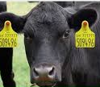
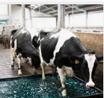
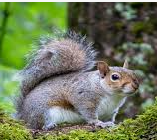
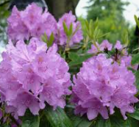
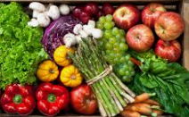
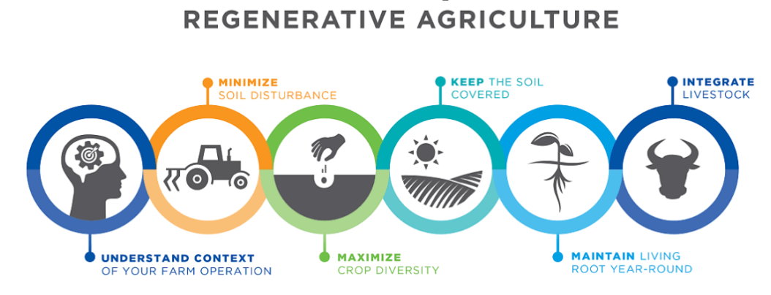
Biosecurity
Biosecurity (biological security) can be risk of pests, diseases, infections or invasive species.
Impacts | Solution
Have good biosecurity means protecting land based businesses from risk of infections such as foot and mouth and bird flu. The Black death was brought into the UK by rats carrying fleas off trading ships. Now we have customs and excise to help safeguard our biosecurity. Livestock events such as markets and shows have a high biosecurity risk as large amounts of livestock are moving around the country potentially bringing infections Biosecurity also refers to plant diseases such as ash die back in trees Biosecurity can also mean protection against invasive species non-native species such as grey squirrel (originally from USA out-competed our native red squirrel) | Livestock passports and ear tags were introduced after the foot and mouth outbreak in 2001. Ear tag technology can be easily scanned to give detailed profile of the livestock’s life in terms of where it was born, health conditions, vaccinations. Vaccinations help protect biosecurity Use of footbaths and cleaning protocols are biosecurity measures to help keep livestock healthy. Adventure sport and leisure equipment should be cleaned thoroughly between locations to prevent spread of disease or seeds from invasive species.
Decrease in subsidies
Pre-Brexit | Post - Brexit
When in the European Union UK farmers were under the CAP – the Common Agricultural Policy. This was designed to give consistency between all farms in Europe in terms of what chemicals they could use and practices. | Farmers have not seen the results promised from the Brexit campaign Harder due to level of paper work for British producers to sell to European markets.
Pre-Brexit subsides | Post Brexit subsidies
Higher Level Stewardship Scheme (HLS) – paid for field margins – more land, higher payments Paid for ‘setting aside’ land for wildlife. Paid BPS payment for over 5 hectares, help many farms | BPS gone Natural England runs ELMS – Environmental land management schemes. Pays farmers to look after habitats which in turn look after society. For example to restore wetlands to act as natural reservoir to prevent flooding.
Impact on the countryside
Impacts | Solutions
Light pollution from built up tourist areas disrupt wildlife – especially nocturnal animals. Noise pollution – people generally are attracted to the countryside for peace and quiet. Events/activities can disrupt this. Increased traffic – brings antisocial parking (on farmland) pollution from exhausts. Litter , path erosion and crime generally follow big crowds – e.g. Lockdown. | Lights are installed with hoods to minimise light pollution Curfew to events to minimise disruption from noise, light and events. Car parks, park and ride, cycle tracks and public transport reduce traffic. Bins and recycling prevent litter. CCTV, neighbourhood watch prevent crime.
Pollution
Air, water and soil are being polluted by intensive farming. Air by the use of fossil fuels, water by eutrophication and the soil by use of chemical fertilisers and pesticides. However intensive farming also causes light and noise pollution
air | water | soil
Reduce use of fossil fuels in exchange for renewable sources of energy. Hydrogen powered tractors waste is just water. | More policing of slurry/nitrogen application to ensure done at a safe time. All rivers to be bordered by woodland Livestock fenced out of rivers. Ban of maize near rivers. | Farm organically No use of chemicals Look after soil biome with as much care as livestock. Farm regeneratively – end to monocrops, maintain living roots in ground with cover crops..
Global vs Local markets
Challenges | Solution
Global markets provide food all year round. However, there are high transport costs – financial and environmental – high food miles and levels carbon dioxide produced. Local markets have low food miles and artisan producers selling produce locally made and seasonally available. Conflict lack of choice but fantastic quality Brexit has made exporting goods more challenging due to increased paperwork | Support local markets where local producers can sell direct to customers More simpler exporting procedures Eat seasonal food grown locally.
Generically modified food
Genetically modification is when scientists purposely change the DNA of a cell to encourage favourable characteristics.
Advantages | Disadvantages
Virus tolerance Insect resistance Improved yields Resistant to herbicide/pesticide Flood resistant Drought resistant Nutrient enhancement | Air born pollen could cause escape GM genes to pollinate organic crops – i.e. genetic pollution It’s relatively new technology and long term impacts are not fully understood.
Increase in population
The challenge: More food is needed to feed the growing population – 9.8 billion by 2050. • With the pressure of climate change causing sea level rise and urbanisation take up more agricultural land, the pressure is on to produce more food using less space without harming the environment. | Solution: Increase of use of technology to improve efficiency. • Innovative ideas needed to fulfil need of providing food in challenging areas. E.g tower farms in London

