Slide 1
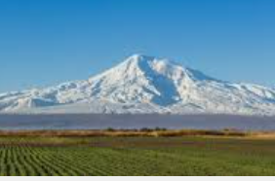
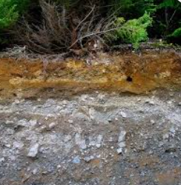
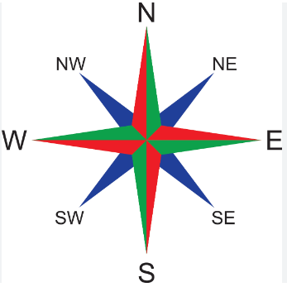
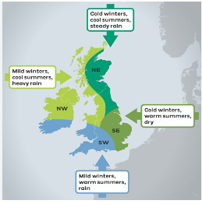
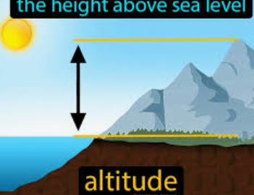
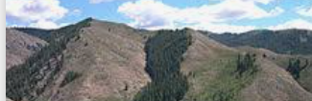
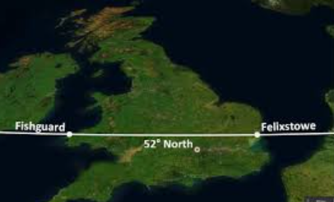
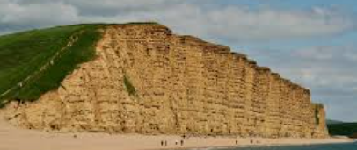
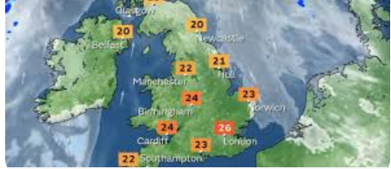
Geographical Factors 1.1.2 Which effect land based businesses
This topic enables you to understand how the type of the landscape suits different land based businesses.
Geographical factor | What is it? | What does it look like | How it effects land businesses
Topography | The shape of the land - whether it is mountainous, lowland or flat. Spacing of contour lines on maps indicate topography. West UK is generally either lowland or mountainous, where eastern UK has flat topography. |  | Topography is vital in land based as it has a direct impact on food production. It affects water drainage, soil erosion, machinery access and crop suitability. It helps plan irrigation systems. Flat topography is ideal for arable, steep topography ideal for sheep farming.
Geology | Geology is the type of bedrock and effects the topography of the land and colour of the soil. Granite geology in mountainous areas is hard and does not erode easily, therefore produces shallow soils. Sandy geology in Eastern side of UK is good for root crops. |  | Geology effects the type of mineral matter in the soil. This effects the nutrients which are available. E.g red Devon rocks are high in iron, Dorset white chalk rocks are high in calcium.
Geography | Where the land is located- north, south, east or west, access to transport links proximity to rivers/flood plains/sea. |  | Where the land effects which type of climate, topography, geology and the amount of sunlight. It can also refer to whether the business is close to transport links or cities.
Altitude | How many metres above sea level does the land lie above sea level. This is indicated on maps by contour lines. |  | Higher altitude means lower temperature. Lower temperature effects the rate of photosynthesis therefore grass grows slower and courser. i.e ideal for sheep farming but not dairy which needs lush green grass.
Aspect | Which direction does the land face? How much sun it gets through the day |  | Fields that are south facing receive most sunlight and therefore plants can photosynthesis for longest. North facing fields are colder and receive less sunlight therefore photosynthesis rate is less.
Latitude | The equator is the most famous latitude line. Human created lines around the globe from equator to each pole. South of England is 50̊̊ N Scotland is 58 ̊̊N |  | Lower the latitude (south) the higher the sunlight hours the piece of land receives. Therefore the higher the rate of photosynthesis and longer growing season. Higher latitude such as Scotland has lower sunlight hours. Therefore Scotland has a short growing season.
Stratification | Is layers – can describe how the UK sheep industry breeds sheep to suit different altitudes and topography i.e hill, upland and lowland. Or layers of sedimentary rock. |  | Jacob and Herdwick sheep are small, agile and good mothers ideal for mountainous areas. In contrast. Dorset Down sheep have longer backs and bigger shoulders making them harder to birth, therefore these lowland sheep are lambed inside barns.
Climate | The weather conditions in an area. Can be whole countries, counties or regions. A greenhouse creates a microclimate. |  | South West has warm and wet climate which makes lush green grass suitable for dairy. Dry warm climate in east encourages arable crops to dry. NW is cold and wet sheep

