Slide 1






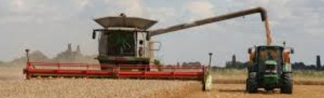
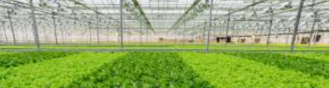
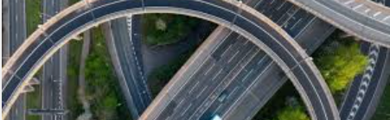


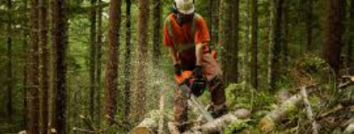
Land Based Organisations 1.1.1
What is land based? Who makes the laws? Who protects it? Who is driving sustainable land use forward? Where does the money come from?
DEFRA – UK Government Department for the Environment, Food and Rural Affairs
 | Protects biodiversity by designating SSSI (sites of special scientific interest.) They encourage farmers to look after biodiversity through ELMS (Environmental Land Management Scheme) subsidy. Land owners can gain grants to restore and maintain habitats
 | Are responsible for; Protecting land against flooding Protecting animal health and welfare on farms Protecting from all forms of pollution – air, water and land. Can fine farmers if they break regulations on any of the above.
 | Created in 1919 after the WWI to re-grown the nations timber supply. Timber is a slow crop to grow therefore Forestry England (or Commission) also have secondary remit of providing places for adventure sport and leisure. E.g Moors Valley Park.
Non-Government Organisations - Charities
 | RSPB will provide farmers with free surveys of their farmland to identify habitat areas for birds. Farmers can then use these surveys for evidence when they claim subsidies through Natural England’s ELMS. They give advice on how to manage farmland hedgerows for wildlife, from their value and history to upkeep and maintenance.
 | Were formed to look after places of historic interest and natural beauty for the benefit of everyone. That includes nearly 260,000 hectares of land in UK – biggest land owner other than the King. Spearheading sustainable farming approaches.
 | .Farms on the RSPCA Assured scheme are assessed and monitored regularly to ensure all the animals are raised to the RSPCA's strict higher welfare standards. They can launch an investigation An investigation is launched every time RSPCA Assured receives a complaint or is made aware of potential welfare issues on one of its member sites. These could be made by farm workers, other animal welfare organisations, RSPCA Assured Assessors or members of the public.
Land Based Sectors – more than farming
Agriculture | Horticulture | Infrastructure | Adventure, Sport & Leisure | Energy Production | Forestry
Agriculture is split into arable (crop) and livestock (animal) farming. 70% of UK land is covered by agriculture. Worth £7.2 billion in 2022. The total croppable area saw little change and was 6.1 million hectares. The total labour force on commercial holdings decreased by 1.7% and was 462 thousand people. | Commercial horticulture is the growing of fruit, vegetables and ornamental flowers The horticultural sector is worth over £5 billion to the UK economy. In 2022, UK home-produced fruit was worth just over £1 billion, while vegetables were worth £1.8 billion. Horticulture contributes significantly to food security, however the UK produces only 17% of its fruit and 55% of its vegetable supply, | Infrastructure is the backbone of the country. It is the set of facilities and systems that serve a country, city, or other area, and encompasses the services and facilities necessary for its economy, households and to businesses to function. Infrastructure is composed of public and private physical structures such as roads, bridges, energy supply, internet and communications supply. | The United Kingdom is the largest adventure tourism market in Europe, according to the World Tourism Organization, with 19% of the world's adventure travel tourists. A recent Visit Britain survey concluded that 40% of British tourists prefer sports and active holidays. Also includes animal health and welfare, wildlife conservation and the game, shooting and fishing industries. | UK is transitioning away from fossil fuels to renewable sources. In 2024 43% of energy was from, renewable sources coming from a mix of wind, solar, bioenergy and hydroelectric sources. Burning fossil fuels to create electricity has long been a major contributor in the emission green house gasses. into our atmosphere. UK Government is promising zero-carbon by 2035. | The area of woodland in the United Kingdom at 31 March 2023 is estimated to be 3.25 million hectares. Wood products imported into the UK in 2022 were valued at £10.7 billion . Average employment in 2021 of 20 thousand in forestry, 8 thousand in sawmilling and 5 thousand in panel mills. The UK was the third-largest net importer (imports less exports) of forest products in 2021, behind China and the USA.

