Slide 1


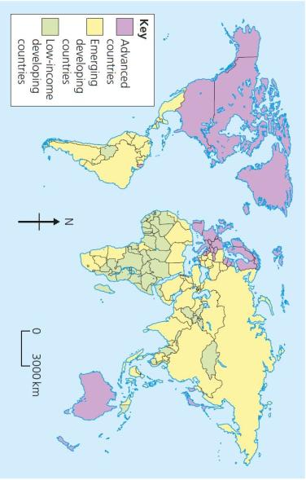











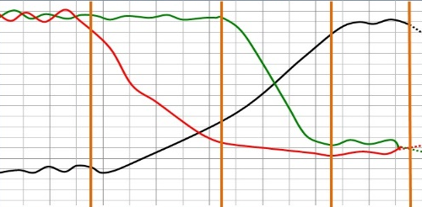
What is development?
Development is an improvement in living standards through better use of resources.
Economic | This is progress in economic growth through levels of industrialisation and use of technology.
Social | This is an improvement in people’s standard of living. For example, clean water and electricity.
Environmental | This involves advances in the management and protection of the environment.
Variations in the level of development
LICs | Poorest countries in the world. GNI per capita is low and most citizens have a low standard of living.
NEEs | These countries are getting richer as their economy is progressing from the primary industry to the secondary industry. Greater exports leads to better wages.
HICs | These countries are wealthy with a high GNI per capita and standards of living. These countries can spend money on services.
Human factors affecting uneven development
Aid | Trade
Aid can help some countries develop key projects for infrastructure faster. Aid can improve services such as schools, hospitals and roads. Too much reliance on aid might stop other trade links becoming established. | Countries that export more than they import have a trade surplus. This can improve the national economy. Having good trade relationships. Trading goods and services is more profitable than raw materials.
Education | Health
Education creates a skilled workforce meaning more goods and services are produced. Educated people earn more money, meaning they also pay more taxes. This money can help develop the country in the future. | Lack of clean water and poor healthcare means a large number of people suffer from diseases. People who are ill cannot work so there is little contribution to the economy. More money on healthcare means less spent on development.
Politics | History
Corruption in local and national governments. The stability of the government can effect the country’s ability to trade. Ability of the country to invest into services and infrastructure. | Colonialism has helped Europe develop, but slowed down development in many other countries. Countries that went through industrialisation a while ago, have now develop further.
Measuring development
These are used to compare and understand a country’s level of development.
Economic indictors examples
Employment type | The proportion of the population working in primary, secondary, tertiary and quaternary industries.
Gross Domestic Product per capita | This is the total value of goods and services produced in a country per person, per year.
Gross National Income per capita | An average of gross national income per person, per year in US dollars.
Social indicators examples
Infant mortality | The number of children who die before reaching 1 per 1000 babies born.
Literacy rate | The percentage of population over the age of 15 who can read and write.
Life expectancy | The average lifespan of someone born in that country.
Mixed indicators
Human Development Index (HDI) | A number that uses life expectancy, education level and income per person.
Causes of uneven development
Development is globally uneven with most HICs located in Europe, North America and Oceania. Most NEEs are in Asia and South America, whilst most LICs are in Africa. Remember, development can also vary within countries too.
Unit 2b
The Changing Economic World
Physical factors affecting uneven development
Natural Resources | Natural Hazards
Fuel sources such as oil. Minerals and metals for fuel. Availability for timber. Access to safe water. | Risk of tectonic hazards. Benefits from volcanic material and floodwater. Frequent hazards undermines redevelopment.
Climate | Location/Terrain
Reliability of rainfall to benefit farming. Extreme climates limit industry and affects health. Climate can attract tourists. | Landlocked countries may find trade difficulties. Mountainous terrain makes farming difficult. Scenery attracts tourists.
Consequences of Uneven Development
Levels of development are different in different countries. This uneven development has consequences for countries, especially in wealth, health and migration.
Wealth | People in more developed countries have higher incomes than less developed countries.
Health | Better healthcare means that people in more developed countries live longer than those in less developed countries.
Migration | If nearby countries have higher levels of development or are secure, people will move to seek better opportunities and standard of living.
The Demographic Transition Model
The demographic transition model (DTM) shows population change over time. It studies how birth rate and death rate affect the total population of a country. |  | STAGE 1 | STAGE 2 | STAGE 3 | STAGE 4 | STAGE 5
 |  | High DR High BR Steady | BR Low Declining DR Very High | Rapidly falling DR Low BR High | Low DR Low BR Zero | Slowly Falling DR Low BR Negative
 |  | e.g. Tribes | e.g. Kenya | e.g. India | e.g. UK | e.g. Japan

Slide 2




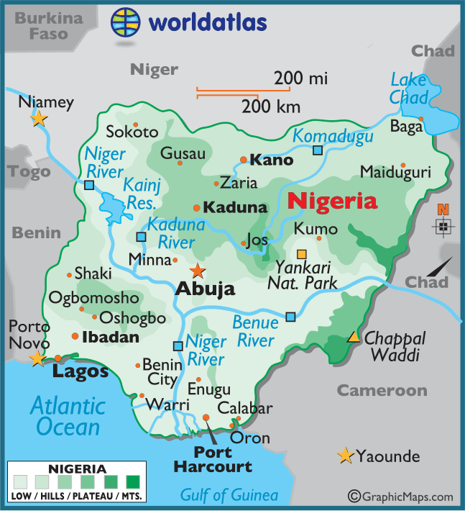
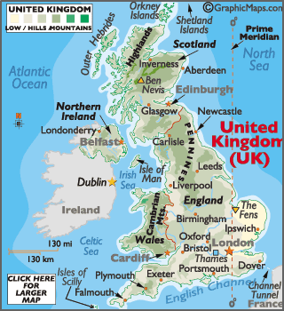













Reducing the Global Development Gap
Microfinance Loans This involves people in LICs receiving smalls loans from traditional banks. + Loans enable people to begin their own businesses - Its not clear they can reduce poverty at a large scale. | Foreign-direct investment This is when one country buys property or infrastructure in another country. + Leads to better access to finance, technology & expertise. - Investment can come with strings attached that country’s will need to comply with.
Aid This is given by one country to another as money or resources. + Improve literacy rates, building dams, improving agriculture. - Can be wasted by corrupt governments or they can become too reliant on aid. | Debt Relief This is when a country’s debt is cancelled or interest rates are lowered. + Means more money can be spent on development. - Locals might not always get a say. Some aid can be tied under condition from donor country.
Fair trade This is a movement where farmers get a fair price for the goods produced. + Paid fairly so they can develop schools & health centres. -Only a tiny proportion of the extra money reaches producers. | Technology Includes tools, machines and affordable equipment that improve quality of life. + Renewable energy is less expensive and polluting. - Requires initial investment and skills in operating technology
Case Study: Economic Development in Nigeria
Location & Importance
Nigeria is a NEE in West Africa. Nigeria is just north of the Equator and experiences a range of environments. Nigeria is the most populous and economically powerful country in Africa. Economic growth has been base on oil exports.
Influences upon Nigeria's development
Political | Social
Suffered instability with a civil war between 1967-1970. From 1999, the country became stable with free and fair elections. Stability has encouraged global investment from China and USA. | Nigeria is a multi-cultural, multi-faith society. Although mostly a strength, diversity has caused regional conflicts from groups such as the Boko Haram terrorists.
Cultural | Industrial Structures
Nigeria’s diversity has created rich and varied artistic culture. The country has a rich music, literacy and film industry (i.e. Nollywood). A successful national football side. | Once mainly based on agriculture, 50% of its economy is now manufacturing and services. A thriving manufacturing industry is increasing foreign investment and employment opportunities.
The role of TNCs | Changing Relationships
TNCs such as Shell have played an important role in its economy. + Investment has increased employment and income. - Profits move to HICs. - Many oil spills have damaged fragile environments. | Nigeria plays a leading role with the African Union and UN. Growing links with China with huge investment in infrastructure. Main import includes petrol from the EU, cars from Brazil and phones from China.
Environmental Impacts | Aid & Debt relief
The 2008/09 oil spills devastated swamps and its ecosystems. Industry has caused toxic chemicals to be discharged in open sewers - risking human health. 80% of forest have been cut down. This also increases CO² emissions. | + Receives $5billion per year in aid. + Aid groups (ActionAid) have improved health centres, provided anti-mosquito nets and helped to protect people against AIDS/HIV. - Some aid fails to reach the people who need it due to corruption.
Effects of Economic Development
Life expectancy has increased from 46 to 53 years. 64% have access to safe water. Typical schooling years has increased from 7 to 9.
Case Study: Economic Change in the UK
UK in the Wider World
The UK has one of the largest economies in the world. The UK has huge political, economic and cultural influences. The UK is highly regarded for its fairness and tolerance. The UK has global transport links i.e. Heathrow and the Eurostar.
Causes of Economic Change | Towards Post-Industrial
De-industrialisation and the decline of the UK’s industrial base. Globalisation has meant many industries have moved overseas, where labour costs are lower. Government investing in supporting vital businesses. | The quaternary industry has increased, whilst secondary has decreased. Numbers in primary and tertiary industry has stayed the steady. Big increase in professional and technical jobs.
Developments of Science Parks | CS: UK Car Industry
Science Parks are groups of scientific and technical knowledge based businesses on a single site. Access to transport routes. Highly educated workers. Staff benefit from attractive working conditions. Attracts clusters of related high-tech businesses. | Every year the UK makes 1.5 million cars. These factories are owned by large TNCs. i.e. Nissan. 7% of energy used there factories is from wind energy. New cars are more energy efficient and lighter. Nissan produces electric and hybrid cars.
Change to a Rural Landscape
Social | Economic
Rising house prices have caused tensions in villages. Villages are unpopulated during the day causing loss of identity. Resentment towards poor migrant communities. | Lack of affordable housing for local first time buyers. Sales of farmland has increased rural unemployment. Influx of poor migrants puts pressures on local services.
Improvements to Transport | UK North/South Divide
A £15 billion ‘Road Improvement Strategy’. This will involve 10 new roads and 1,600 extra lanes. £50 billion HS2 railway to improve connections between key UK cities. £18 billion on Heathrow’s controversial third runway. UK has many large ports for importing and exporting goods. | - Wages are lower in the North. - Health is better in the South. - Education is worse in the North. + The government is aiming to support a Northern Powerhouse project to resolve regional differences. + More devolving of powers to disadvantaged regions.
CS: Reducing the Development Gap In Jamaica
Location and Background
Jamaica is a LIC island nation part of the Caribbean. Location makes Jamaica an attractive place for visitors to explore the tropical blue seas, skies and palm filled sandy beaches
Tourist economy | Multiplier effect
-In 2015, 2.12 million visited. -Tourism contributes 27% of GDP and will increase to 38% by 2025. -130,000 jobs rely on tourism. -Global recession 2008 caused a decline in tourism. Now tourism is beginning to recover. | -Jobs from tourism have meant more money has been spent in shops and other businesses. -Government has invested in infrastructure to support tourism. -New sewage treatment plants have reduced pollution.
Development Problems
Tourists do not always spend much money outside their resorts. Infrastructure improvements have not spread to the whole island. Many people in Jamaica still live in poor quality housing and lack basic services such as healthcare.

