Slide 1

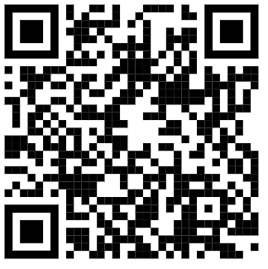
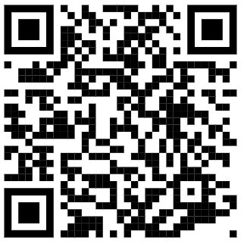
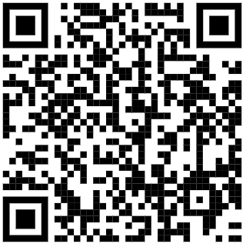
GCSE English Unseen Poetry
Language
 | Alliteration | Repeated first letter across a number of words.
 | Assonance | Repeated vowel sound across a number of words.
 | Consonance | Repeated consonant sound across a number of words.
 | Colloquial Language | Casual, informal language.
 | Emotive | Appeals to your emotions.
 | Extended Metaphor | A metaphor that unfolds across multiple lines or even paragraphs.
 | Half Rhyme | Nearly rhymes.
 | Hyperbole | Exaggeration
 | Imagery | Something used to describe something else.
 | Internal Rhyme | Rhyme that is on the same line of the poem.
 | Metaphor | Something is described as being something else to draw on a comparison between the two.
 | Mood | The atmosphere of the text.
 | Onomatopoeia | A verb that sounds like the sound it makes.
 | Personification | A non-human thing is given human qualities.
 | Plosive Letters | p/t/k/b/d/g.
 | Rhyme | Words that sound the same often found at the end of poetry lines.
 | Semantic Field | Words that are about or linked to the same thing/theme.
 | Sibilance | A repeated ‘s’ sound.
 | Simile | A comparison is made between two things using the words ‘like’ or ‘as’.
 | Symbolism | Some representing something else.
 | Tone | The emotions / feelings coming from the text/poem.
Structure
Form
Assessment Objectives
Chronological | In order of time.
Caesura | A break in the middle of a line.
Enjambment | A sentence runs over more than one line.
Iambic Pentameter | 5 sets of unstressed/stressed beats in a line.
Juxtaposition | Deliberately placing two things together to create a contrasting effect.
Layout | Position of lines/words/stanzas on a page.
Anaphora | Repeated first few words at the start of lines.
Oxymoron | Two opposite words next to each other.
Rhyme scheme | The organisation of the rhyme.
Rhyming couplet | Two lines that rhyme next to each other.
Stanza | A verse in a poem.
Volta | The turning point of a poem (usually a sonnet).
Repetition | Something appears more than once.
Autobiographical | The poem is about the poet.
Ballad | Story poem - often organised into four-line stanzas.
Blank verse | Verse with no rhyme.
Dramatic monologue | A character speaks to the reader.
Free verse | A poem with no regular rhyme or rhythm.
Lyrical | Emotional or beautiful.
Narrative | A story.
Rhetoric | Persuasive.
Sonnet | 14 lined poem.
Assessment Objective 1:
What is AO1?
What are the key ingredients of an answer that responds well to AO1?
Assessment Objective 2:
What is AO2?
What are the key ingredients of an answer that responds well to AO2?
Example Questions
Key Skills
Sample Questions:
Question 1: In ‘To a Daughter Leaving Home’, how does the poet present the speaker’s feelings about her daughter? (24 marks)
Question 2: In both ‘Poem for My Sister’ and ‘To a Daughter Leaving Home’ the speakers describe feelings about watching someone
they love grow up. What are the similarities
and/or differences between the ways the poets present those feelings? (8 marks)
Question 1 — 30 minutes
Question 2 — 15 minutes
STEP 1: read and highlight key words in the question.
STEP 2: read and annotate the first poem. Use the reading strategies covered in class. For example, find the ‘neon’ lines or highlight the verbs.
STEP 3: plan your response
STEP 4: write your answer.

Slide 2
GCSE English Unseen Poetry
Language
What is an extended metaphor?
What is colloquial language?
How might it add to the tone of a poem? Find three examples of simile.
What is a semantic field?
If you were going to use a semantic field of war, what words might you include?
What is the difference between assonance and consonance?
What letters create a plosive sound?
What is rhyme?
What is another word for hyperbole?
What’s the difference between a simile and metaphor?
What is colloquial language? Which poem contains colloquial language?
Can you think of an example of a metaphor from the ‘EDUQAS Anthology’?
Structure
Form
Assessment Objectives
What is chronological order?
What is enjambment? Find an example from a poem you have studied.
What is caesura? Find an example from a poem you have studied?
What is the difference between an oxymoron and juxtaposition?
What is the correct term for when the same words are repeated at the beginning of different lines in a poem?
What is the volta in a sonnet?
What is anaphora?
What is the difference between rhyme scheme and rhythm?
What is a stanza?
What do you think a lyrical ballad is?
What is rhetoric?
Assessment Objective 1:
What is AO1?
What are the key ingredients of an answer that responds well to AO1?
Assessment Objective 2:
What is AO2?
What are the key ingredients of an answer that responds well to AO2?
What is the difference between free verse and blank verse?
Which poem from the‘EDUQAS Anthology’ is written as a dramatic monologue?
A sonnet is a poem of 14 lines. An Italian sonnet consists of two sections with a volta in the middle to show a change in direction. What are the two different sections called?
What type of poems are:
‘Ozymandias’?
‘To Autumn’?
‘Hawk Roosting’?
‘The Manhunt’?
‘Dulce Et Decorum Est’?
FLIRT
Remember to FLIRT with the poem:
Find the meaning.
Language needs to be explored.
Imagery should be considered.
Rhyme, rhythm and structure.
Themes within the poem.
Example Questions
Key Skills
Question 1
What does question 1 test your ability to do?
How many poems will you have to talk about?
How many marks is this question worth?
Question 2
What does question 2 test your ability to do?
How many poems will you have to talk about?
How many marks is this question worth?
What are the four steps to completing a response?
How much time should you spend on question 1?
How much time should you spend on question 2?
How many reading strategies can you identify that will help you annotate the poem?

