Slide 1

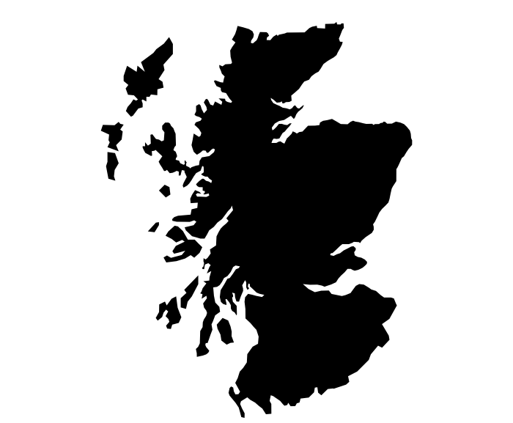

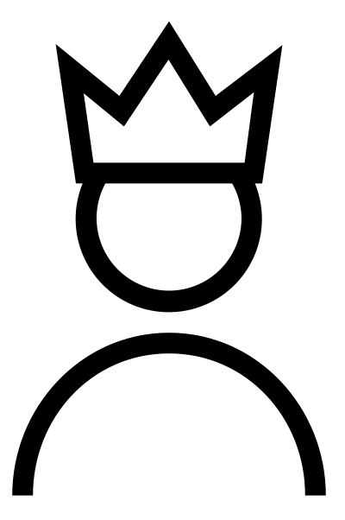
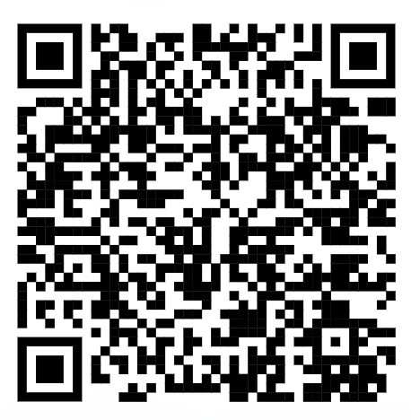







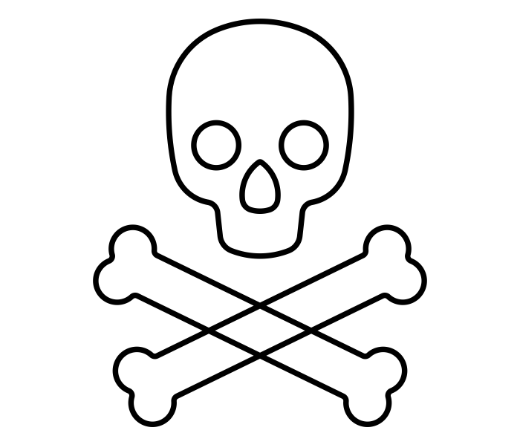
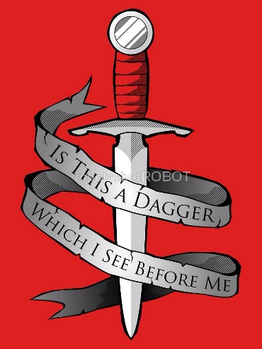
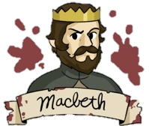
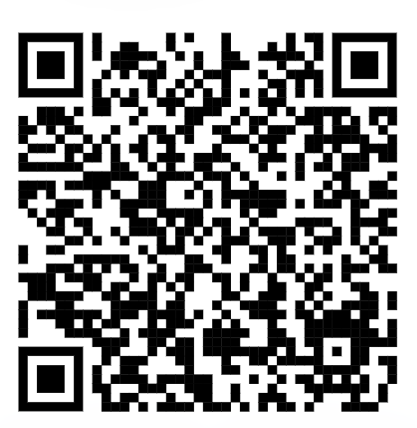
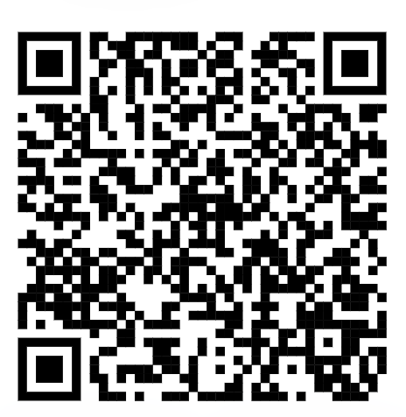
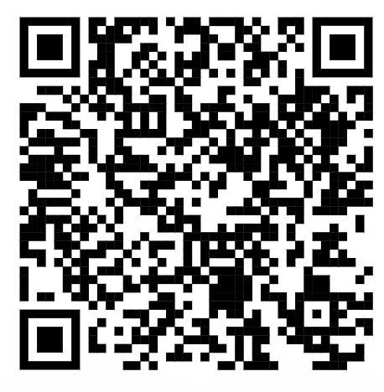
MACBETH
English KO – Year 11 – Autumn 1
Duncan’s son, Malcolm, starts to form an army.
Macbeth visits the witches who give him three prophecies.
A guilt-ridden Lady Macbeth sleepwalks washing her hands of blood and eventually commits suicide.
Three witches meet, talking of a battle and arrange to meet Macbeth.
Macbeth murders King Duncan.
Macbeth has Banquo murdered.
In England, Macduff and Malcolm prepare to invade Scotland.
Malcolm is hailed as the new King of Scotland.
Macbeth and Lady Macbeth plot King Duncan’s murder.
Macbeth is named King.
ACT 1
ACT 2
ACT 3
ACT 4
PLOT
ACT 5
The witches prophesise that Macbeth will be King, and Banquo, father of kings.
Lady Macduff and her children are murdered on Macbeth’s orders.
Battle ensues. Macbeth is killed
The King’s sons flee Scotland.
The ghost of a bloody Banquo
appears to Macbeth.
MAIN CHARACTERS
KEY THEMES
CONTEXT
King James I - James I had been James VI of Scotland before he succeeded to the English throne in 1603. In focusing on Macbeth, a figure from Scottish history, Shakespeare paid homage to his king’s Scottish lineage. Additionally, the witches’ prophecy that Banquo will found a line of kings is a clear nod to James’ family’s claim to have descended from the historical Banquo.
Witchcraft and Daemonologie - King James was convinced that a group of witches were plotting to bring about his death and played an active role in the North Berwick witch trials. He later published Daemonologie in 1597. Charges of witchcraft continued in Great Britain, with Scotland experiencing a number of witch hunt crazes throughout the 17th century.
Gunpowder Plot - failed attempt to assassinate King James I of England during the Opening of Parliament in November 1605.
Macbeth Thane of Glamis: ambitious, courageous, deceitful, impulsive, ruthless, treasonous, tyrannical, zealous
Lady Macbeth his wife: cunning, dominant, emasculating, malevolent, mutinous, powerful, scheming, vulnerable
Banquo Macbeth’s best friend: devoted, intuitive, loyal, trustworthy, virtuous
Duncan King of Scotland: benevolent, faithful, honest, naïve, sincere
Macduff – Thane of Fife: devout, fervent, heroic, merciless, patriotic, unwavering
Malcolm Duncan’s eldest son
Donalbain Duncan’s younger son
Fleance Banquo’s son
Ross, Lennox, Angus Scottish nobles
Weird Sisters (the witches) supernatural beings who predict events in the play: corrupt, ignoble, manipulative, sinister, subversive
Hecate goddess of the witches
KEY WORDS
Scan here for more on…
ambition | A strong desire to do or achieve something
regicide | Murdering a monarch
antithesis | Opposite
malevolent | Having or showing a wish to do evil or harm
patriarchal | A system of society or government controlled by men
hubris | Excessive pride or self-confidence
Character
Themes
Context

Slide 2



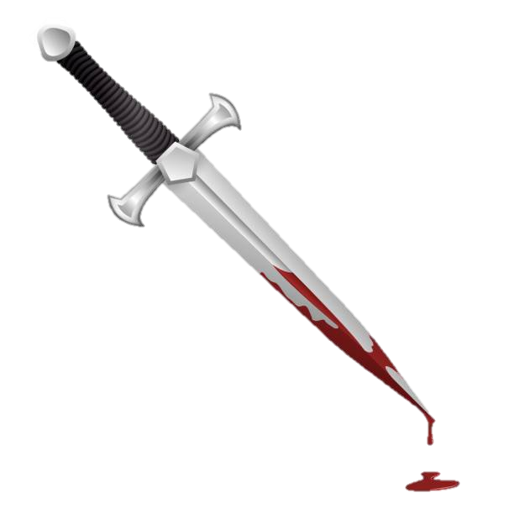
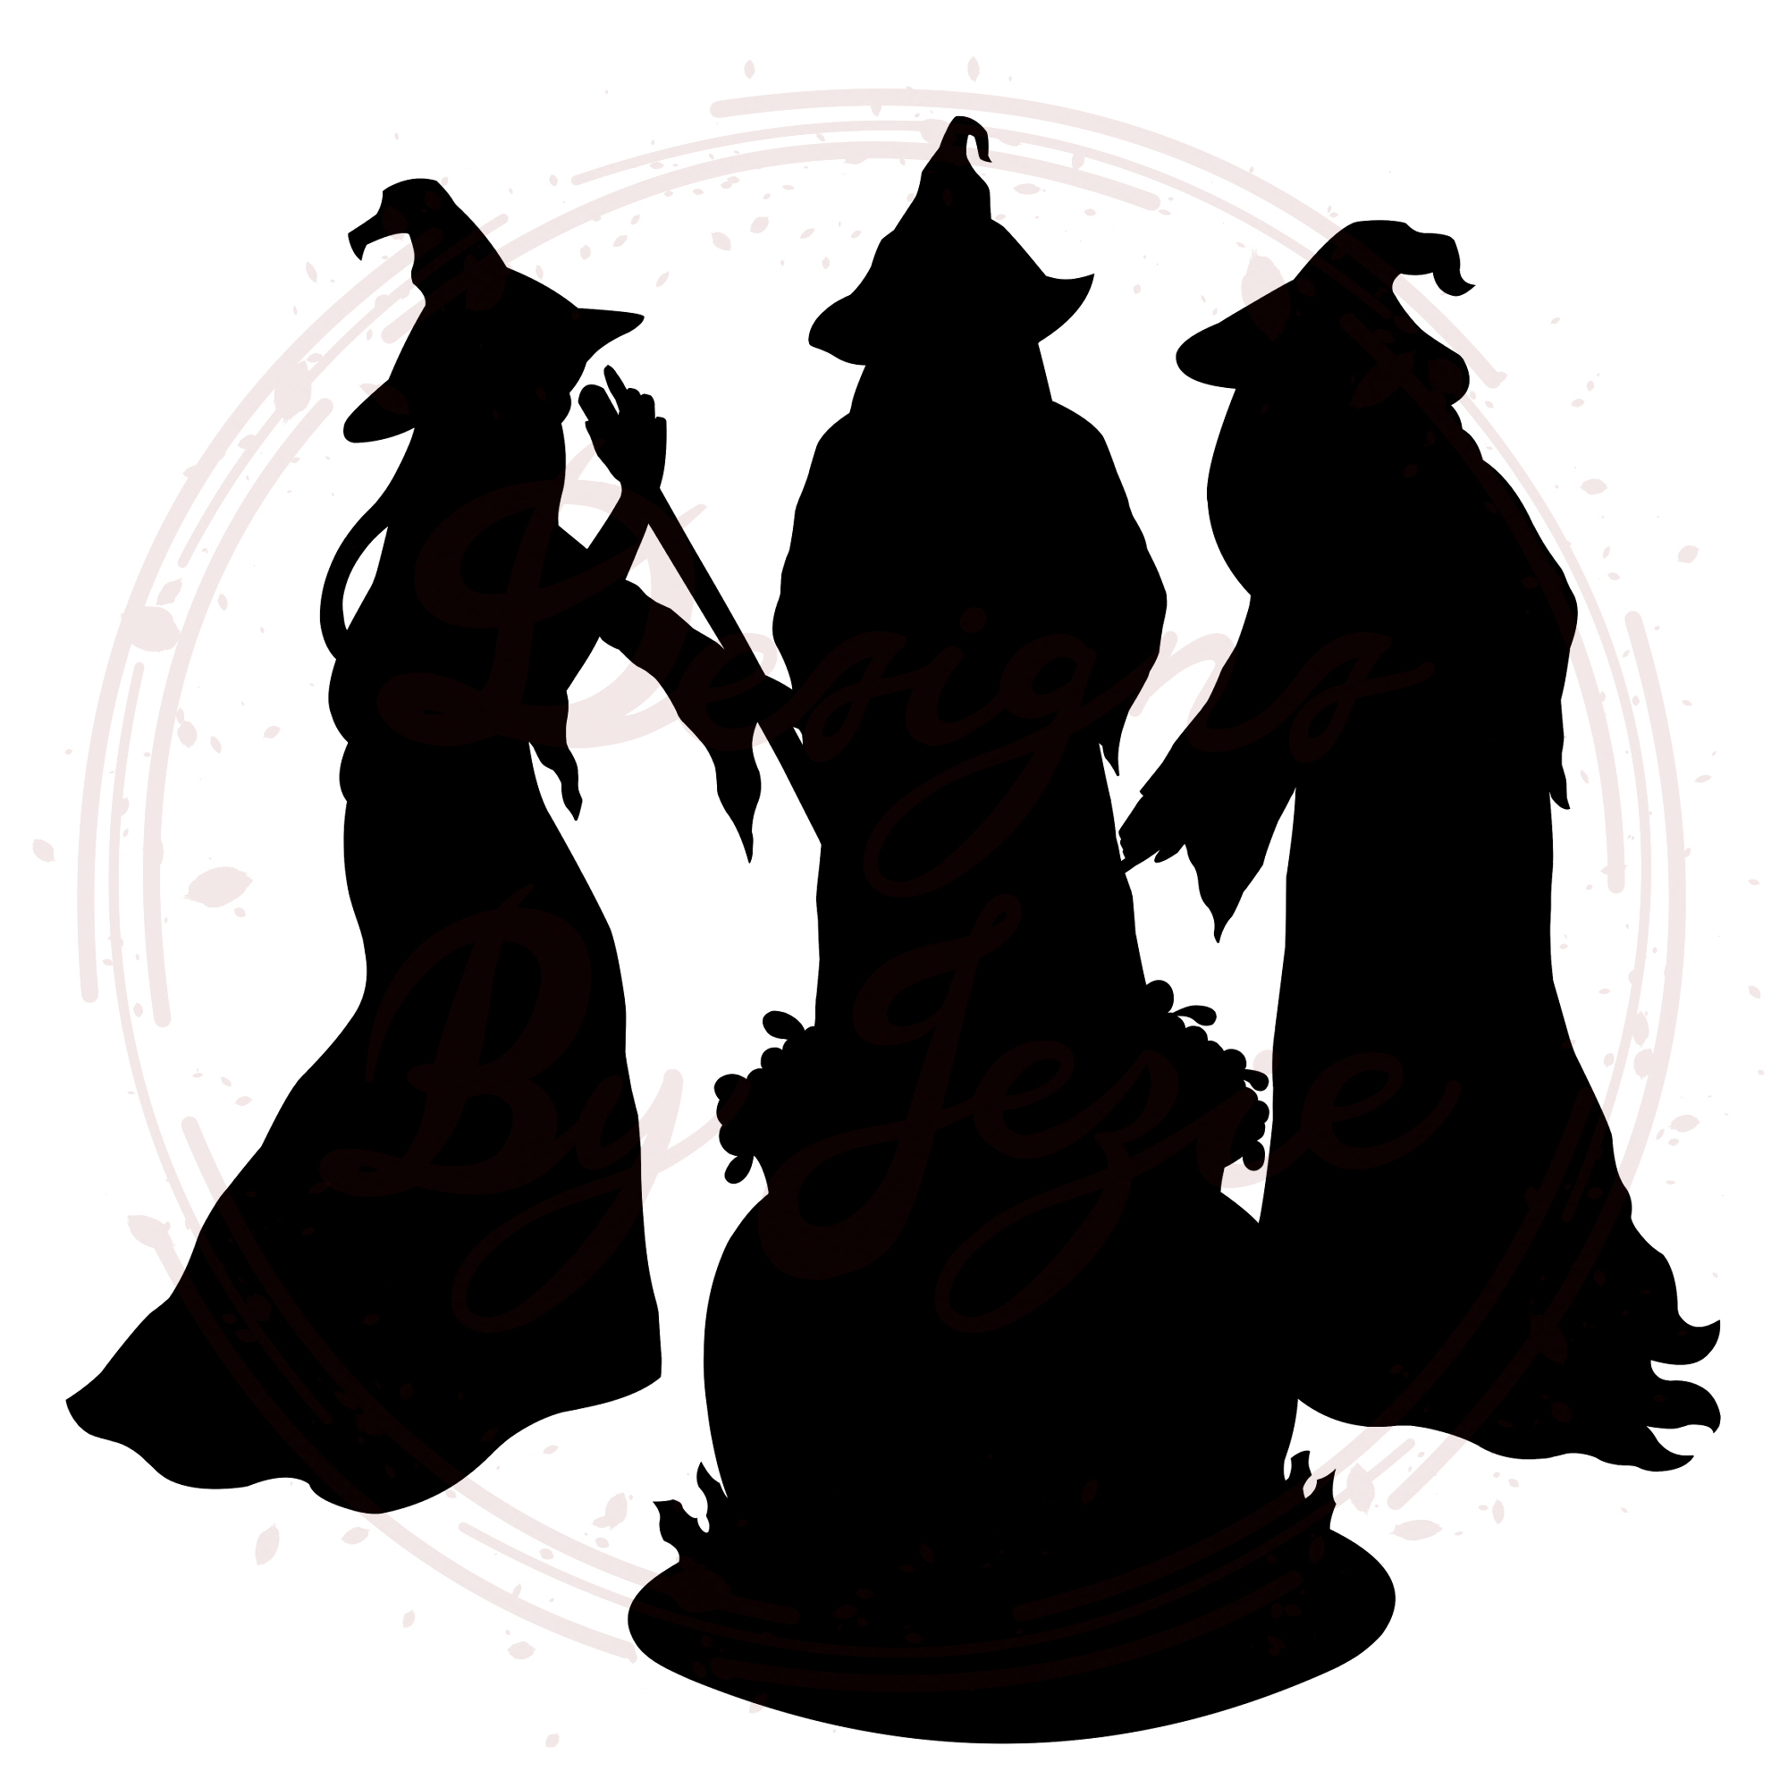

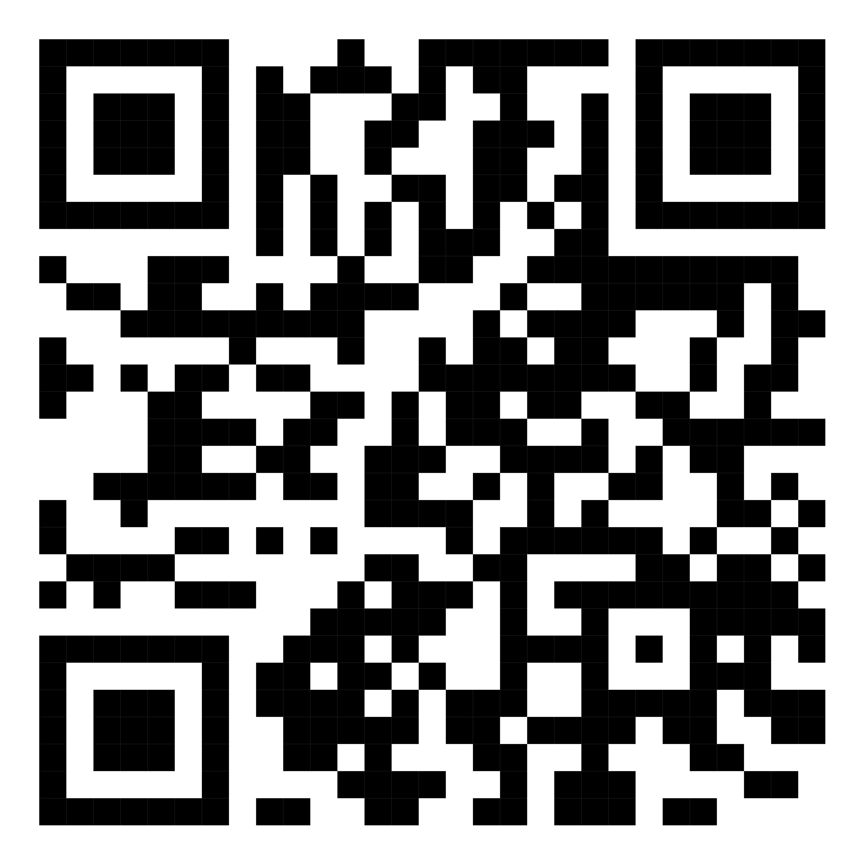
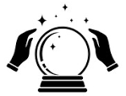

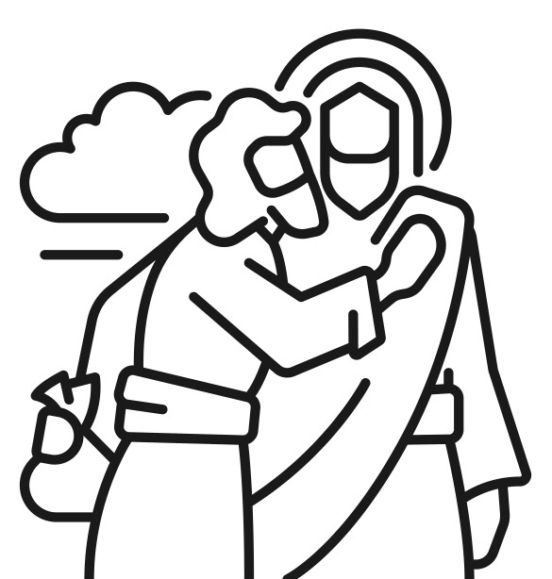
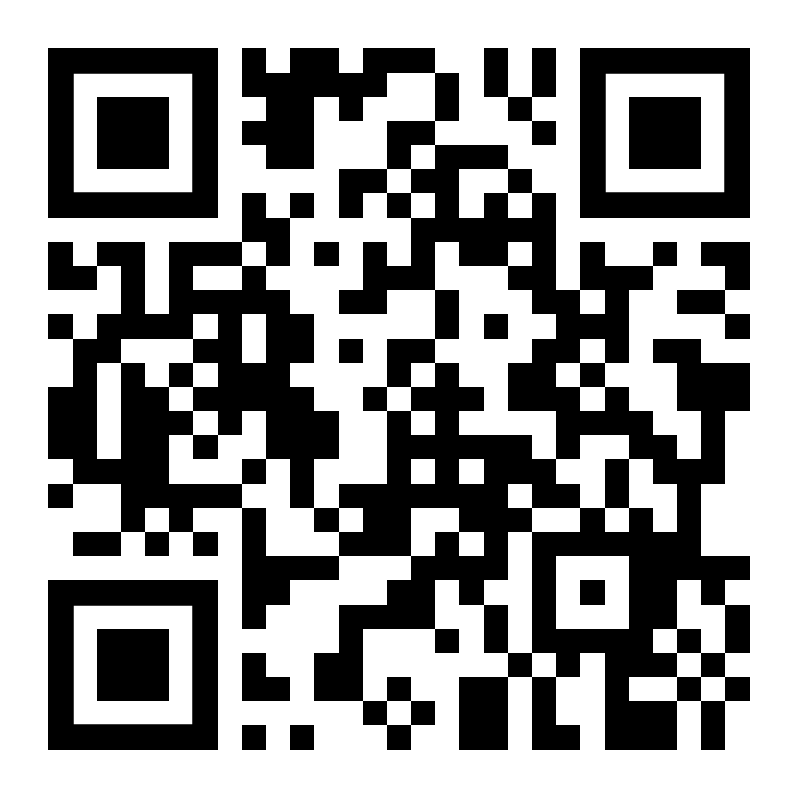
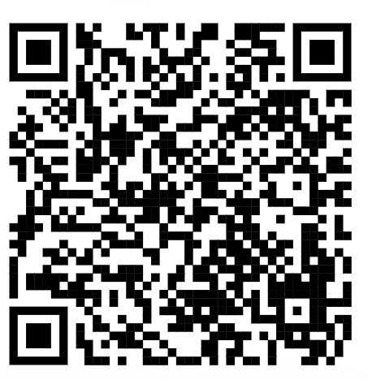



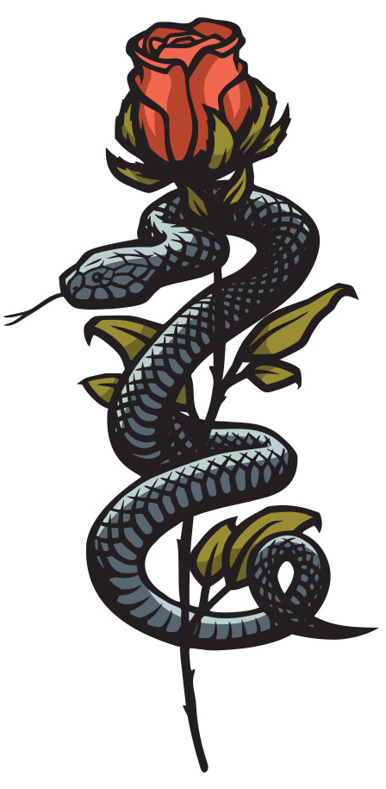
THEMES and QUOTES
Power and Ambition Lady M - 'Glamis thou art, and Cawdor, and shalt be’ Macbeth: “I dare do all that may become a man” Witches: "Be bloody, bold and resolute; laugh to scorn the power of man, for none born of woman shall harm Macbeth." | Violence Lady M: ‘Who would have thought the old man to have so much blood in him?’ Macbeth: ‘My slaughterous thoughts’ Macbeth: 'I'll fight till from my bones my flesh be hacked’ Malcolm: this butcher and his fiend-like queen." | Gender Lady M: ‘Unsex me here/And fill me from the crown to the toe topfull of direst cruelty Lady M: Make thick my blood; / Stop up the access and passage to remorse Lady M: When you durst do it, then you were a man Lady M: "My hands are of your colour, but I shame to wear a heart so white."
The Supernatural Witches: 'Fair is foul and foul is fair.’ Banquo: ‘Can the devil speak true?’ Witches: ‘By the pricking of my thumbs, something wicked this was comes’ | Guilt Macbeth: ‘This is a sorry sight’ Macbeth: ‘I am afraid to think what I have done’ Macbeth: ‘Is this a dagger I see before me? Macbeth: ‘O full of scorpions is my mind’ Lady M: ‘Out damn spot. Out I say!’ | Fate and Freewill Captain: For brave Macbeth (well he deserves that name) / Disdaining Fortune, with his brandished steel Witches: 'All hail, Macbeth, that shalt be king hereafter!’ Macbeth: 'If chance will have me king, why chance may crown me’
HOW TO ANSWER A THEME QUESTION
MACBETH: ANALYTICAL SKILLS
LANGUAGE TECHNIQUES
English KO – Year 11 – Autumn 1.1
Allusion – references to ideas outside of the text e.g. historical events, other literary works or philosophical ideas such as the story of Judas
Light imagery – visually descriptive language referencing light
Metaphor – an image/idea used to represent something else
Motif – an idea or image that runs
throughout a piece of work
Oxymoron – two contradictory terms paired together to make a point
Paradox – a figure of speech that seems contradictory but actually reveals a truth
Religious imagery – visually descriptive language referencing religion
Rhyming couplets – two consecutive lines with the same sound at the end. Used by Shakespeare to show the person speaking is important or powerful
Semantic field – a group of words linked by a theme
Simile – comparison of one
thing to another using ‘like’ or
‘as’
Symbolism – using symbols,
images or ideas to represent qualities
Word play – manipulating words in order to create humour
STRUCTURAL TECHNIQUES
FORM
Dramatic irony – the audience understanding/knowledge is greater than the characters
Foreshadowing – a warning or indication of a future event
Tragedy: a play dealing with tragic events and having an unhappy ending, especially one concerning the downfall of the main character.
CHARACTERISATION/DRAMATIC DEVICES
Archetype – a typical example of a person
Hamartia – a fatal flaw leading to a downfall
Foils – characters that are opposite to exaggerate contrasting qualities
Soliloquy – one character speaking to the audience
Monologue – a long speech by a single character
Peripeteia – sudden reversal of fortune
Anagnorisis - the point in which a principal character recognises or discovers the true nature of their own circumstances.

