Slide 1


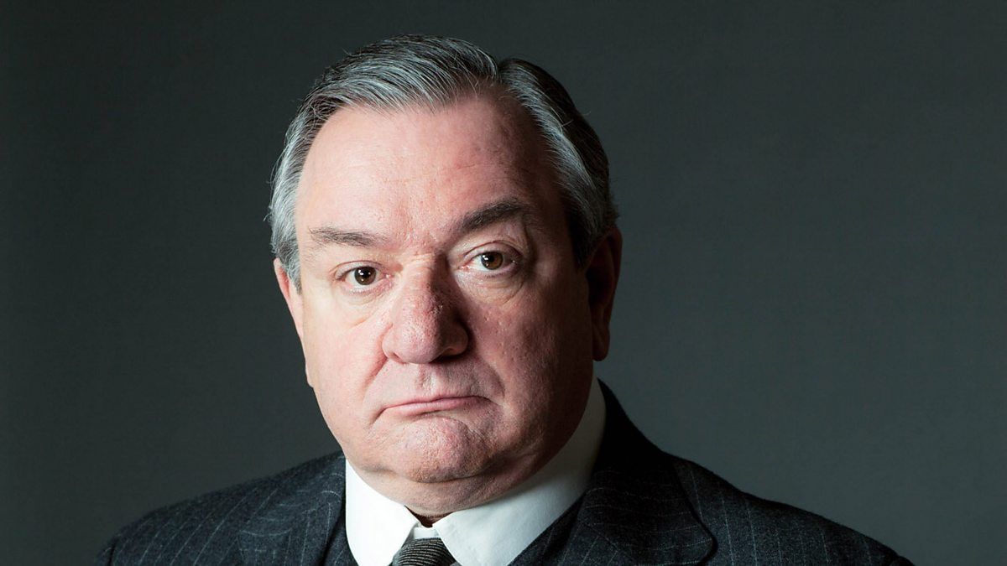
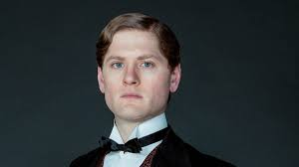
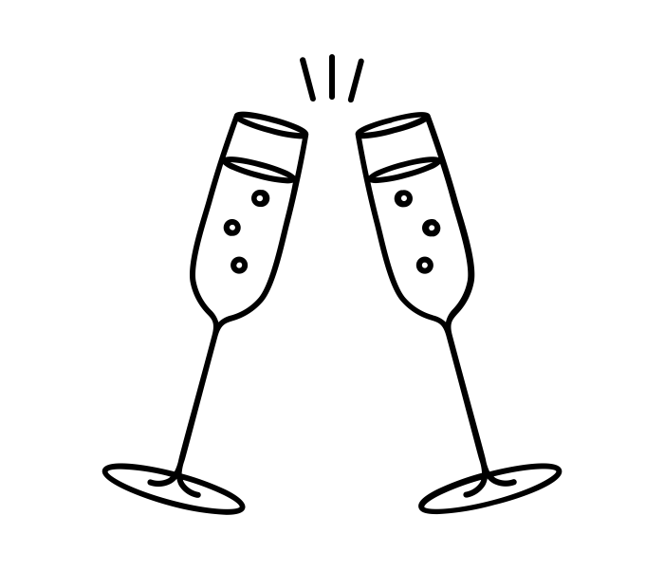





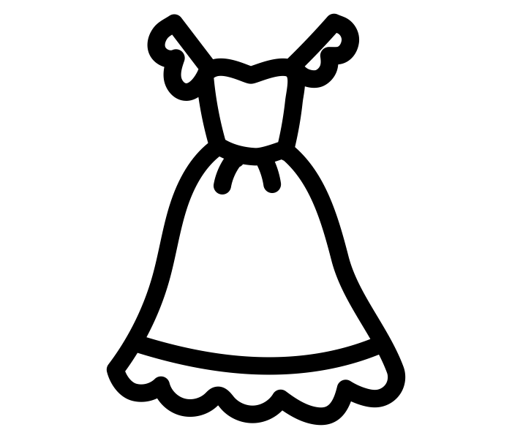
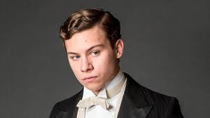
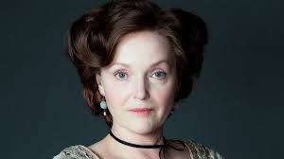

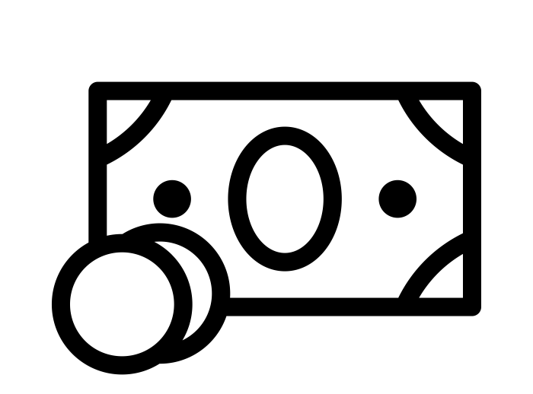
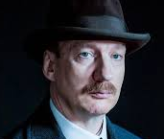
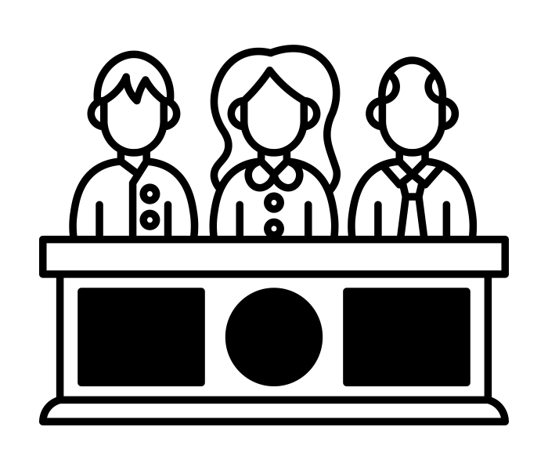
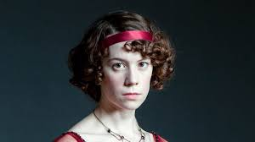







AN INSPECTOR CALLS
English KO – Year 10 – Autumn 1 – 1.0
ACT 1
Mr. Birling – father, factory owner
Capitalistic Egotistical Traditional | Naïve Dogmatic Nouveau riche
‘It’s my duty to keep labour costs down’ ‘Look here, Inspector, I consider this uncalled for and officious’ ‘You all helped kill her’ (pointing at Sheila and Eric and laughing)
Gerald – factory owner, engaged to Sheila
Duplicitious Misogynistic Privileged | Manipulative Charismatic
‘You couldn’t have done anything else.’ ‘I didn’t feel about her as she felt about me’ ‘Everything’s all right now, Sheila. What about this ring?’
HOW TO STRUCTURE A CHARACTER QUESTION
Engagement toast
Inspector enters
Mr. Birling interviewed
Sheila interviewed
Mrs. Birling – mother, charity chair
Defensive Callous Condescending | Hypocritical Judgemental
‘a rather cold woman’ ‘girls of that class’ ‘They’re overtired. In the morning they’ll be as amused as we are’
Eric - son
Insecure Impulsive Secretive | Regretful Repentant
Half shy, half assertive ‘Why shouldn’t they try for higher wages?’ ‘I was in that state where a chap easily turns nasty’
STRUCTURAL TECHNIQUES
ACT 2
Form:
Morality play – an allegorical drama teaching a lesson or moral
Naturalistic setting – close to reality
Stage directions – instructions to the actors and director from the playwright
‘Well made’
play
Structure:
Cyclical structure – conditions at the end are the same as at the beginning
Dramatic irony – the audience understanding/knowledge is greater than the characters
Foreshadowing – a warning or indication of a future event
‘One line of enquiry at a time’
Gerald interviewed
PLOT
Sheila returns engagement ring
Inspector Goole – police inspector (?)
Omnisicient Enigmatic Authoritative | Tenacious Unconventional
‘need not be a big man but he creates at once an impression of massiveness’ ‘It’s my duty to ask questions.’ ‘If man will not learn that lesson he will be taught it in fire and blood and anguish. Goodnight’
Mrs. Birling interviewed
Sheila – daughter, engaged to Gerald
Contrite Progressive Reflective | Perceptive Socialist
‘Oh Mummy – look – isn’t it a beauty?’ ‘I’ll never, never do it again. I’m desperately sorry’ ‘It frightens me the way you talk’
ACT 3
Eric interviewed
Inspector’s final speech
Eva Smith
Oppressed Courageous Hardworking | Vulnerable Resilient
‘pretty’ ‘a good worker… he was ready to promote her’ ‘country-bred’
Characterisation:
Foils – characters that are opposite to exaggerate contrasting qualities
Caricature – a deliberately exaggerated image or idea
Counter stereotype – reversing an established view of someone or something
Absent/silent characters – characters not represented on stage
Monologue – a character talking alone and uninterrupted
Sentence fragments – parts of sentences that are incomplete
Phone calls to police and infirmary
Celebrate
Phone rings
CHARACTERS and QUOTES

Slide 2





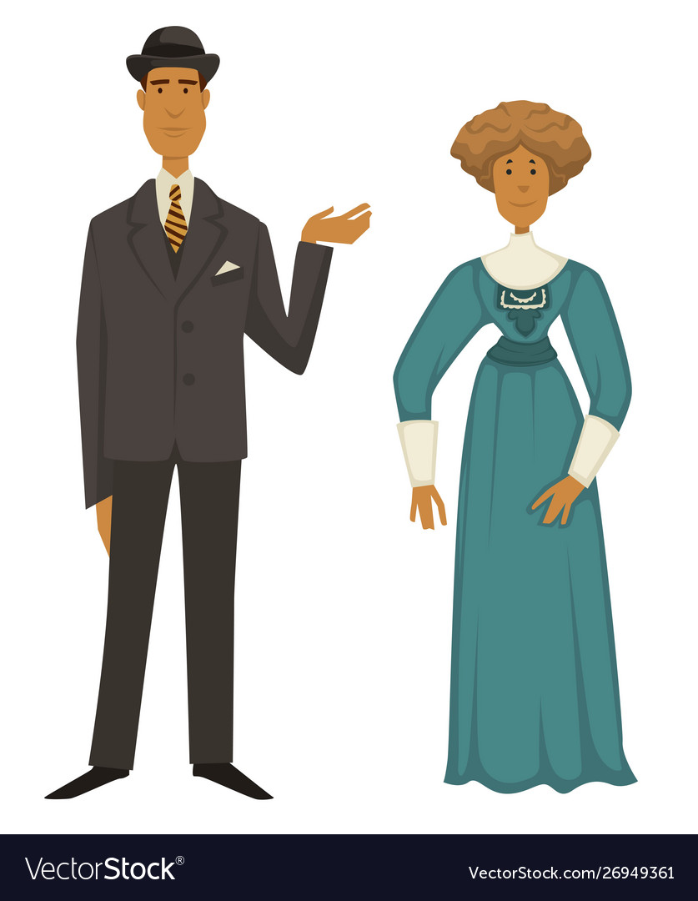

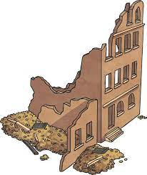

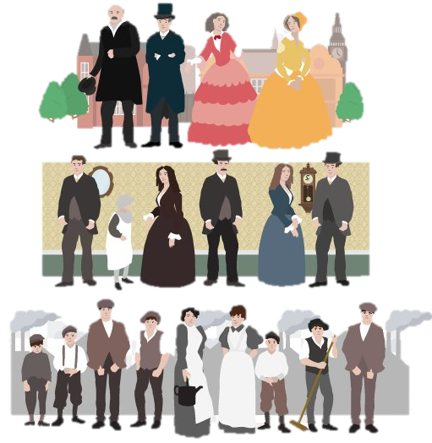
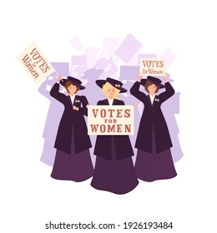
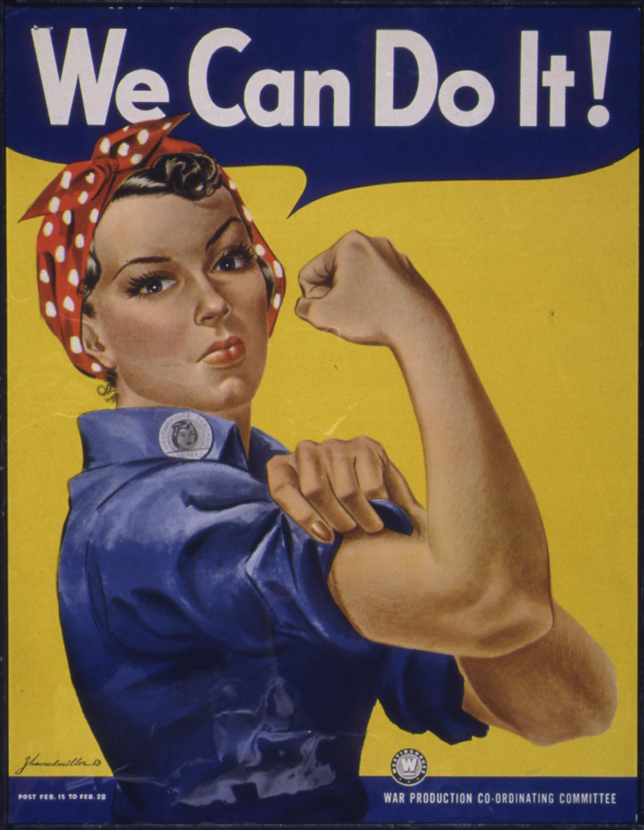
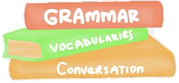
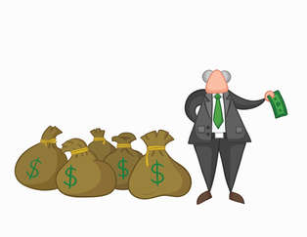

THEMES and QUOTES
Responsibility Mr. B – ‘all mixed up together like bees in a hive… community and all that nonsense’ Inspector – ‘one Eva Smith has gone but there are millions and millions and millions of Eva Smiths and John Smiths left with us’ Eric - ‘You lot might be letting yourselves out nicely but I can’t.’ | Power Mrs. B – ‘I used my influence to have it refused. I did my duty’ Eric – ‘I insisted – it seems… I threatened to make a row.’ Inspector - ‘public men, Mr. Birling, have responsibilities as well as privileges’ | Gender Mrs. B – ‘Now Sheila… when you’re married you’ll realise that men with important work to do sometimes have to spend nearly all their time and energy on their business’ Sheila – ‘Is it the one you wanted me to have?’ Sheila – ‘You were the wonderful Fairy Prince. You must have adored it, Gerald.’
Class Mr. B – ‘Edna’ll answer it.’ Mr. B – ‘Perhaps I ought to warn you that he [the Chief Inspector] is an old friend of mine. We play golf together.’ Mrs. B – ‘As if a girl of that sort would ever refuse money.’ | Generational divide Mr. B – ‘Now you three young people, just listen to this, and remember what I’m telling you’ Eric - ‘Because you’re not the kind of father a chap can go to when he’s in trouble.’ Mr. B – ‘… - the famous younger generation who know it all. And they can’t even take a joke – (the telephone rings) | Public vs. private Gerald - ‘it’s a favourite haunt of women of the town’ Sheila – ‘…everybody knows about that horrible old Meggarty’ Mr. B – ‘… the difference between a lot of stuff like this coming out in private and a downright public scandal’
HOW TO ANSWER A THEME QUESTION
LANGUAGE TECHNIQUES
SOCIAL AND HISTORICAL CONTEXT
Colloquialism – informal expression, slang term
Declarative – a sentence expressing a statement
Emotive language – a word choice used to evoke emotion
Exclamative – a sentence denoting exclamation
Euphemism – mild or indirect expression when referring to something harsh or unpleasant
Imagery – visually descriptive language
Interrogative – a sentence that asks a question
Irony – the opposite of what is actually true
Metaphor – an image/idea used to represent something else
Modal verbs – a verb indicating likelihood or possibility
Opinions as facts
Pronouns – words used in place of nouns
Repetition – saying something more than once
Rhetoric – persuasive language, usually political
Semantic field – a group of words linked by a theme
Stereotype – a fixed or oversimplified image of a person or thing
Symbolism – using symbols, images or ideas to represent qualities
1912 – the world of the play | 1946 – the world of the audience
Edwardian period and Belle Epoque Peace, prosperity and advancement e.g. Titanic Rigid social hierarchy Aristocracy Upper class Middle class Working class Patriarchal society Beginning of suffrage movement Capitalist ideology | Post World War II Rebuilding after two wars Class divisions changing Evacuation Trench warfare Greater equality for women Role in war Move towards socialist ideology Welfare state

