Slide 1


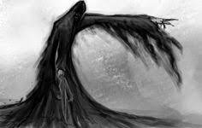
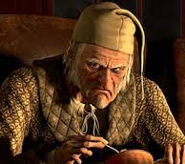
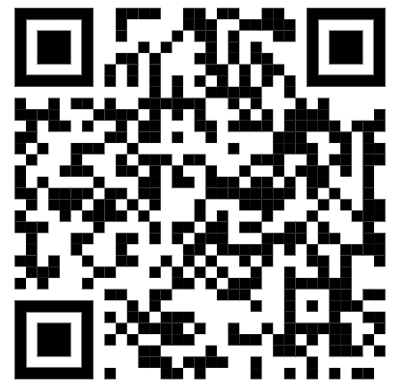
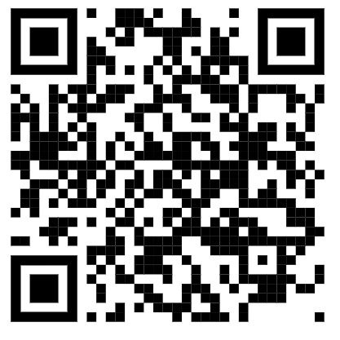
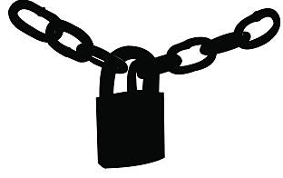

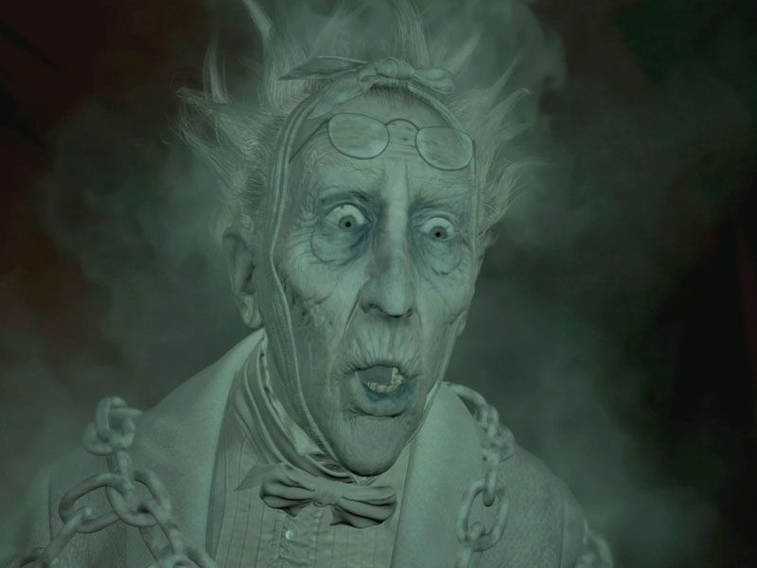
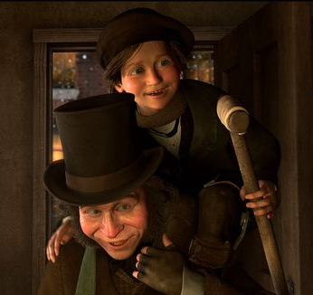

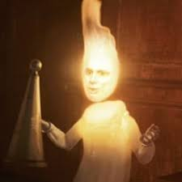

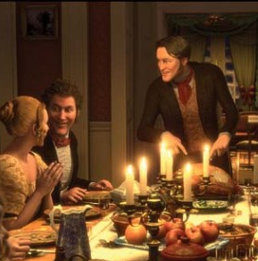


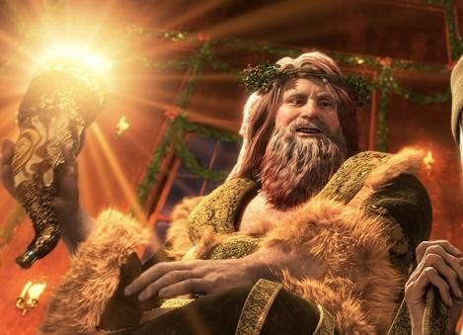


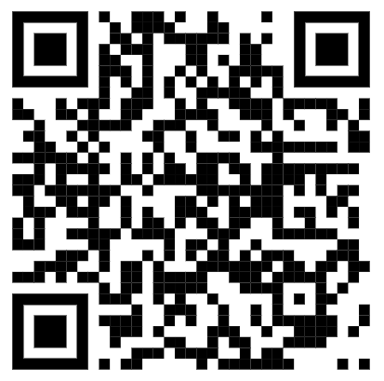
‘A CHRISTMAS CAROL’
English KO – Year 10 and 11
Stave 1
Scrooge at work in his counting house.
Refuses Fred’s invitation
Insults the Charity collectors
Jacob Marley’s visit
Ebenezer Scrooge
Avaricious Misanthropic Isolated | Obstinate Transformed Philanthropic
‘squeezing, wrenching, grasping, scraping, clutching, covetous old sinner’ ‘As solitary as an oyster’ ‘As light as a feather, as happy as an angel’
Ghost of Christmas Yet to Come
Enigmatic Ominous | Silent Commanding
‘a solemn Phantom, draped and hooded, coming, like a mist along the ground, towards him.’ ‘the Ghost pointed with an unmoved finger […] upon the stone of the neglected grave his own name, Ebenezer Scrooge’
CHARACTER ANALYSIS
Scrooge
Ghosts
Stave 2
The Ghost of Christmas past…
Sat alone as a schoolboy
Fezziwig’s party
Belle ends their
engagement
Scrooge extinguishes
the light from the ghost.
Jacob Marley
Penitent Reformed | Remorseful Prophetic
‘I wear the chain I forged in life’ ‘The chain was made up of cash boxes.. ledgers.. heavy purses’ ‘Mankind was my business!’
The Cratchits
Grateful Content | Hardworking Moral / Christian
‘They were happy, grateful, pleased with one another, and contented with the time’ ’I’ll give you Mr. Scrooge, the founder of the feast’ ‘He bore a little crutch, and had his limbs supported by an iron frame!’ ‘God bless us every one’
STRUCTURAL TECHNIQUES
Form:
Novella– a story shorter than a novel but longer than a short story
Allegory – teaching a lesson or moral close to reality
Structure:
Staves – the parts of a carol. The novella is structured in 5 staves, perhaps to suggest a joyous, uplifting story.
Cyclical structure – conditions at the end are the same as at the beginning
This happens internally at the beginning of each Stave.
Chronological – arranged according to the order of the time and marked by the 3 ghosts – past, present, future.
PLOT
Ghost of Christmas Past
Ageless Ephemeral | Everchanging
‘from the crown of its head there sprung a bright clear jet of light’ “Remove me!” […]“I cannot bear it!” ‘Would you so soon put out he light I give?” ‘A small matter to make these folks so full of gratitude’
Stave 3
The Ghost of Christmas Present…
The Cratchits at dinner
Fred’s party
Ignorance and Want
Fred
Charitable Forgiving | Altruistic Family Orientated
‘I have always thought of Christmas as a good time, a kind, forgiving, charitable, pleasant time.’ ‘Scrooge’s offences carry their own punishment. Who suffers? Himself!’
Stave 4
The Ghost of Christmas
Yet to Come…
Tiny Tim’s empty chair
Scrooge’s grave
Ghost of Christmas Present
Jovial Gregarious | Beneficent Plentiful
‘A jolly giant who bore a glowing torch with a cheery voice and a joyful air’ ‘Are there no prisons? No workhouses?’ ‘Yellow, meagre, ragged, scowling, wolfish … Where angels might have sat enthroned, devils lurked’
Belle Fezziwig Both represent a different life Scrooge could have pursued, leading to happiness
Gracious | Generous
‘Another idol has displaced me.. a golden one’ | He has the power to […] to make our service light or burdensome; The happiness he gives is quite as great as if it costs a fortune.
Stave 5
Scrooge’s transformation:
Buys the turkey
Attends Fred’s party
CHARACTERS and QUOTES

Slide 2






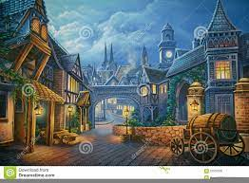



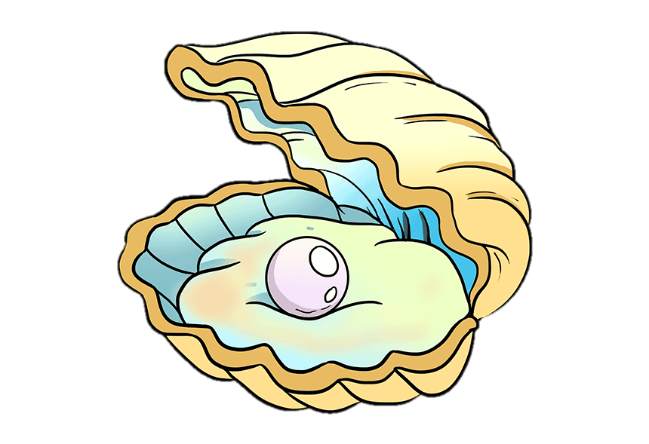
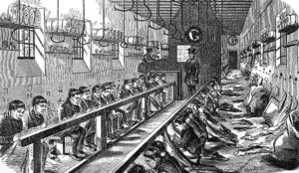
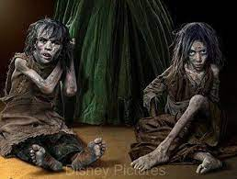
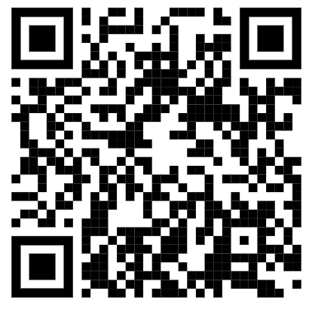

THEMES and QUOTES
English KO – Year 10 and 11
Social Responsibility Scrooge - ‘If they would rather die, . . . they had better do it, and decrease the surplus population’ Narrator – ‘The misery with them all was, clearly, that they sought to interfere, for good, in human matters, and had lost the power forever.’ Ghost of Present – ‘They are man’s […] The boy is Ignorance. The girl is Want. Beware them both’ | Greed vs Charity Collectors & Scrooge – “You wish to remain anonymous?” / “I wish to be left alone. I don't make merry myself at Christmas and I can't afford to make idle people merry.” Narrator – ‘Darkness is cheap, & Scrooge liked it.’ Scrooge -“I’ll send it to Bob Cratchit’s,” whispered Scrooge, rubbing his hands, and splitting with a laugh. “He shan’t know who sends it. It’s twice the size of Tiny Tim….” | Transformation / Redemption Narrator – ‘Sharp and hard as flint’ Scrooge – ‘I will honour Christmas in my heart. I will live in the Past, the Present, and the Future. I will not shut out the lessons that they teach.’ Scrooge - ‘I’ll raise your salary and endeavour to assist your struggling family’
Family Narrator – Bob ‘ran home […] as hard as he could pelt, to play at blindman’s-buff.’ Narrator –Oh, a wonderful pudding! […] Everyone had something to say about it.’ Narrator - ‘Then all the Cratchit family drew round the hearth’ Scrooge – ‘and to Tiny Tim, who did not die, he was a second father.’ | The Supernatural Narrator – ‘Scrooge trembled more and more’ Marley – ‘I am here tonight to warn you, that you have yet a chance and hope of escaping my fate.’ Scrooge - ‘I know your purpose is to do me good, I am prepared to bear you company with a thankful heart.’ | Loneliness / Isolation Narrator – ‘Scrooge took his melancholy dinner in his usual melancholy tavern’ Narrator - ‘A solitary child, neglected by his friends, is left there‘ Belle’s husband – ‘there he sat alone. Quite alone in the world, I do believe.’
LANGUAGE TECHNIQUES
SOCIAL AND HISTORICAL CONTEXT
Caricature – extreme, over exaggerated characteristics
Foils – characters that are opposite to exaggerate contrasting qualities
Repetition – saying something more than once
Motif – a recurring image or idea through out a text
Simile – compares two
objects using like or as
Intrusive narration – use of direct address and an informal tone. The narrator interrupts the story to ‘speak’ to the reader.
Listing – used to over emphasise or exaggerate
Light Imagery - use of images of light and darkness to emphasize deeper meanings and emotions
Juxtaposition – deliberate placing of contrasting ideas or images (wealth & poverty, darkness & light, kindness & selfishness)
Cliché – over used, familiar phrases to create
Pathetic fallacy – personification of the weather. Reflects the mood
or emotions of the characters
Symbolism – using symbols, images or ideas to represent qualities
1843 – Victorian London
Dickens wrote ‘A Christmas Carol’ in 1843 focusing on how many of society’s ills can be blamed on greed. Victorian London was a place of great wealth and great poverty living amongst each other, but largely ignored by the rich. Dickens’ early life gave him first-hand experience of poverty when his father was sent to debtor’s prison and Dickens was separated from his family and sent to work in a blacking factory. 1834 – Poor Law Amendment Act – Led to a cut in aid given to the poor. Workhouses were created, in which poor people would have to live and work, if they were unable to pay for their own housing. Thomas Malthus – a Victorian economist who claimed the poor were ‘idle' and society was unable to support them. He called for Dickens wanted to use his popularity to bring the problem of child poverty to the attention of a wider public.
Top Level Analysis

