Slide 1

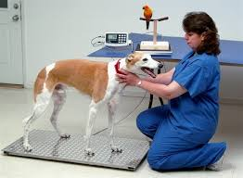
Why is monitoring animal health important?
Moral responsibility: We may feel we have a moral duty to prevent pain and suffering in an animal. Legal obligation: The Animal Welfare Act 2006 states the need to protect animals from pain, suffering, injury and disease. Human benefit Ensuring animals used for food production are healthy and free from disease will prevent illness through the food chain Animals used in research may need to be protected from ill health to provide valid results Animals used for their abilities, such as working animals and those used for sport, will need to be healthy in order to perform to the highest standards
Routine health checks and visual checks
Owners, keepers and qualified professionals may observe an animal to check for visual signs of health. Animals show visible signs of health through their behaviour, mobility and temperament. Routine health checks may include: Checking a young animal’s posture and movement to assess growth and joint development. Checking older animals to assess their mobility. Monitoring any changes in an animal’s behaviour and temperament that could indicate pain.
Animal Care
Animal Health and Welfare
Learners must understand what to look out for to
determine whether an animal is well. They must know the signs of ill health that may
need further investigation. Animal species covered in this learning outcome must include
dogs, cats, rabbits, hamsters and guinea pigs.
Routine health checks: observation checks
An observation check is like a visual health check because the animal is not handled. Also, health factors are observed visually and recorded. But observation checks on an animal’s behaviour and movement are normally carried out over a longer period of time. This method is useful in cases with some animals, such as: Very young animals Aggressive animals Venomous and poisonous animals.
Routine health checks: Physical checks
The following checks may be made by qualified professionals to diagnose conditions that may not be identified through the visual health check method: Weighing Checking blood pressure Checking pulse rate Assessing mobility Checking temperature Carrying out blood, urine and faecal tests Palpation
Which aspects of health should be monitored?
A pregnant animal- Weight, heart rate, temperature, food and water intake and behaviour. An older animal- Weight and food and water intake An animal after surgery- Wound appearance, weight, temperature, food and water intake and behaviour An animal with an injury Wound appearance, weight, temperature, food and water intake, heart rate and respiratory rate A venomous animal Food and water intake and behaviour
How to record and monitor animal health
There are many ways to keep a record of an animal’s health in order to monitor changes: Journal/diary/folder Whiteboard Electronic database Veterinary records Photographs and videos.
KEY TERMS/VOCABULARLY:
Palpation: examining an animal with the hands to check for problems.

Slide 2
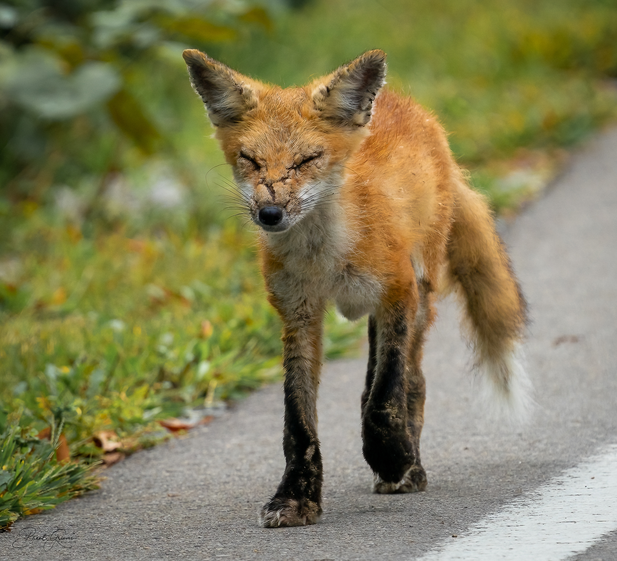
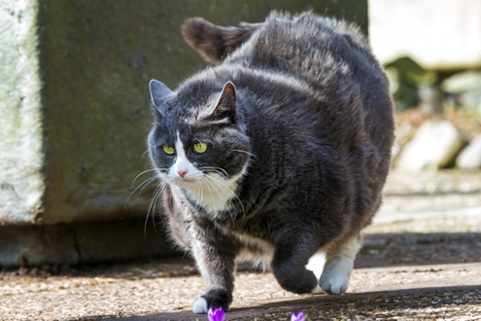
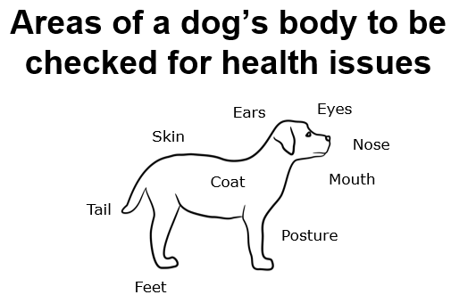
Signs of good health
Main indicators of good health Eyes: bright, clear pupils, response to movement Ears: natural movement, response to sound, clean Nose: clear airways, response to smell, clean Mouth: pink gums, clean teeth Coat: clean and shiny, full, no bald patches Skin: correct colour, no breaks in the skin, no rashes Tail: natural movement, absence of lumps or abrasions Further indicators of good health Feet: correct number of toes, correct number of claws Posture: normal stance for the species, equal weight on all limbs Breathing: apt respiratory rate for situation Urine: normal colour/quantity, passed frequently and with ease Faeces: normal consistency/colour, passed frequently and with ease Food and water intake: normal quantity/frequency, correct foodstuff, ease of ingestion Behaviour: natural/normal Body language: no signs of pain
Signs of ill health
Eyes: sunken, discharge, cloudy pupils, bloodshot, limited sight Ears: discharge, loss of hearing, injury Nose, discharge, abrasions Mouth: pale or discoloured gums, discoloured or broken teeth Coat: dull, matted, bald pitches Skin: abnormal colour, break in the skin, rash Tail: lumps or abrasions, broken Feet: broken claws, cracked pads Posture: reluctance to use all limbs, hunched appearance Breathing: irregular respiratory rate for the situation Urine: discoloured, contains blood or pus, strong smell, displaying signs of difficulty passing urine Faeces: loose consistency, colour change, contains blood, displaying signs of difficulty passing faeces Food and water intake: loss of appetite, increased thirst, rapid weight loss, unexpected weight gain Behaviour: abnormal Body language, signs of pain.
Common causes of stress in animals
Natural stressors:
Food shortages The presence of predators Conflicts with neighbouring animals or group members Fluctuations in food and water availability Temperature changes. Although individuals can sometimes predict when stressors will occur, e.g. food shortages during the winter months, they cannot always foresee the intensity or duration of individual stressors.
Common causes of stress in animals
Captivity stressors:
Human presence False social groups, unfamiliar enclosure/mates Unfamiliar stimuli (noises, smells, objects, etc.) Change Sanitation Comfort Handling Transportation Training Unpredictable feeding.
Assessing an animals health
Fox with scabies/ mange | Obese cat
Common signs of stress
Physiological signs: Increased heart rate and Increased respiratory rate (panting). Behavioural signs: Aggression, lowered body posture, vocalisations (e.g. hissing, growling, etc.), avoiding eye contact, running away, hiding, self-mutilation/overgrooming and loss of appetite.
What is stress?
Stress is an animal’s response to a stressor such as an environmental condition. It is the body's method of reacting to a condition such as a threat, challenge or physical and psychological barrier.

