Slide 1
BTEC Animal Care - Component 1 : Animal Behaviour and Handling ANIMAL BEHAVIOUR
1 | Behaviour | How an animal acts / what it does.
2 | Behaviour pattern | A set of behaviours that have the same purpose.
3 | Normal behaviour | Behaviours you would expect to see.
4 | Abnormal behaviour | Behaviour that you would not expect to see.
5 | Stereotype | Repeated movement or action for no particular reason.
6 | Internal factor | Something inside of the animal's body.
7 | External factor | Something outside of the animal’s body.
8 | Handling | Working with an animal but allowing some freedom of movement.
9 | Restraint | Working with an animal and restricting movement.
10 | Nocturnal | Peak activity during the night.
11 | Diurnal | Peak activity during the day.
12 | Crepuscular | Peak activity at dawn / duck.
13 | Vocalisation | Communication using sound.
14 | Scenting | Communication using smell.
15 | Interspecific | Happens between the same type of animal / species. E.g Dogs playing together.
16 | Intraspecific | Happens between different types / species. E.g Cat chasing a mouse.
17 | Biosecurity | Preventing the spread of bacteria / virus / fungi.
Key term

Slide 2
BTEC Animal Care - Component 1 : Animal Behaviour and Handling PPE / Handling equipment
PPE
Handling equipment
1 | PPE | Why is it needed?
2 | Overalls | Biosecurity Professional standards
3 | High vis jacket | Seen by machinery Seen by animal
4 | Gloves | Biosecurity
5 | Gauntlet | Protection from bites and scratches
6 | Steel toes boots | Prevent foot injury from livestock / equipment.
7 | Hair tie | Biosecurity + prevent injury.
8 | Eye protection | Protection from beaks / claws.
9 | Face mask | Some protection from dust, especially with birds.
10 | Handling equipment | Used for
11 | Collar and lead | Prevent escape and allows the animal to be moved / led.
12 | Muzzle | Hold the mouth and prevent bites.
13 | Headcollar and harness | Provide more control for moving larger, stronger animals.
14 | Crush cage | Gently holds animal in place within the cage for restraint.
15 | Graspers and nooses | Prevents animal from approaching the handler, especially if aggressive.
16 | Towels and blankets | Wrap small animals to hold them in place and prevent bites.

Slide 3
BTEC Animal Care - Component 1 : Animal Behaviour and Handling Large animal equipment
Calf
1 | Halter | Restraint of the head. Can be used with a lead.
2 | Hurdles | Metal fencing used to build an enclosure to keep calves contained.
3 | Calf crush | Restrains the calf within a metal frame.
4 | Calf head yoke | Placed over the neck to fully restrain the head for disbudding.
Cattle
1 | Corral | Used to contain a herd for observation or further handling.
2 | Race | A pathway made from large hurdles , used to move cattle.
3 | Crush | Restrains the cow within a strong metal frame.
4 | Foot-trimming crush | A crush with a food restraint block to allow safe trimming.
5 | AI cubicle | Cubicle with a chain at the rear to keep the cow in place.
6 | Head yoke | Placed over the neck to hold head and neck in place.
Sheep
1 | Race | A pathway made from large hurdles , used to move sheep.
2 | Halter | Restraint of the head. Can be used with a lead to move the animal.
3 | Shepherd’s crook | Used to catch sheep by the neck of foot for restraint.
4 | Sheepdog | Used to move sheep from a distance.
Pig
1 | Pig board | Large plastic board used to move pigs along a race and prevent turning around.
2 | Snares | A wire noose on the end of a pole. Used to restrain and move swine while keeping the handler safe.
3 | Fixed race | A race that is fixed with concrete to prevent it being moved by pigs.

Slide 4
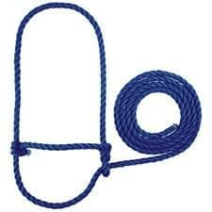
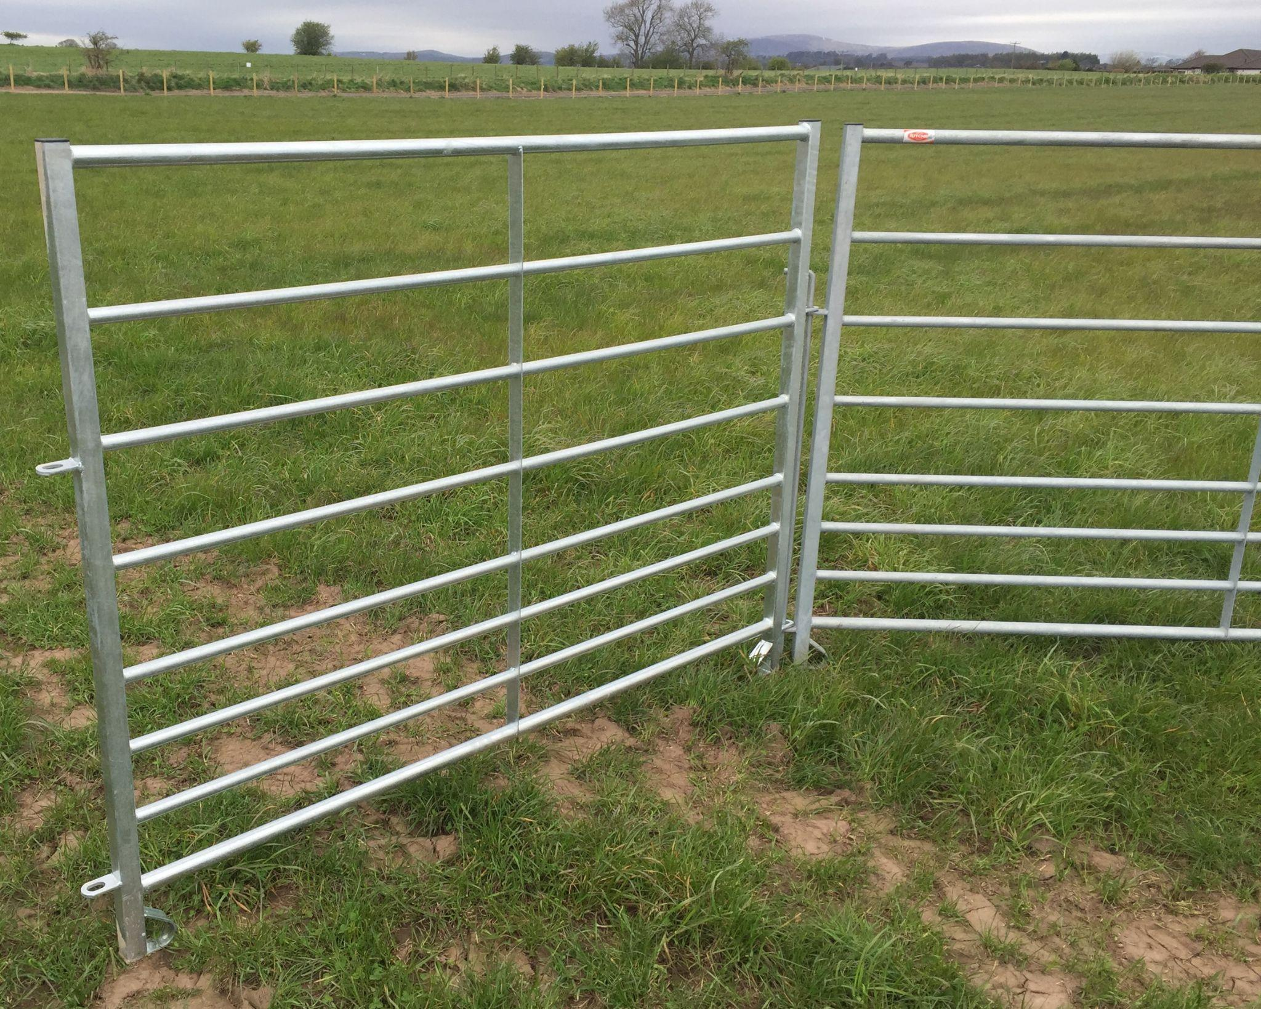
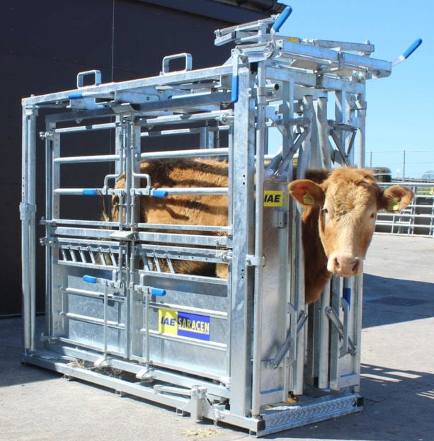
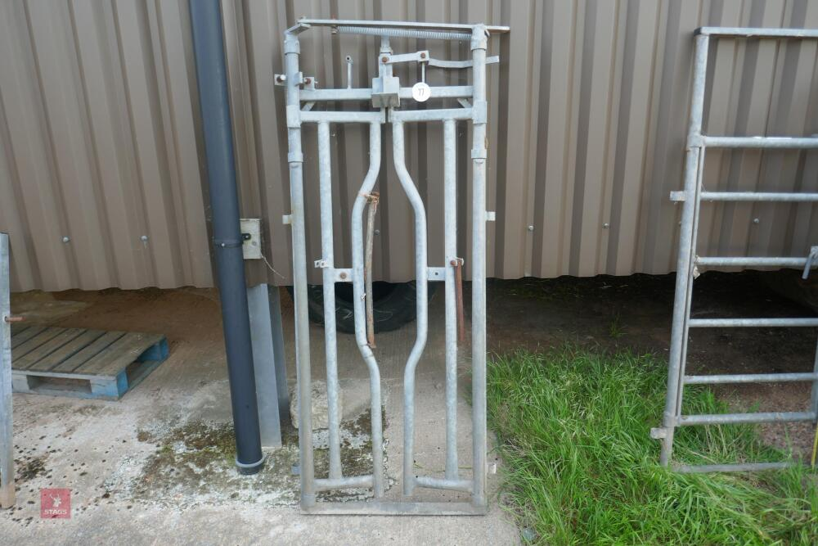
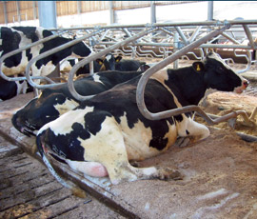
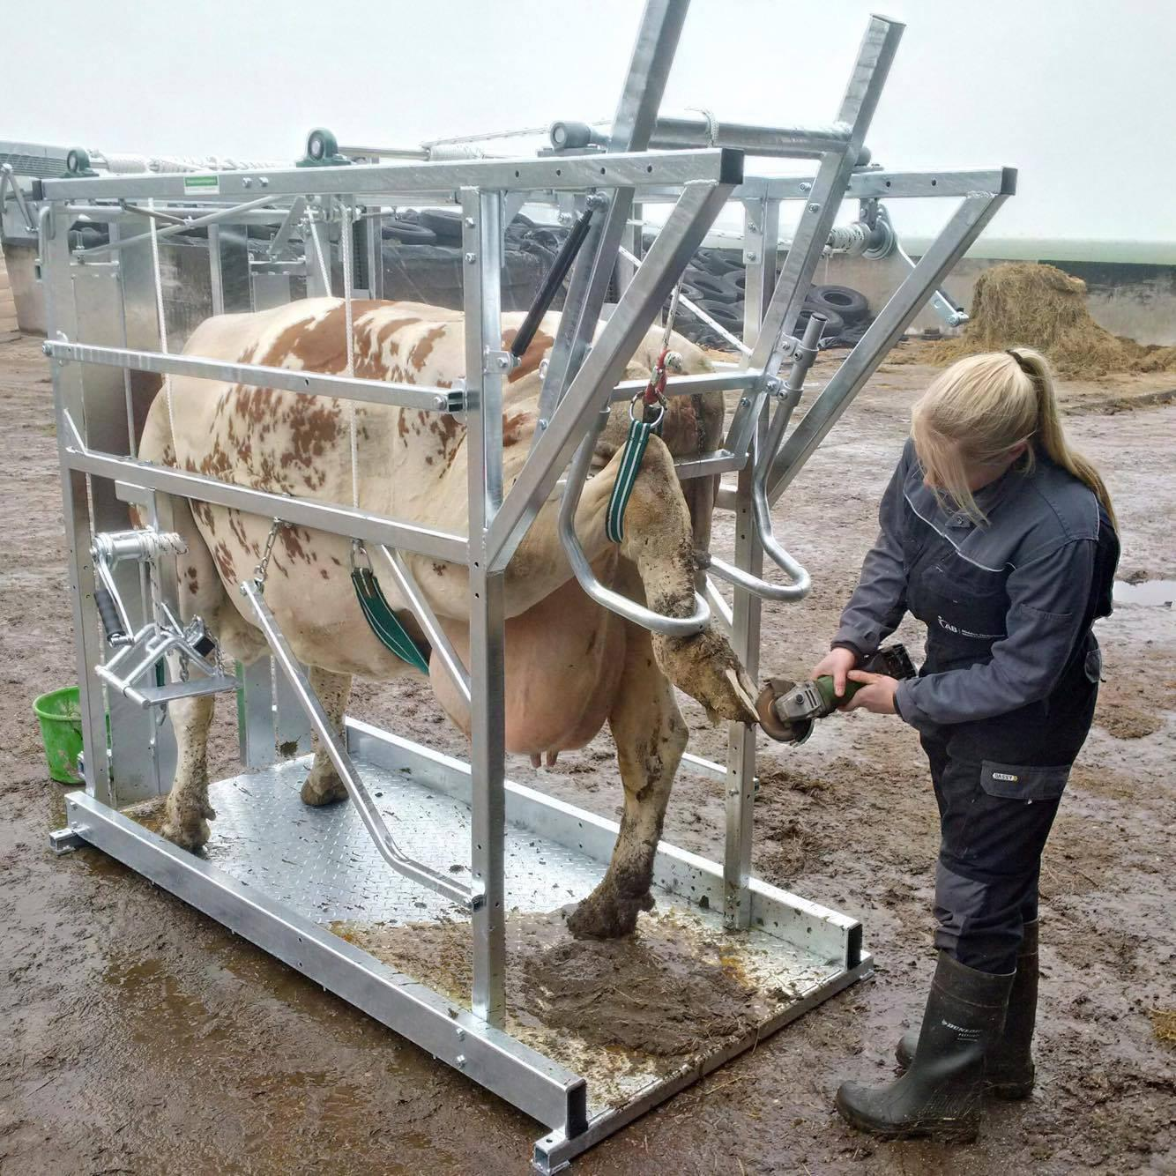
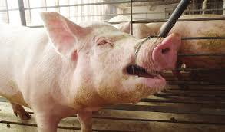
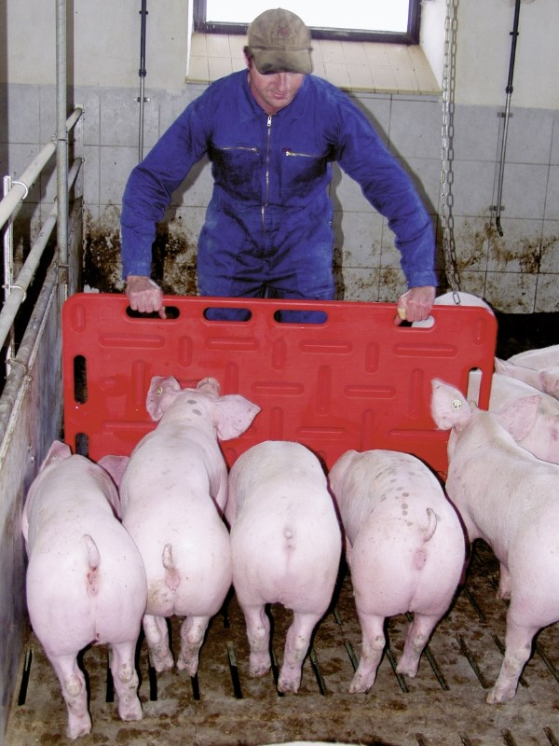
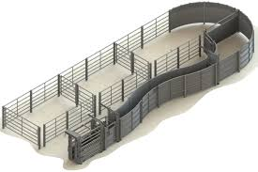
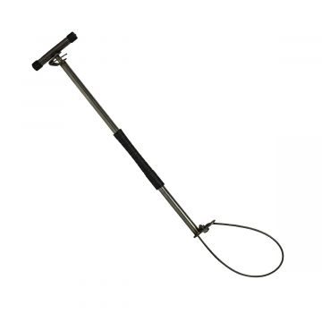
BTEC Animal Care - Component 1 : Animal Behaviour and Handling Livestock handling equipment
1. Rope halter and lead
2. Hurdle
3. Crush cage
3. Head yolke
4. AI cubicle
5. Pig snare
7. Livestock race
8. Foot-trimming crush
6. Pig board

Slide 5
BTEC Animal Care - Component 1 : Animal Behaviour and Handling
Handling poultry

Slide 6
BTEC Animal Care - Component 1 : Animal Behaviour and Handling
Handling sheep

Slide 7
BTEC Animal Care - Component 1 : Animal Behaviour and Handling
Handling cattle

